Slide 1

New Lebanon Central School District
2026-2027 school Budget
Final Budget Presentation for Board Adoption
By Danielle Brewster & Christopher Harper
APRIL 21, 2026

Slide 2
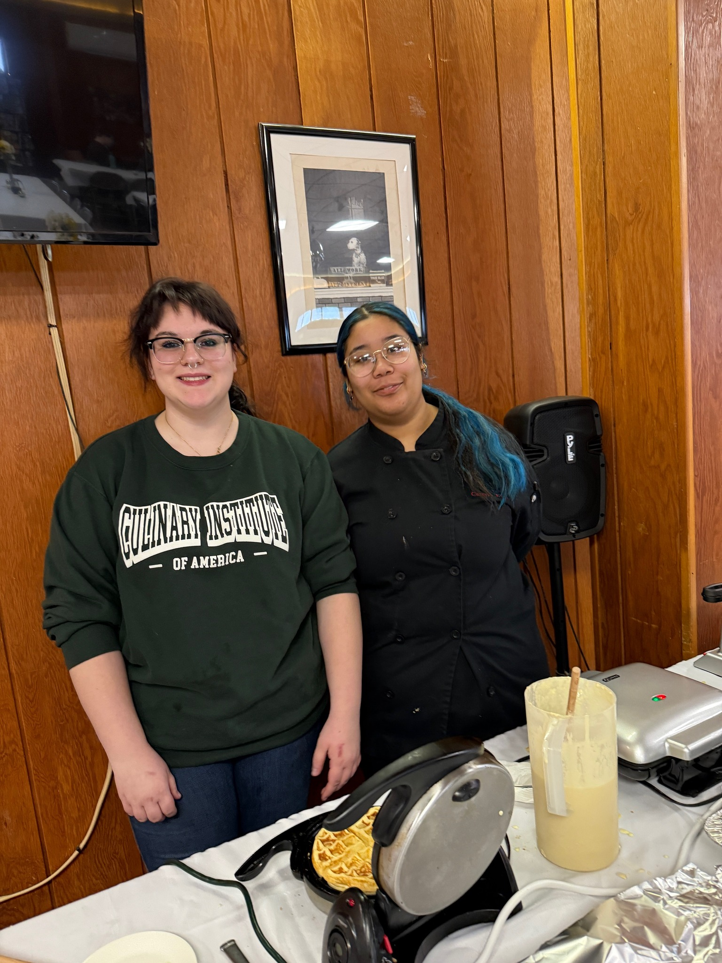
2026-2027 Budget Calendar
January 14, 2026 - Facilities and Food Service.
February 11, 2026- Instructional Programs and Transportation.
March 11, 2026 - Preliminary Full 26-27 Budget Presentation.
April 1, 2026 - Budget Workshop
April 21, 2026 - Final Discussion and Adoption of 26-27 school year budget.
April 21, 2026 - Special BOE Meeting - Questar III Budget Vote and Election
May 6, 2026 - Public Hearing on Proposed Budget.
May 19, 2026 - Public Budget Vote and Board of Education Election.

Slide 3
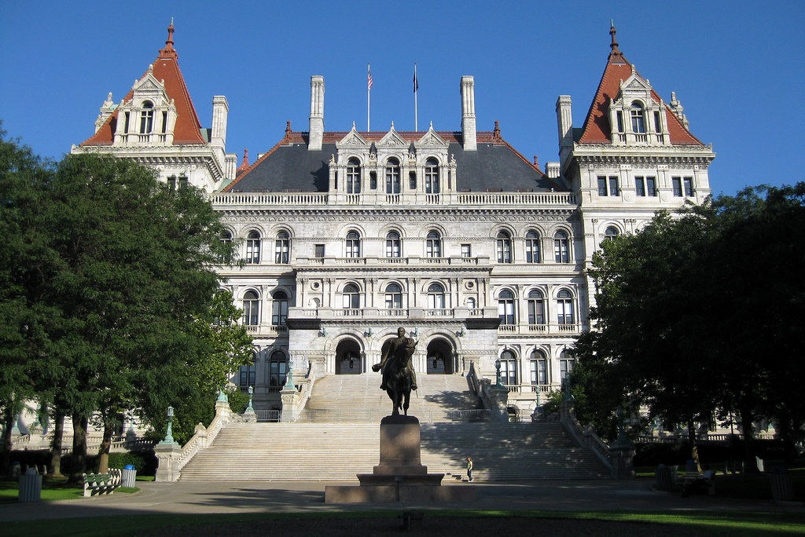

What's changed since last board meeting?
State Aid: Revenue estimates assume a 1% increase in Foundation Aid. (+$26,000) Budget has not been approved by the state yet.
Additional Vehicle Replacement Needed – Transportation
The 2015 Suburban requires major repairs (estimated at $6,500+) and has significant rust. Given its low value, investing in repairs is not cost-effective. However, a vehicle is required to support an outside placement bus run for the upcoming year.
Recommendation:
Lease a minivan for the 2026–2027 school year at an estimated cost of $10,000.

Slide 4
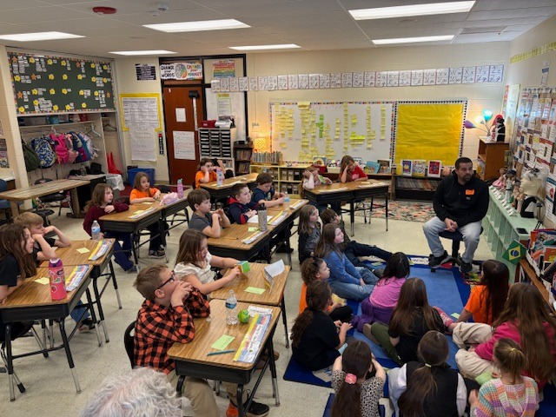
Over the past two years, the district has taken significant steps to reduce costs.
The following positions have been eliminated:
2025-2026 School year:
2 Elementary regular education teachers
1 PE teacher
1 Business Teacher
1 Special Education Teacher
1 Reading Teacher
2026-2027 School year:
1 Psychologist
2 Elementary regular education teachers
In total, 9 teaching positions have been reduced—equivalent to 16% of the district’s teaching staff.

Slide 5

Budget to Budget
2025-2026 | 2026-2027
$15,427,799 | $16,054,977
$627,178
4.1% increase

Slide 6
Tax Levy Scenarios
 | Scenario #1 | Scenario #2 | Scenario #3 | Scenario #4
 | 4.32% Levy Increase | 5.5% Levy Increase | 6% Levy Increase | 6.5% Levy Increase
Budget | $16,054,977 | $16,054,977 | $16,054,977 | $16,054,977
Revenue | $4,338,660 | $4,338,660 | $4,338,660 | $4,338,660
Levy | $11,196,317 | $11,322,963 | $11,376,626 | $11,430,289
Fund Balance | $400,000 | $393,354 | $339,691 | $286,028
Reserves/Debt Service | $120,000 | $0 | $0 | $0
Any proposed tax levy increase above 4.32% must receive at least 60% voter approval to pass.
Using less of the districts fund balance helps support future budgets. It also provides a larger buffer against rising costs in future budgets.
Scenarios 1 and 2 are projected to reduce the district’s fund balance to below 4%. For reference, 4% equals $642,199.

Slide 7
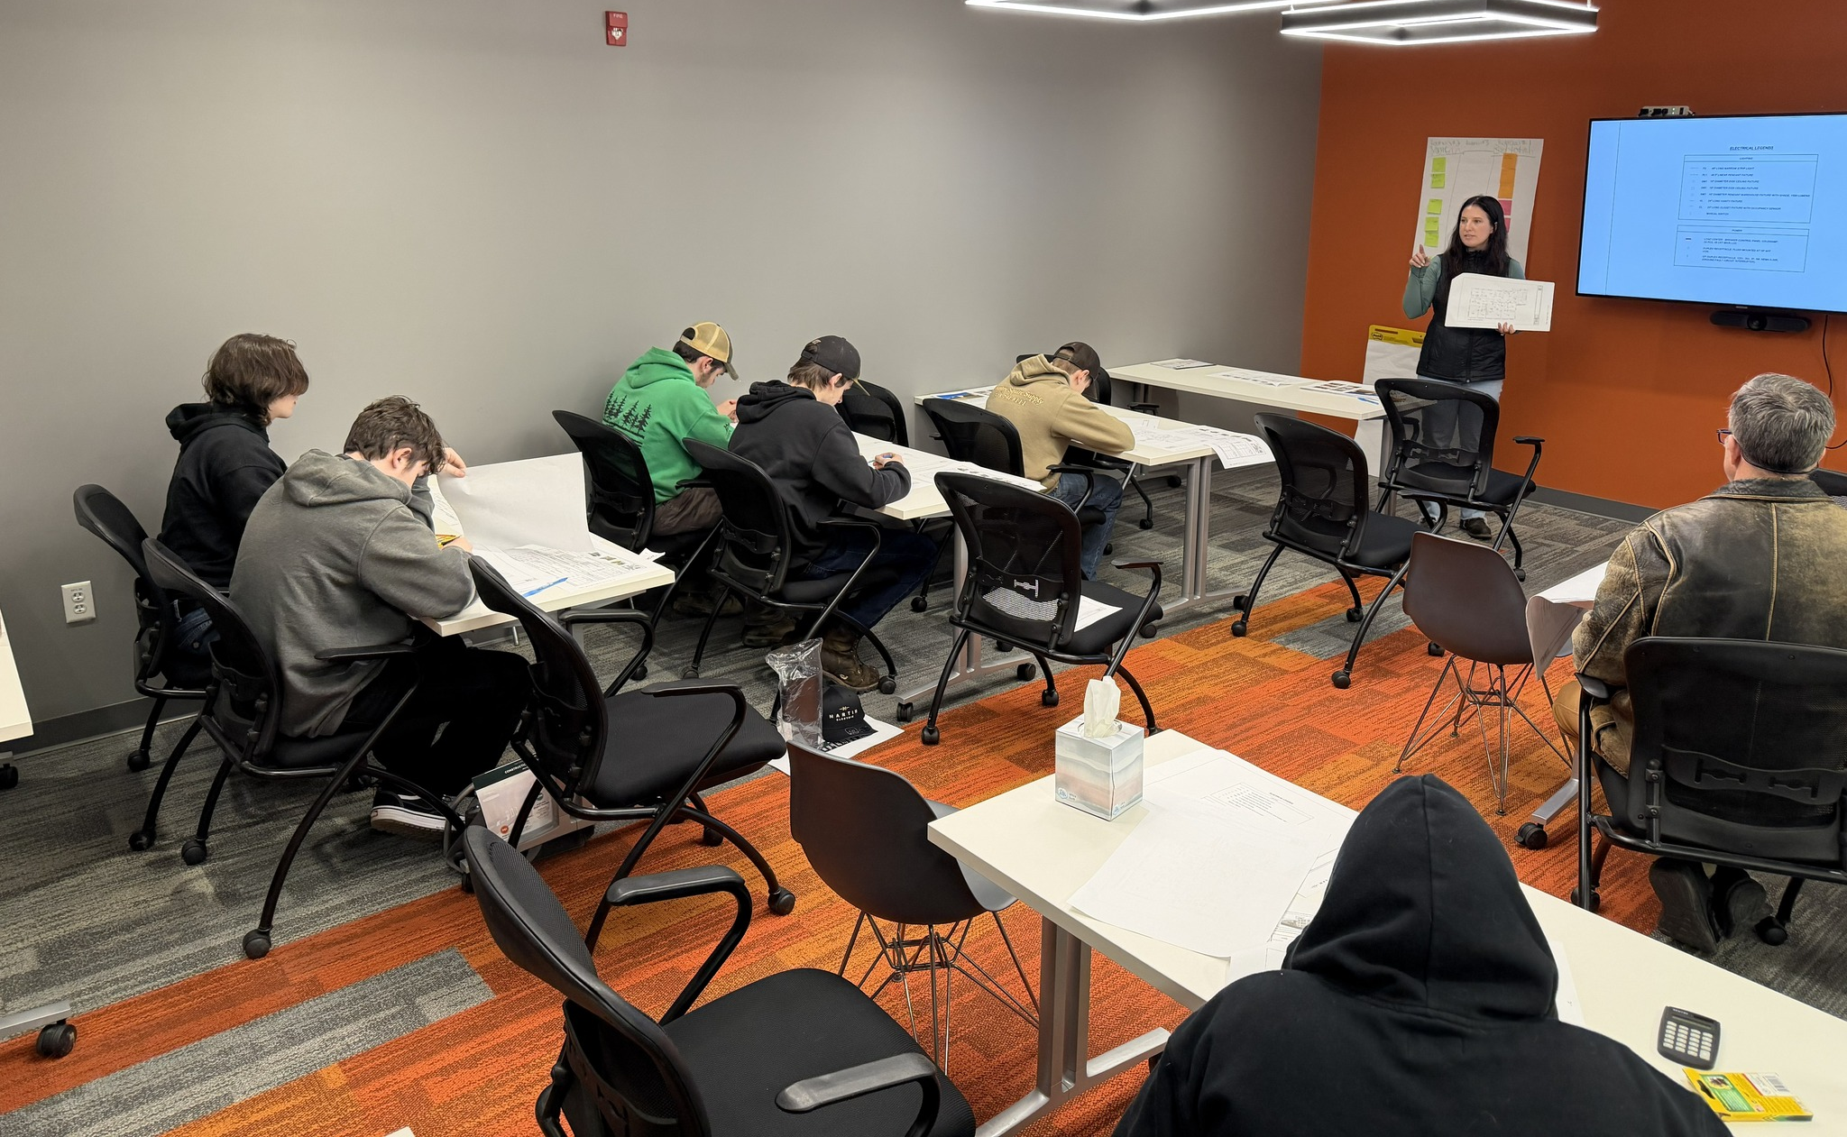

What Happens if the budget doesn’t pass?
If the budget does not pass the board has three options:
Resubmit the defeated budget to the voters.
Resubmit a revised budget to voters.
Adopt a contingent budget.
If the resubmitted budget is defeated again, the BOE must adopt a contingent budget.

Slide 8
What is a Contingent Budget?
• A contingent budget is what a school district must adopt if voters reject the proposed budget twice.
When a district goes to a contingent budget:
The BOE is required to adopt a budget with a 0% Tax levy increase. Meaning the district would have a $983,651 budget gap and would need to use reductions/reserves/fund balance to balance the budget.
All Non-Contingent expenses would be removed from the budget. (equipment purchases, supplies, extracurricular, sports, field trips etc.)

Slide 9

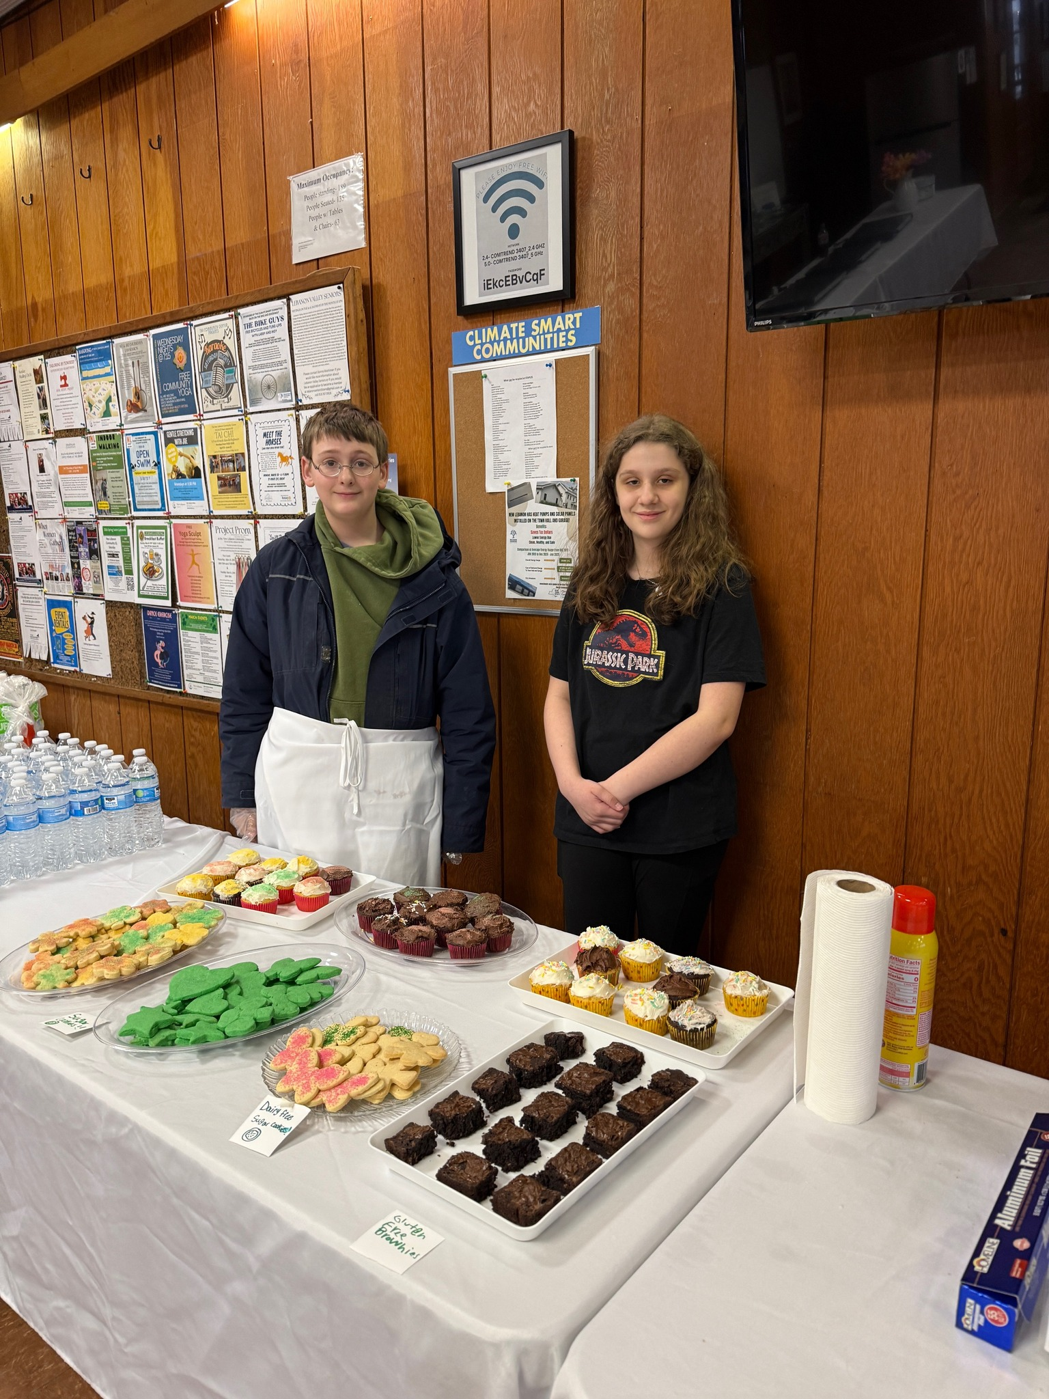

Next Steps:
Board Adopts the Budget tonight, $16,054,977
Budget Hearing, May 6, 2026
Budget Vote, May 19, 2026

