Slide 1

Review of key metrics for Foundation Aid and the impact of funding levels on New Lebanon CSD’s financial projections

Slide 2
Background
Due to the demographics of New Lebanon CSD (property wealth due to higher than average number of second homes), the District looks relatively wealthier on paper compared to neighboring Districts
As a result, the District receives comparatively less Foundation Aid per Student
This puts a strain on District resources and ability to provide their educational mission

Slide 3
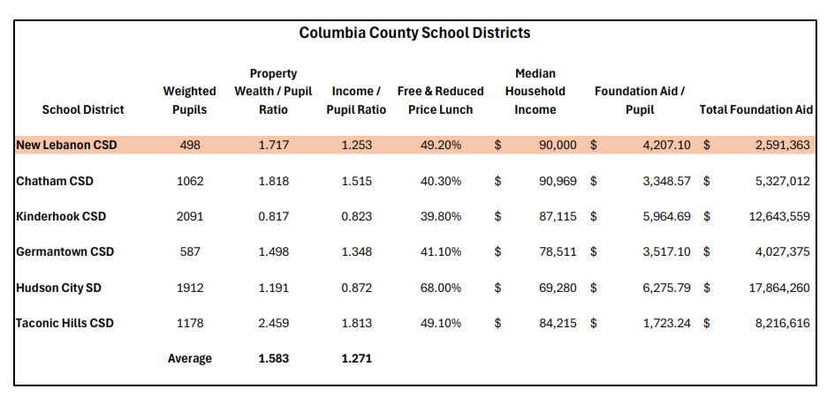

Slide 4
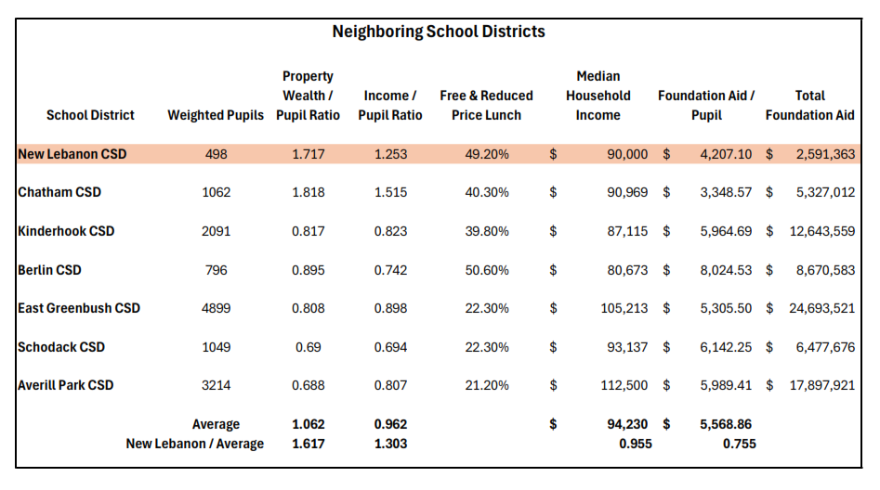

Slide 5
Columbia County/Neighboring Districts
Compared to neighboring Districts, New Lebanon appears 1.6x wealthier in property values and 1.3x wealthier in income.
However, the District Free-and-Reduced Priced Lunch (FRPL) and Median Household Income (MHI) are generally similar to or lower than their peers, indicating the District is actually poorer than some of their neighbors
As a result, New Lebanon CSD receives roughly half the amount of Foundation Aid that their peers receive
If funded at similar levels, it could mean roughly $500,000 - $1,000,000 of additional aid that could be used to educate students and maintain adequate facilities

Slide 6
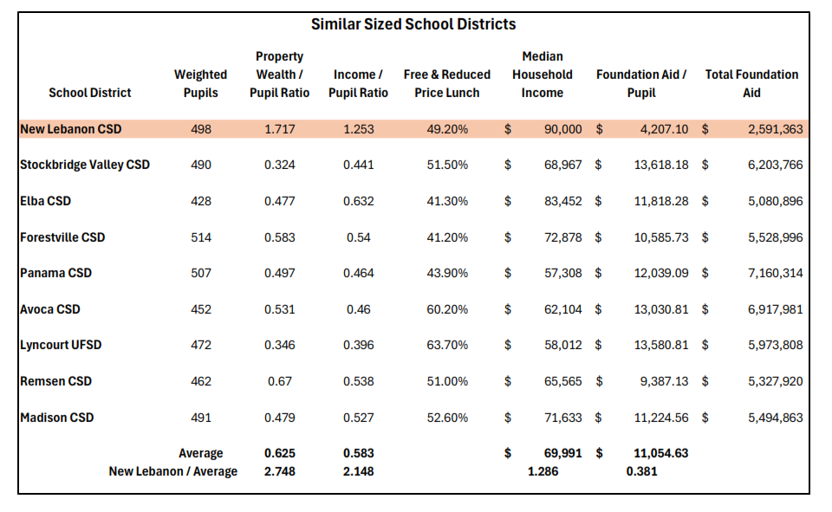

Slide 7
Districts of Similar Size in NYS
When compared to similar sized Districts statewide, the differences become even larger.
The District appears 2.75x wealthier in property value and 2.15x wealthier in income values than similar sized Districts throughout the state, despite similar FRPL and MHI levels
If funded at similar levels to these Districts, it could mean between $2.5M - $4.5M in additional Foundation Aid

Slide 8
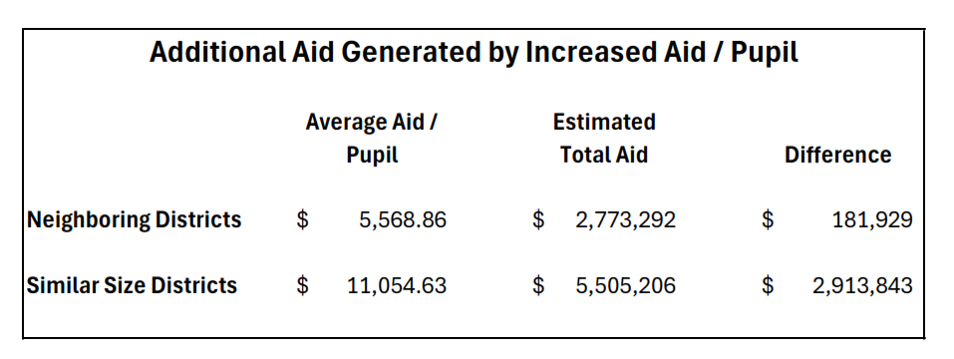

Slide 9
