Slide 1
Unlawful Discrimination & Harassment
New Lebanon Central School District
September 1, 2022
Monica Lenahan
(518) 487-7764
mlenahan@woh.com

Slide 2
Introduction
Training is being provided to fulfill statutory obligations and in furtherance of the District’s commitment to proactively
prevent and effectively respond to incidents of
unlawful discrimination & harassment.
2

Slide 3
AGENDA
Laws prohibiting harassment of employees and students.
What is unlawful harassment.
Sexual Harassment.
District Policies.
What to do if you have a complaint.
What to do if you witness harassment or learn of a report of harassment.
District response to harassment.
Prohibition on retaliation.

Slide 4
Laws Governing Harassment of Employees and Students
State
Dignity for All Students Act (DASA)
Students only, all forms of discrimination and harassment.
New York State Human Rights Law
Employees.
Students too, since 2019.
All forms of discrimination and harassment.

Slide 5
Laws Governing Harassment of Employees and Students
Federal
Title IX
Students and employees.
Sexual and gender-based discrimination and harassment, including sexual orientation and gender identity/expression.
Title VII
Employees only.
All forms of discrimination and harassment.
ADA & 504
Students and employees.
Discrimination and harassment based on disability.
. . . and more . . .

Slide 6
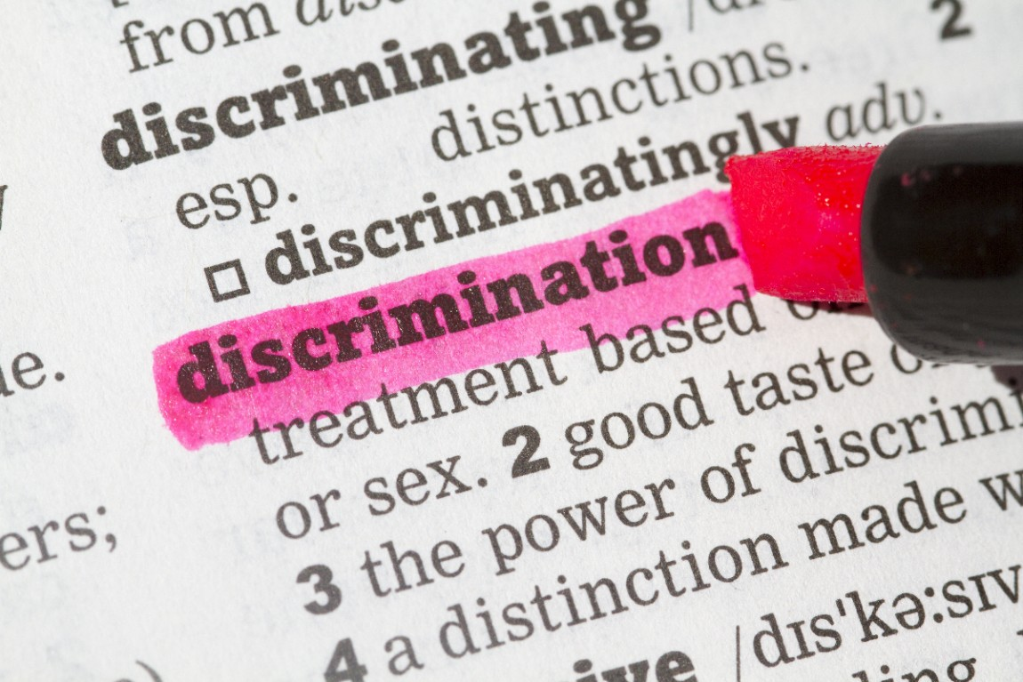
Federal, state and local laws prohibit discrimination and harassment against an employee or student based upon a protected characteristic.
Harassment Generally: Protected Characteristics
Age
Race
Sex/Gender
Ethnicity/National Origin
Color
Disability
Religion
Sexual orientation
Gender identity/ expression
Genetic Predisposition/ Carrier Status
Military Status, Veteran Status
Marital/Familial Status
Arrest Record/Criminal Record
Status as Victim of Domestic Violence or Stalking
Weight

Slide 7
What is Unlawful Harassment?
Harassment
based upon a protected characteristic
IS
Discrimination.
7

Slide 8
What is Harassment?
Under New York State law, harassment need not be “severe or pervasive” to be unlawful.
Any of the harassing conduct described in this training can be unlawful unless it is shown to be no more than “petty slights or trivial inconveniences.”
Notes:
Under New York State law, harassment need not be “severe or pervasive” to be unlawful. Any of the harassing conduct described in this training can be unlawful unless it is shown to be no more than “petty slights or trivial inconveniences.”

Slide 9
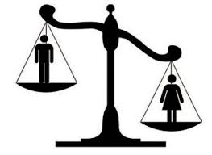
What is Sexual Harassment?
Sexual harassment:
Is a form of sex discrimination and is unlawful
Includes harassment on the basis of sex, sexual orientation, self-identified or perceived sex, gender expression, gender identity and the status of being transgender.
Is unlawful when it subjects an individual to inferior terms, conditions, or privileges of employment.
Notes:
What is Sexual Harassment?
Sexual harassment is a form of sex discrimination and is unlawful under federal, state, and (where applicable) local law.
Sexual harassment includes harassment on the basis of sex, sexual orientation, self-identified or perceived sex, gender expression, gender identity and the status of being transgender.
Sexual harassment is unlawful when it subjects an individual to inferior terms, conditions, or privileges of employment.

Slide 10
What is Sexual Harassment?
It includes unwelcome conduct, either of a sexual nature or which is directed at an individual because of that individual’s sex when:
Such conduct has the purpose or effect of unreasonably interfering with an individual’s work performance or creating an intimidating, hostile or offensive work environment;
Such conduct is made either explicitly or implicitly a term or condition of employment; or
Submission to or rejection of such conduct is used as the basis for employment decisions.
Notes:
What is Sexual Harassment?
Sexual harassment includes unwelcome conduct which is either of a sexual nature, or which is directed at an individual because of that individual’s sex when:
Such conduct has the purpose or effect of unreasonably interfering with an individual’s work performance or creating an intimidating, hostile or offensive work environment, even if the reporting individual is not the intended target of the sexual harassment;
Such conduct is made either explicitly or implicitly a term or condition of employment; or
Submission to or rejection of such conduct is used as the basis for employment decisions affecting an individual’s employment.
There are two main types of sexual harassment.

Slide 11
What is a Hostile Environment?
Sexual or discriminatory displays or publications anywhere in the workplace
Hostile actions taken against an individual because of that individual’s sex
Notes:
Hostile Environment
A hostile environment on the basis of sex may be created by any action previously described, in addition to unwanted words, signs, jokes, pranks, intimidation, physical actions or violence, either of a sexual nature or not of a sexual nature, directed at an individual because of that individual’s sex.
Hostile environment sexual harassment includes:
Sexual or discriminatory displays or publications anywhere in the workplace, such as displaying pictures, posters, calendars, graffiti, objects, promotional material, reading materials or other materials that are sexually demeaning or pornographic.
This includes such sexual displays on workplace computers or cell phones and sharing such displays while in the workplace.
This also includes sexually oriented gestures, noises, remarks, jokes or comments about a person’s sexuality or sexual experience.
Hostile actions taken against an individual because of that individual’s sex, such as:
Rape, sexual battery, molestation or attempts to commit these assaults.
Physical acts of a sexual nature (including, but not limited to, touching, pinching, patting, grabbing, kissing, hugging, brushing against another employee’s body or poking another employee’s body)
Interfering with, destroying or damaging a person’s workstation, tools or equipment, or otherwise interfering with the individual’s ability to perform the job;
Sabotaging an individual’s work;
Bullying, yelling and name-calling.

Slide 12
What is Quid Pro Quo Harassment?
Occurs when a person in authority trades, or tries to trade, employment benefits or educational benefits for sexual favors.
Always involves an imbalance of power between a victim and someone with authority who can grant or withhold employment or educational benefits.

Slide 13
Sex Stereotyping
Harassing a person because that person does not conform to gender stereotypes is sexual harassment.
Harassment because someone is performing a job that is usually or was previously performed mostly by persons of a different sex is sex discrimination.
Notes:
Sex Stereotyping
Sex stereotyping occurs when conduct or personality traits are considered inappropriate simply because they may not conform to other people's ideas or perceptions about how individuals of either sex should act or look.
Harassing a person because that person does not conform to gender stereotypes as to “appropriate” looks, speech, personality, or lifestyle is sexual harassment.
Harassment because someone is performing a job that is usually performed, or was performed in the past, mostly by persons of a different sex, is sex discrimination.

Slide 14
Sexual harassment can be perpetrated between members of opposite genders, or members of the same gender.
The perpetrator may be anyone, including but not limited to a co-worker, a student teacher, a supervisor, a visitor, a student, an independent contractor, anyone who conducts business with the District.
The victim may be anyone, including but not limited to a co-worker, a student teacher, a supervisor, a visitor, a student, an independent contractor, anyone who conducts business with the District.
The conduct need not be motivated by sexual desire to constitute sexual harassment.

Slide 15
Where Can Harassment Occur? Anywhere.
Can occur whenever and wherever employees are fulfilling their work responsibilities, or students are engaging in educational activities.
Can occur through interactions during non-school hours and off District property.
Can occur through electronic communications, both through the District’s network and personal devices:
Text messages;
Email;
Social networking sites.

Slide 16
When & How
Does Sexual Harassment Occur?
Sexual harassment occurs in a variety of situations that share a common element:
The inappropriate introduction of unwelcome sexual or gender-based comments or conduct.
An intent to harass is not required.
16

Slide 17
At What Point Does Harassment Occur?
Never assume that is OK!
Harassment does not have to be “severe or pervasive” to be legally actionable. Now, any conduct that subjects an individual to inferior terms, conditions or privileges of employment or education because of the individual’s membership in a protected category may constitute legally actionable harassment.

Slide 18
Prohibited sexual harassment includes, but is not limited to, unwelcome:
Sexual advances;
Flirting;
Propositions;
Requests for dates;
Sex stereotyping;
Spoken or written remarks of a sexual nature (whether directed to an individual or a group);
Leering;
Sexually explicit, offensive, or gender-based jokes and comments;
Sexual or gender-based comments about an individual or an individual’s appearance;
Sexually suggestive visual displays (cartoons, posters or calendars, and electronic images); or
Physical contact or sexual assault.
18

Slide 19
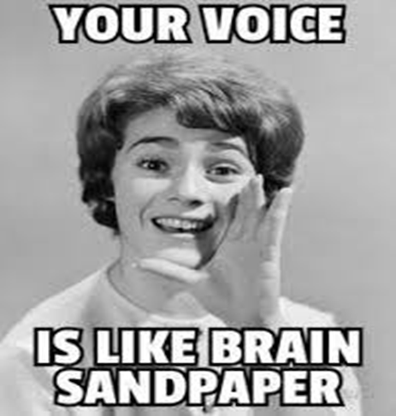
What isn’t Harassment?
An annoying, rude or
unfriendly co-worker.
Your supervisor being your supervisor:
Being counseled or warned about work performance or attendance issues; or
An increase in your workload, or a non-preferred assignment, for reasons other than a protected characteristic or activity.

Slide 20
Retaliation
It is unlawful to retaliate against an individual who has:
Made a good faith complaint of harassment or discrimination;
Assisted another employee who is complaining of harassment;
Participated in the investigation of such a complaint (i.e. a witness); or
Opposed conduct that is reasonably believed to violate anti-discrimination laws.

Slide 21
Retaliation
Retaliation includes any action by a person subject to the control of the District taken to alter an employee’s terms and conditions of employment, or a student’s education, taken because of the employee’s or student’s protected activity.
Retaliation by an employee may result in disciplinary action, up to and including dismissal from employment.
Retaliation by a student may result in suspension or other disciplinary action under the Code of Conduct.
Any retaliation should be immediately reported to a supervisor, or the Title IX Coordinator, or a Building Principal, or the Superintendent of Schools.

Slide 22
District Policies
The District has multiple anti-discrimination/anti-harassment policies and complaint resolution procedures due to differing requirements of applicable laws.
Title IX Complaint Procedure:
for some but not all sex or gender-based complaints by students or employees, available at https://www.newlebanoncsd.org/district/title-ix-information/
Student Harassment and Bullying Prevention and Intervention:
for all other discrimination/harassment complaints by students, (Policy # 0115) available at https://www.newlebanoncsd.org/wp-content/uploads/2020/2019-Policy-Final.pdf
Discrimination and Harassment of Employees and Non-Employees Regulation:
for all other discrimination or harassment complaints by employees, (Policies # 0100 and 0110) available at https://www.newlebanoncsd.org/wp-content/uploads/2020/2019-Policy-Final.pdf

Slide 23
What to Do if You Have a Complaint
Tell the perpetrator to stop.
Clear the air.
If that approach is not successful, or if you are not comfortable trying that approach, report your complaint to:
your supervisor
or
the Title IX Coordinator
or
the Building Principal
or
the Superintendent of schools.
Notes:
Verbally or complaint form.

Slide 24
What to Do if You Have a Complaint
Don’t worry about which District policy or complaint form applies.
You can make an oral complaint, and receive assistance with submitting a written complaint, if that would be helpful.
Your complaint will not be rejected or ignored because you referred to the “wrong” policy, or submitted the “wrong” complaint form.
Notes:
Verbally or complaint form.

Slide 25
District’s Title IX Coordinator Contact Information:
Jennifer Morris, Committee on Special Education Chair, Title IX Coordinator
1478 US-20, New Lebanon, NY 12125
Telephone Number: 518-794-7600
Jmorris@newlebanoncsd.org

Slide 26
Complaints
In addition, or as an alternative, you may also contact:
New York State Division of Human Rights (“DHR”)
Agency Building 1, 2nd Floor
Empire State Plaza
Albany, New York 12220
(518) 474-2705 or (888) 392-3644
Call 1-800-HARASS-3.
People experiencing sexual harassment in the workplace may use the free and confidential hotline to connect with pro-bono attorneys on sexual harassment issues or submit a complaint.

Slide 27
Employee Complaints
In addition, or as an alternative, employees may also contact:
Equal Employment Opportunity Commission (“EEOC”)
6 Fountain Plaza, Suite 350
Buffalo, New York 14202
(800)-669-4000

Slide 28
Supervisor Obligations
Supervisors are required by law to immediately report any complaints of discrimination and/or harassment or any conduct that they witness or are aware of which may constitute discrimination or harassment. NO exceptions!
Supervisors may be subject to discipline and/or liability for failing to report suspected discrimination or harassment or otherwise knowingly allowing discrimination or harassment to continue.

Slide 29
Witnesses: Reporting a Complaint
Any employee who witnesses or otherwise becomes aware of what might be considered harassment of a student must immediately notify the building principal and/or the Title IX Coordinator.
Employees are strongly encouraged to report any incidents of harassment involving a co-worker.
If you see something, say something.
Notes:
Verbally or complaint form.

Slide 30
Bystander Obligations
Bystander: An individual who observes harassment or discrimination. They are not directly involved but have a choice to intervene, speak up or do something about it.
Intervene to stop events before they happen;
Intervene while they are happening; or
Deal with the outcome after.

Slide 31
Active Intervention:
Engage the perpetrator; or
Engage the victim;
Engage other bystanders;
Engage a supervisor.
Passive Intervention:
Create a distraction.
Do something silly but safe. Pretend to trip and fall, or spill your cup of coffee.
The perpetrator and the victim will likely divert their attention to you.
*Call 911 if there’s an imminent danger.

Slide 32
Response to Complaints
The District must respond to reports of sexual and other unlawful harassment or discrimination.
An investigation will be initiated as soon as practical after receipt of the complaint.
The investigation may consist of:
reviewing any relevant documents, emails, phone records;
speaking with involved parties;
making factual findings; and
notifying the involved parties of completion of investigation and any final determination.

Slide 33
Disciplinary Action – Employees
The District will take all actions necessary to stop harassment and/or discrimination.
Appropriate discipline can be anything from a verbal warning to termination. Must be consistent with applicable laws and any collective bargaining agreement.
Other remedial action may include a change in job assignments or shift schedule, and/or a “do not contact” order.

Slide 34
Disciplinary Action – Students
Student offenders will receive in-school guidance and, if appropriate, disciplinary action in accordance with the Code of Conduct.
Remedial action including a change of class schedule or bus transportation.
A “do not contact” order may also be imposed.

Slide 35
Disciplinary Action – Students
Before taking any student disciplinary action for sexual harassment, building principals must first confer with the Title IX Coordinator.
Different process may be required.

Slide 36
Question Number 1
Li Yan's coworker Ralph has just been through a divorce. He drops comments on a few occasions that he is lonely and needs to find a new girlfriend. Li Yan and Ralph have been friendly in the past and have had lunch together in local restaurants on many occasions. Ralph asks Li Yan to go on a date with him—dinner and a movie. Li Yan likes Ralph and agrees to go out with him.
When Ralph first asked Li Yan for a date, this was sexual harassment.
True or False?

Slide 37
Question Number 1
When Ralph first asked Li Yan for a date, this was sexual harassment.
True or False?
FALSE: Ralph's initial comments about looking for a girlfriend and asking Li Yan, a coworker, for a date are not sexual harassment. Even if Li Yan had turned Ralph down for the first date, Ralph had done nothing wrong by asking for a date and by making occasional comments that are not sexually explicit about his personal life.

Slide 38
Question Number 2
Li Yan enjoys her date with Ralph but decides that a relationship is not a good idea. She thanks Ralph for a nice time, but explains that she does not want to have a relationship with him. Ralph waits two weeks and then starts pressuring Li Yan for more dates. She refuses, but Ralph does not stop. He keeps asking her to go out with him.
Question 2. Li Yan cannot complain of sexual harassment because she went on a date with Ralph.
True or False?

Slide 39
Question Number 2
Question 2. Li Yan cannot complain of sexual harassment because she went on a date with Ralph.
True or False?
FALSE: Being friendly, going on a date, or even having a prior relationship with a coworker does not
mean that a coworker has a right to behave as Ralph did toward Li Yan. She has to continue working
with Ralph, and he must respect her wishes and not engage in behavior that has now become
inappropriate for the workplace.

Slide 40
Question Number 3
Li Yan complains to her supervisor, and the supervisor (as required) reports her complaint to the person designated by her employer to receive complaints. Ralph is questioned about his behavior and he apologizes. He is instructed by the designated person to stop. Ralph stops for a while but then
starts leaving little gifts for Li Yan on her desk with accompanying love notes. The love notes are not overtly offensive, but Ralph's behavior is starting to make Li Yan nervous, as she is afraid he may start stalking her.
Question 3. Ralph's subsequent behavior with gifts and love notes is not sexual harassment because he has stopped asking Li Yan for dates as instructed. He is just being nice to Li Yan because he likes her.
True or False?

Slide 41
Question Number 3
Question 3. Ralph's subsequent behavior with gifts and love notes is not sexual harassment because he has stopped asking Li Yan for dates as instructed. He is just being nice to Li Yan because he likes her.
True or False?
FALSE: Li Yan should report Ralph's behavior. She was entitled to have effective assistance in getting Ralph to stop his inappropriate workplace behavior. Because Ralph has returned to pestering
Li Yan after being told to stop, he could be subject to serious disciplinary action for his behavior.

Slide 42
Question Number 4
Tatiana is hoping for a promotion to a position that she knows will become vacant soon. She knows that her boss, David, will be involved in deciding who will be promoted. She tells David that she will be applying for the position, and that she is very interested in receiving the promotion. David says, “We'll see. There will be a lot of others interested in the position.” A week later, Tatiana and David travel together on state business, including an overnight hotel stay. Over dinner, David tells Tatiana that he hopes he will be able to promote her, because he has always really enjoyed working with her. He tells her that some other candidates “look better on paper” but that she is the one he wants. He tells her that he can “pull some strings” to get her into the job and Tatiana thanks David. Later David suggests that they go to his hotel room for “drinks and some relaxation.” Tatiana declines his “offer.”
Question 4. David's behavior could be harassment of Tatiana. True or False?

Slide 43
Question Number 4
Question 4. David's behavior could be harassment of Tatiana. True or False?
TRUE: David's behavior as Tatiana's boss is inappropriate, and Tatiana should feel free to report the behavior if it made her uncomfortable. It is irrelevant that this behavior occurs away from the workplace. Their relationship is that of supervisor and supervisee, and all their interactions will tend to impact the workplace.
David's behavior, at this point, may or may not constitute quid pro quo harassment; David has made no threat that if Tatiana refuses his advance he will handle her promotion any differently. However, his offer to “pull some strings” followed by a request that they go to his hotel room for drinks and relaxation might be considered potentially coercive. Certainly, if David persists in his advances—even if he never makes or carries out any threat or promise about job benefits—then this could create a hostile environment for Tatiana, for which the employer could be strictly liable because David is her supervisor.

Slide 44
Question Number 5
After they return from the trip, Tatiana asks David if he knows when the job will be posted so that she can apply. He says that he is not sure, but there is still time for her to “make it worth his while” to pull strings for her. He then asks, “How about going out to dinner this Friday and then coming over to my place?”
Question 5. David engaged in sexual harassment. True or False?

Slide 45
Question Number 5
Question 5. David engaged in sexual harassment. True or False?
TRUE: It is now evident that David has offered to help Tatiana with her promotion in exchange for sexual favors.

Slide 46
Privileged & Confidential / Attorney-Client Communication / Not for Distribution
Disclaimer: The information and materials contained in this presentation were prepared by Whiteman Osterman & Hanna LLP for client use only. Transmission, receipt or use of this presentation does not constitute nor create an attorney-client relationship. No recipients of content from this presentation should act, or refrain from acting, based upon any or all of the contents of this presentation. Whiteman Osterman & Hanna LLP does not wish to represent anyone desiring legal representation based on viewing any material on this presentation where such material does not comply with all laws and rules of professional ethics of the state in which such person is located.
Copyright © 2022 Whiteman Osterman & Hanna LLP. All rights reserved.

