Slide 1

New Lebanon Central School District
2026-2027 school Budget
BUDGET WORKSHOP
APRIL 1, 2026

Slide 2
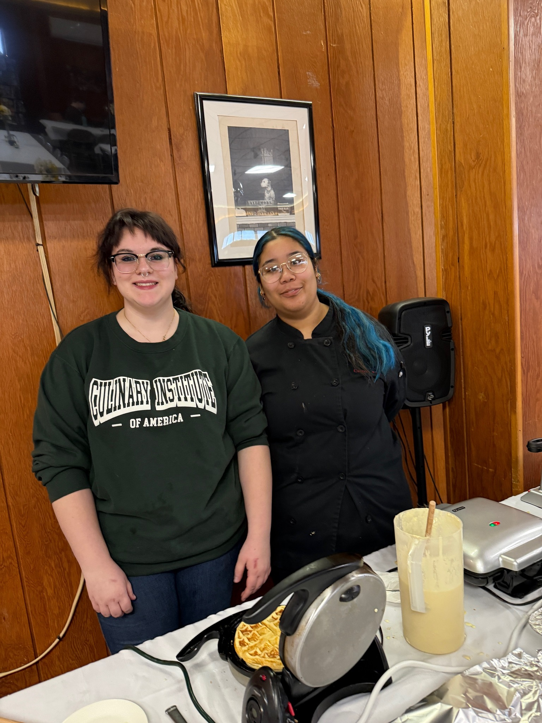
2026-2027 Budget Calendar
January 14, 2026 - Facilities and Food Service.
February 11, 2026- Instructional Programs and Transportation.
March 11, 2026 - Preliminary Full 26-27 Budget Presentation.
April 1, 2026 - Budget Workshop
April 21, 2026 - Final Discussion and Adoption of 26-27 school year budget.
April 21, 2026 - Special BOE Meeting - Questar III Budget Vote and Election
May 6, 2026 - Public Hearing on Proposed Budget.
May 19, 2026 - Public Budget Vote and Board of Education Election.

Slide 3

Board of Education Elections:
Two three-year terms on the Board of Education will be open at the end of this school year.
Alex Polacinski & Sharon Powers
Please contact Kelly McGivern, Board Clerk if you are interested in running for the New Lebanon School Board before April 21st.

Slide 4

Updates Since the March Board Meeting
Questar IT Services:
Questar IT support: It is recommended that the district transition to Questar for IT services starting April 13th, covering the remainder of the current school year and extending through the 2026–2027 school year.
Why this change: Difficult to recruit and retain qualified IT staff. Increasing demand for reliable, consistent support
Long Term Value: Added benefits include structured proactive IT support plan, access to qualified and specialized IT professionals.
State Aid: The district is eligible for 36% state aid reimbursement, which will return approximately $54,000 in the following year (2027-2028).
Net Impact: After state aid reimbursement, the overall cost is expected to be comparable to maintaining in-house IT staffing without Questar services.
Annual Cost: Services for 2026-2027 cost approximately $150,000 which is a $50,000 increase to the 2026-2027 budget.

Slide 5

Updates Since the March Board Meeting (Continued)
Special Education Staffing Adjustment:
Current Structure:
Part-time Special Education Director
Three School Psychologists
Proposed Change:
Move to a full-time Special Education Director
Adjust to two School Psychologists
Why This Change:
Increased need for oversight and leadership in Special Education
Ensures compliance with State and Federal requirements
Supports a growing Special Education population
Difficult to recruit and retain a part-time director
Financial Impact:
No additional cost to the district

Slide 6
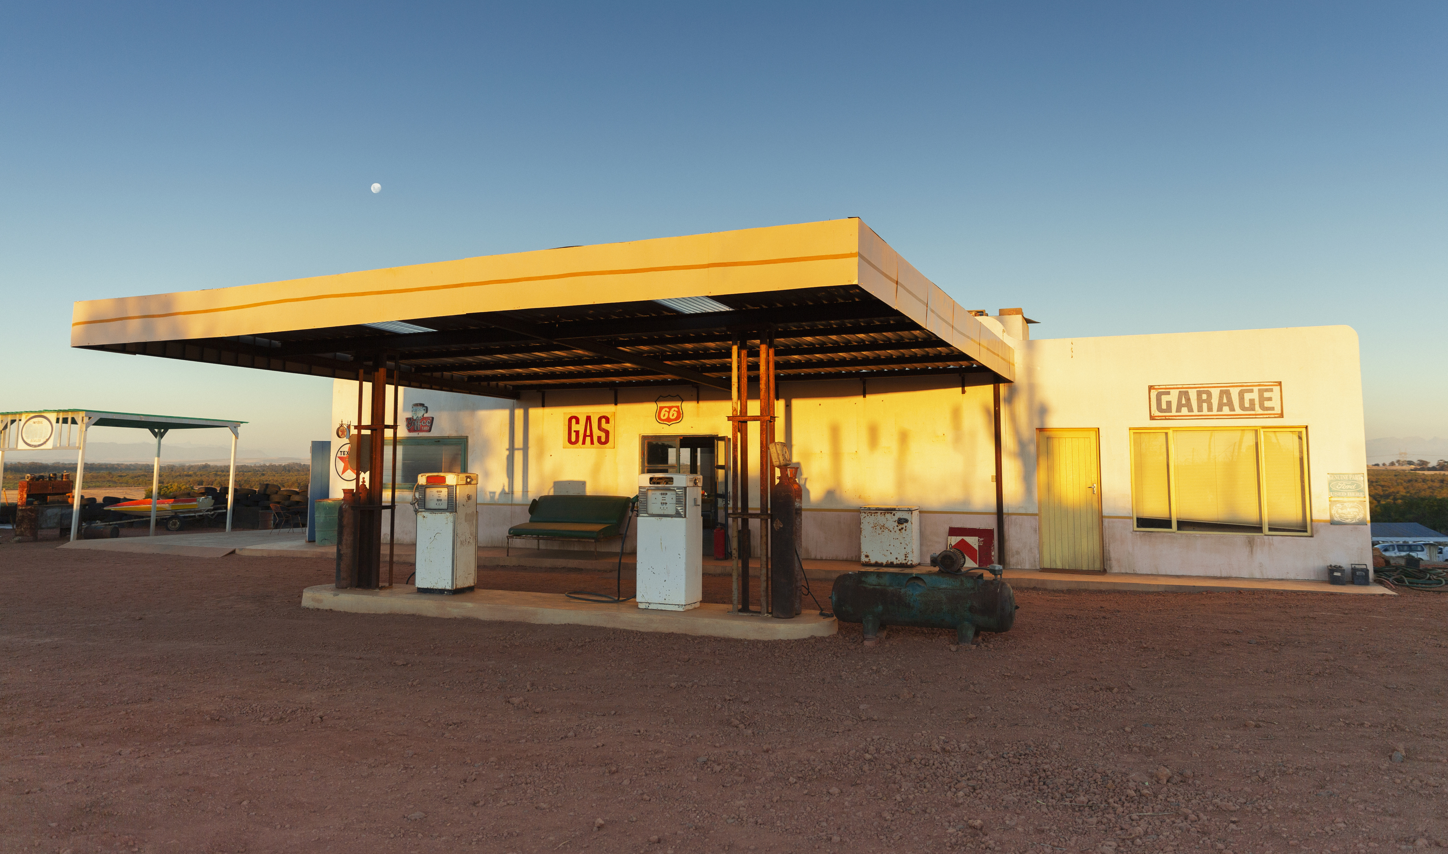

Updates Since the March Board Meeting (Continued)
Rising Fuel Costs
Rising Fuel Costs: district is currently locked in for fixed pricing for Diesel ($2.50) and Propane ($1.39) for the 2026-2027 School year.
Fuel Oil and Unleaded Gas is at a variable rate, with no option for fixed pricing.
In 2025-2026 school year district has spent $260,000 on Fuel, with fixed pricing on all except for Unleaded gas.
Increase the fuel budget line by $35,000 to better align with current spending, bringing the total fuel budget to $275,000 and provide a buffer against price uncertainty.

Slide 7

Updates since the March Board Meeting Continued:
Health Insurance:
District planned for a 3% increase in medical costs and a 16% increase for prescriptions. Final prescription costs came in lower than expected at a 12.3%.
Property & Casualty Insurance:
We expected an 8% increase, but the actual increase was only 7%.
Budget Savings:
Lower-than-expected special education costs has allowed the district to purchase needed Windows 10 computers and fund teacher retirement incentives within the 2025–2026 budget.
CSEA Negotiations has come to an end, but contract has not been finalized with the Union yet.
Proposed Budget has been reduced by $286,023 since March board meeting.

Slide 8
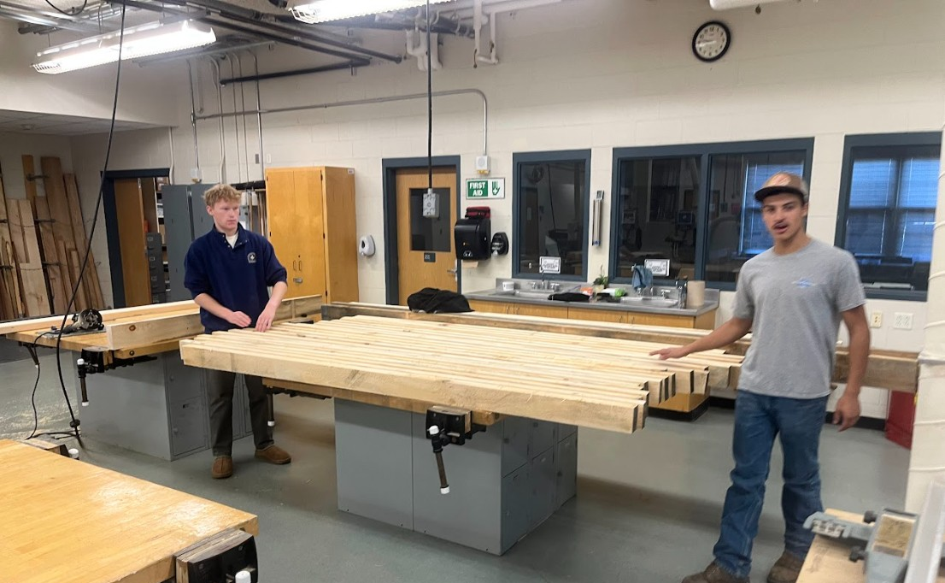
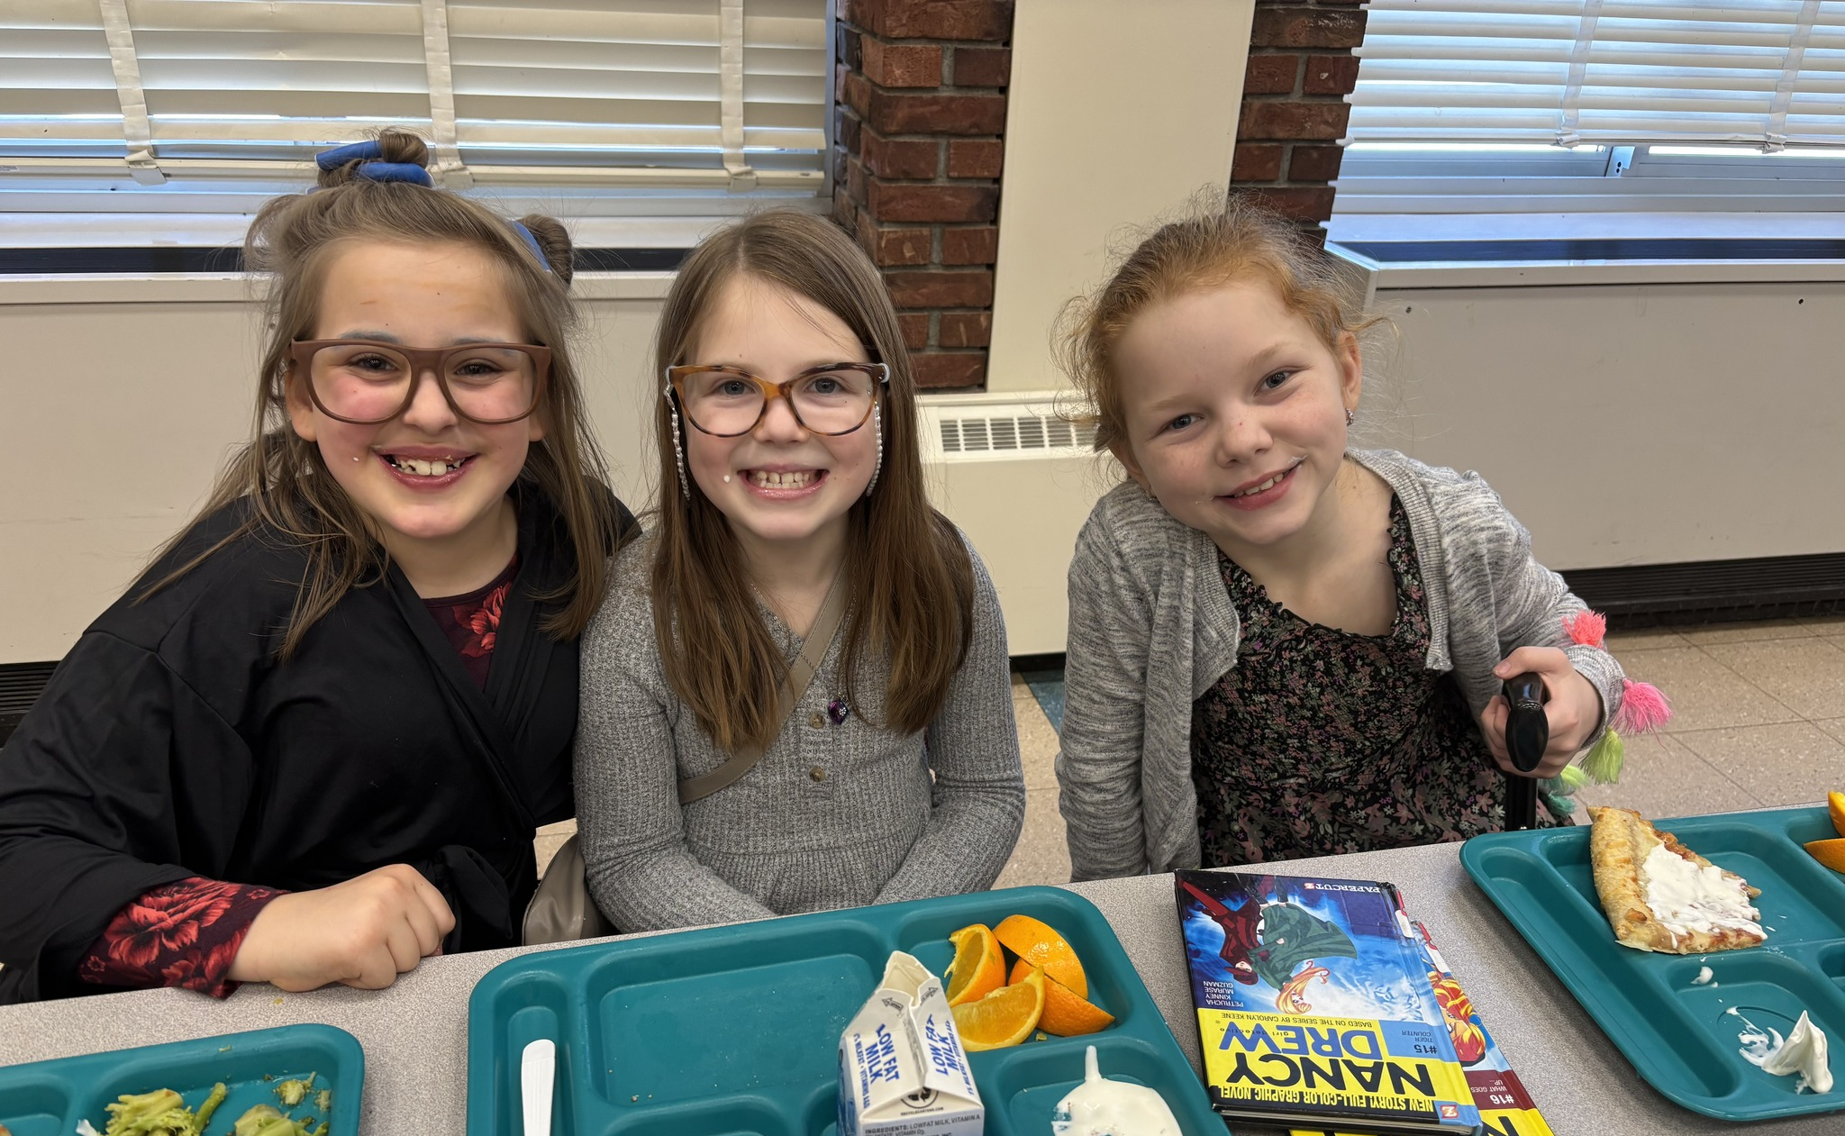
Key Budget Variables Still Pending:
State Aid: Revenue estimates assume a 1% increase in Foundation Aid. (+$26,000)
Additional Vehicle Replacement needed for Transportation: 2015 Suburban requires major repairs, ($6,500+) and has significant rust. Low Value makes repair not cost-effective. Required for an outside placement bus run for next year.
Vehicle must be replaced or leased to meet transportation needs this may be an addition to the budget. Will have more information at the next board meeting.

Slide 9
Budget to Budget
2025-2026 | 2026-2027
$15,427,799 | $16,054,977
$627,178
4.1% increase

Slide 10
2026-2027 Proposed Budget

Slide 11

 | 2026-2027
Budget | $16,054,977
Revenue | $4,338,660
Tax Levy | ?
Fund Balance | ?
Reserves | ?
Debt Service | ?
Budget Gap of $983,651 without a tax increase, reductions or fund balance/reserve usage
Options to Balance Budget:
Tax Levy
Fund balance
Reserves
Debt Service fund
Reductions

Slide 12
2026-2027 Tax Cap Calculation:
Prior Year Tax Levy | $10,732,666
x Tax Base Growth Factor | 1.0072
PILOT | 0
- PY Tax Cap exclusion | $504,434
x CPI | 1.02
Total adjusted tax levy | $10,510,523
+ Capital exclusion - Aid | $685,747
= 26-27 Allowable Tax levy | $11,196,270
4.32% allowable increase
$463,604 additional revenue
Capital Exclusion includes 100k capital outlay project

Slide 13
Fund Balance Projection 2026-2027
 | Budget | Projection
Revenue | $14,984,997 | $15,098,029
Fund Balance | $400,993 | $0
Reserves/ Debt Service Fund | $87,625 | $0
Expenditures | $15,427,799 | $15,100,000
Excess Revenue over Expenditures | $0 | $0
Unassigned Fund Balance | $596,500 | $643,000
Excess Fund Balance (over 4%) | $0 | Unknown until end of school year
It is recommended that the district maintain a 4% fund balance of the projected 2026–2027 budget (approximately $643,000), with current projections indicating the district will end the year at this level.

Slide 14
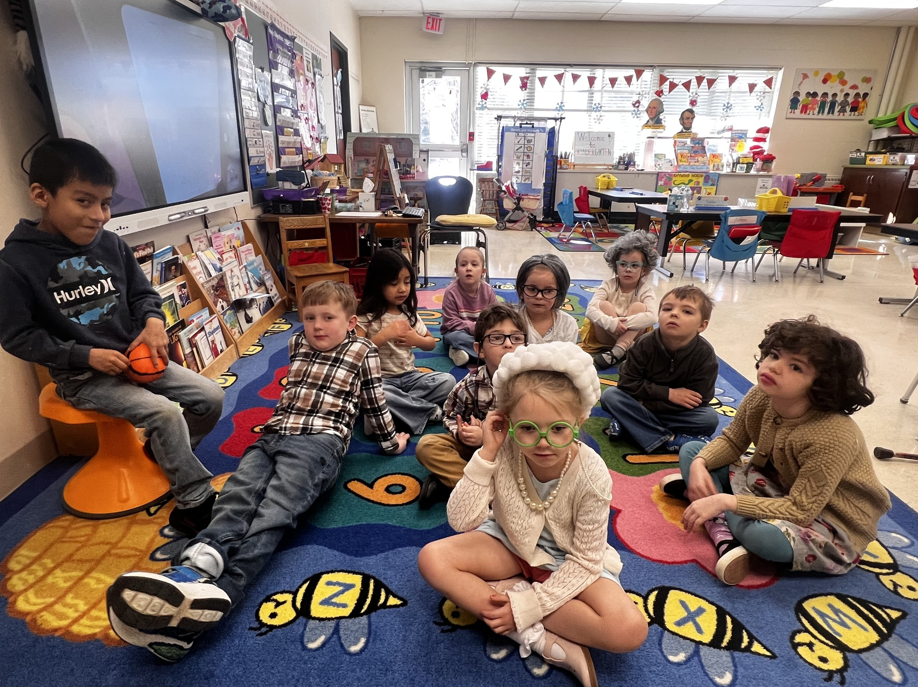

Reserves &
Debt Service
Reserve | 2025-2026 | Purpose
Capital Reserve | $946,206 | Planned for use in an upcoming capital project to replace the WBH roof and address other necessary improvements.
Workers Comp Reserve | $112,717 | To limit a large cost spike due to a significant claim
Unemployment Reserve | $82,902 | To protect district from a significant number of unemployment claims
ERS Reserve | $324,895 | To protect the district from increased employer contribution rates.
Tax Cert Reserve | $33,488 | To protect the district against payments arising from court judgements to reduce school tax assessments on property within districts boundaries.
Employee Benefits Reserve | $128.571 | Protects district from a large single year payout.
Reserve Total: | $1,628,778
Debt Service | $365,180 | Can be used to put towards debt payments
Total Debt Service & Reserves | $1,993,958

Slide 15

Scenario#1
4.32% Max Tax Levy increase
 | 2026-2027
Budget | $16,054,977
Revenue | $4,338,660
Tax Levy | $11,196,317
Fund Balance | $400,000
Debt Service | $120,000

Slide 16


Scenario #2
5% Tax Levy increase
(over the tax cap, would need super majority)
*This option uses less of the district’s “Savings” and helps support future budgets. It also provides a larger buffer against rising costs in future budgets.
 | 2026-2027
Budget | $16,054,977
Revenue | $4,338,660
Tax Levy | $11,269,299
Fund Balance | $400,000
Debt Service | $47,018

Slide 17
Scenario #3
5.5% Tax Levy increase
(over the tax cap, would need super majority)
*This option uses less of the district’s “Savings” and helps support future budgets. It also provides a larger buffer against rising costs in future budgets.
 | 2026-2027
Budget | $16,054,977
Revenue | $4,338,660
Tax Levy | $11,269,299
Fund Balance | $393,354
Reserves/Debt Service | $0

