Slide 1

New Lebanon Central School District
2026-2027 school Budget
Budget Presentation #2
FEBRUARY 11, 2026
By, Danielle Brewster and Chris Harper

Slide 2
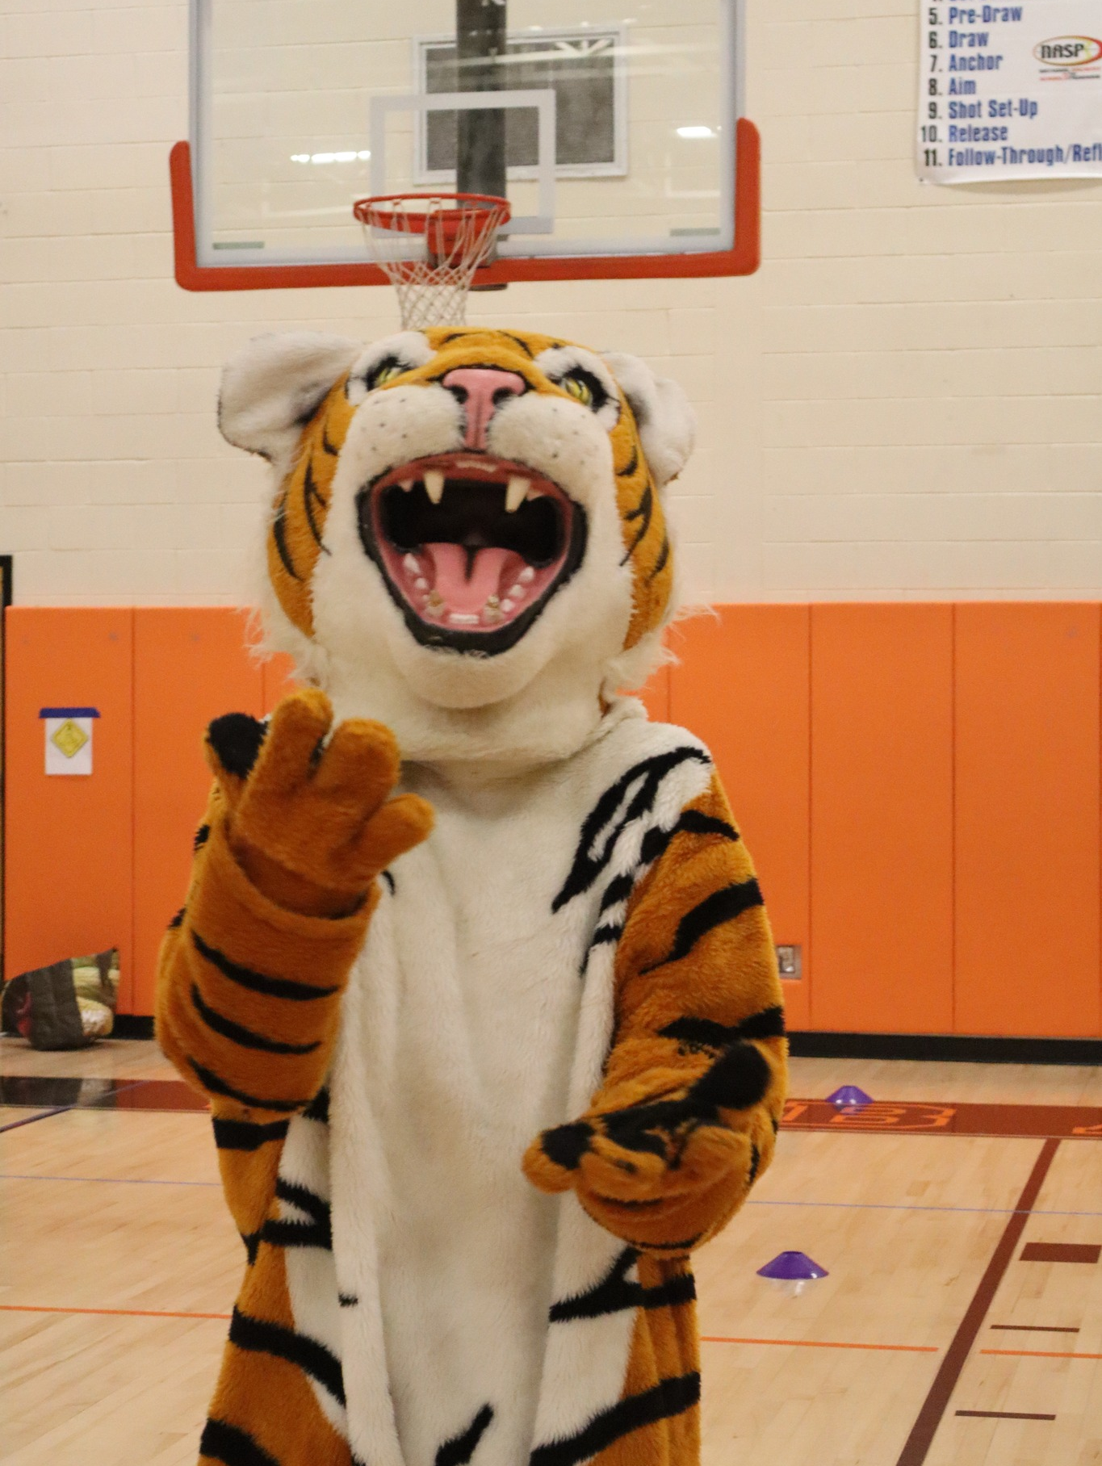
Budget Goals- 2026-2027
1. New Lebanon CSD will maintain a balanced budget while supporting academic excellence and expanding resources for students and staff.
2. Increase fiscal awareness among all stakeholders through communication and professional development.
3. Stay within the tax cap and meet state mandated requirements.

Slide 3
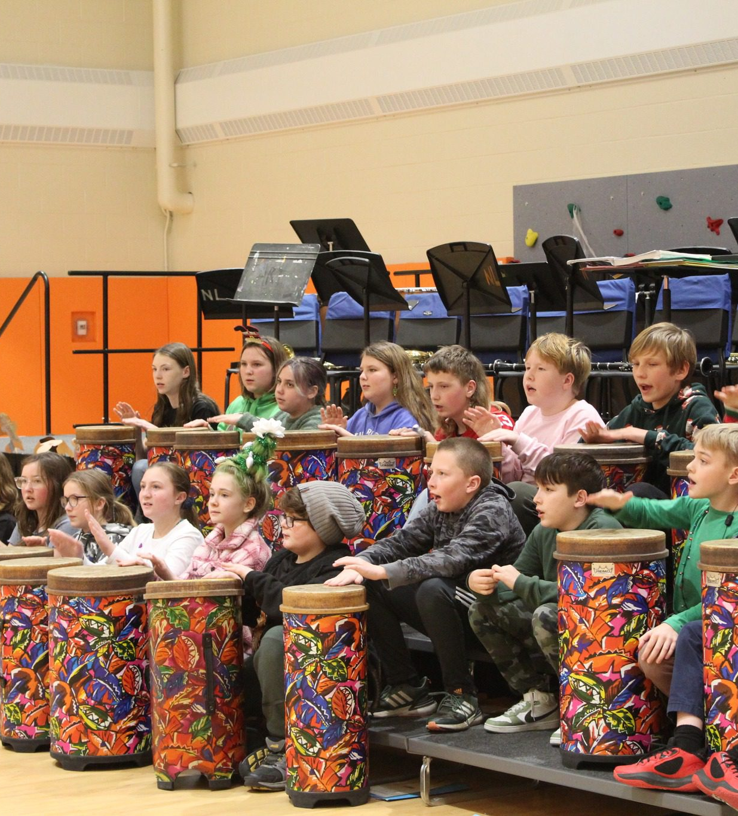
2026-2027 Budget Calendar
January 14, 2026 - Facilities and Food Service.
February 11, 2026- Instructional Programs and Transportation.
March 11, 2026 - Preliminary Full 26-27 Budget Presentation.
April 1, 2026 - Budget Workshop - If Needed.
April 14, 2026 - Final Discussion and Adoption of 26-27 school year budget.
April 14, 2026 - Special BOE Meeting - Questar III Budget Vote and Election - Time TBD.
May 6, 2026 - Public Hearing on Proposed Budget.
May 19, 2026 - Public Budget Vote and Board of Education Election.

Slide 4
2026-2027 Tax Cap Calculation Explained
https://youtu.be/ZnpN9p8Tq9g?si=WrjZnd0kT8Vnt4Ud

Slide 5

2026-2027 Tax Cap Projection
25-26 Levy $9,846,483
Tax Base Growth Factor X 1.0071
$10,808,868
PILOT 0
Prior Year Capital Exclusions -$504,434
$10,304,434
CPI X 1.02
$10,510,523
In November, the districts financial planners estimated a 3.85% maximum levy increase.
This would be $413,617 additional tax levy revenue.
We will have a more accurate projection at next board meeting on the final maximum levy amount.

Slide 6
2026-2027 Executive Budget Proposal
 | 2026-2027 Proposed Aid | 2025-2026 Budgeted Aid | Change
Foundation Aid | $2,669,621 | $2,643,190 | $26,431
Building Aid | $471,518 | $468,320 | $3,198
Reimbursable Aids | $853,094 | $771,919 | $81,175
UPK* | $180,000 | $86,400 | $93,600
Total: | $4,174,233 | $3,969,829 | $204,404
*UPK funding is based on how many students are enrolled in Pre-K
Governor is proposing to increase funding from $5,400 per students to $10,0000 for UPK.
District is currently covering $40k in benefits out of the General fund for Pre-K

Slide 7

Enrollment Projections- Walter B Howard
Grade Level | Student Projection | # of Sections planned for 26-27
Pre-K | 20 | 1
Kindergarten | 15 | 1
1st Grade | 20 | 1
2nd Grade | 28 | 2
3rd Grade | 23 | 1
4th Grade | 28 | 2
5th Grade | 29 | 2
6th Grade | 26 | 1
This would eliminate 2 sections for 26-27, Kindergarten & 1st Grade

Slide 8

WBH Educational Program Faculty/Staff Overview:
 | 26-27 Budgeted Salaries | 25-26 Budgeted Salaries | Difference
PreK through 6th Grade | $854,413 | $998,053 | -$143,640
Art/Music | $84,705 | $86,032 | -$1,327
RTI: 1 Teacher | $97,484 | $92,882 | $4,602
1 Librarian/1 PE | $149,423 | $142,283 | $7,140
Teacher Assistants (8) & School Nurse (1) | *$272,123 | $238,798 | $33,325
WBH Admin (1)/ Office Staff (2) | *$210,543 | $201,134 | $9,409
Total: | $1,668,691 | $1,759,182 | -$90,491
*Pending contract negotiations
Two teaching positions will be eliminated through attrition by combining class sections

Slide 9

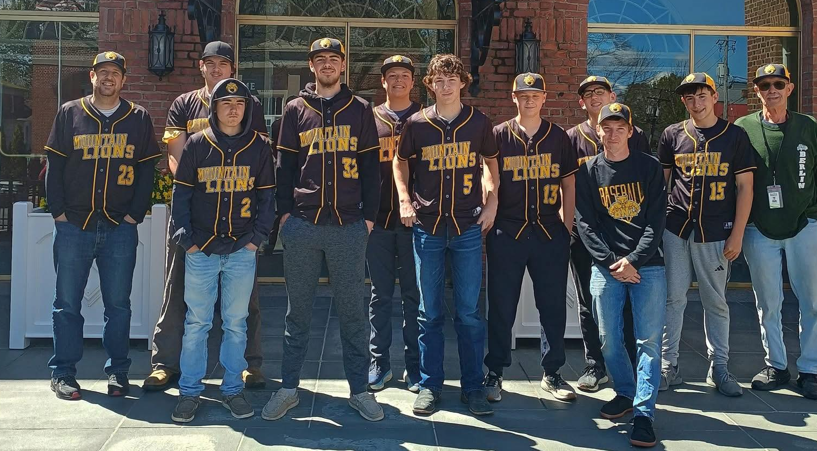
Enrollment Projections- Jr/Sr. Highschool
Grade Level | Student Projection
7th grade | 33
8th grade | 31
9th grade | 21
10th grade | 40
11th grade | 31
12th grade | 28

Slide 10
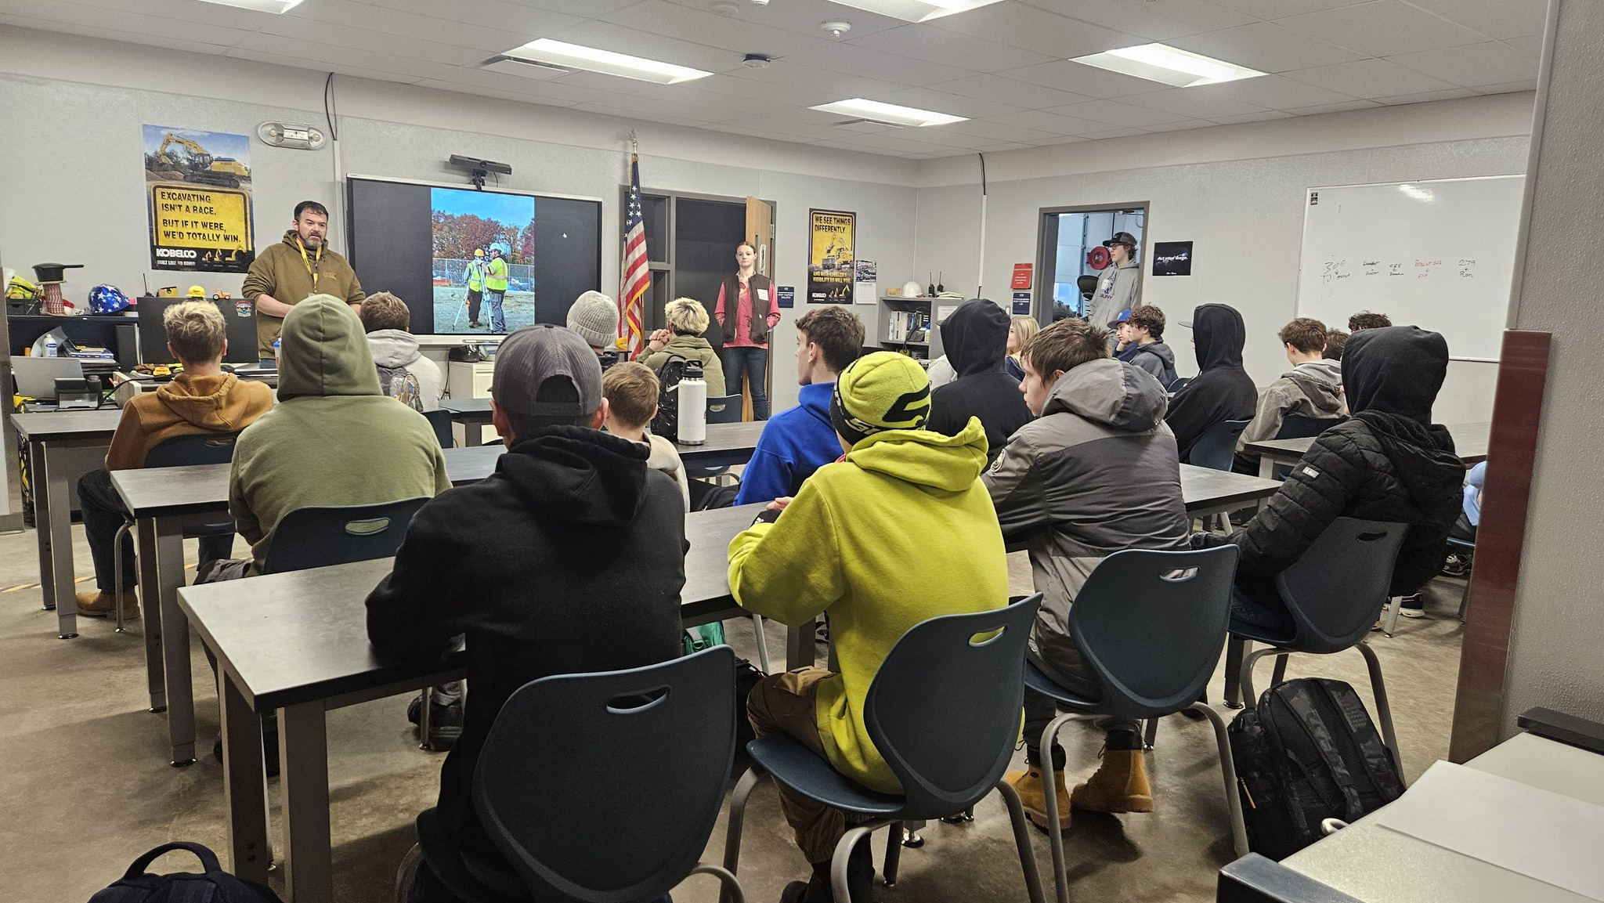

Slide 11
JR/Sr. High School educational Program Faculty/Staff Overview
*CEA pending contract negotiations
1 additional Teaching Assistant has been budgeted for due to IEP
For the 25–26 budget, we initially budgeted for a 0.8 FTE Art teacher. As of January, the position has been increased to a 1.0 FTE full-time Art teacher.
 | 26-27 Budgeted Salaries | 25-26 Budgeted Salaries | Difference
7-12 Teachers (20 FTE) | $1,612,331 | $1,583,812 | $77,500
Teacher Assistant (6) & School Nurse | *$237,519 | $201,545 | $35,974
Jr/Sr. Admin (2)/ Office Staff (2) | *$346,115 | $330,075 | $16,040
Total: | $2,195,965 | $2,115,432 | $129,514
Teachers include: 3 English, 3 Social Studies, 3 Math, 4 Science, 2 Spanish, 1 PE, 1 Librarian, 1 Art & 2 Music

Slide 12
Instructional Budget
ENL: Planning services for 5 WBH students through Questar and 4 MS/HS students through a combination of in-house and Questar services. Estimated Questar cost: $150,000
Literacy program
Two teaching positions will be eliminated through attrition by combining class sections at WBH.
School Resource Officer Salary-$60,000 ( $10,000 increase from 25-26)
Budgeting for additional sub coverage
Retirement incentive payouts and Retiree insurance will be additions to the budget

Slide 13
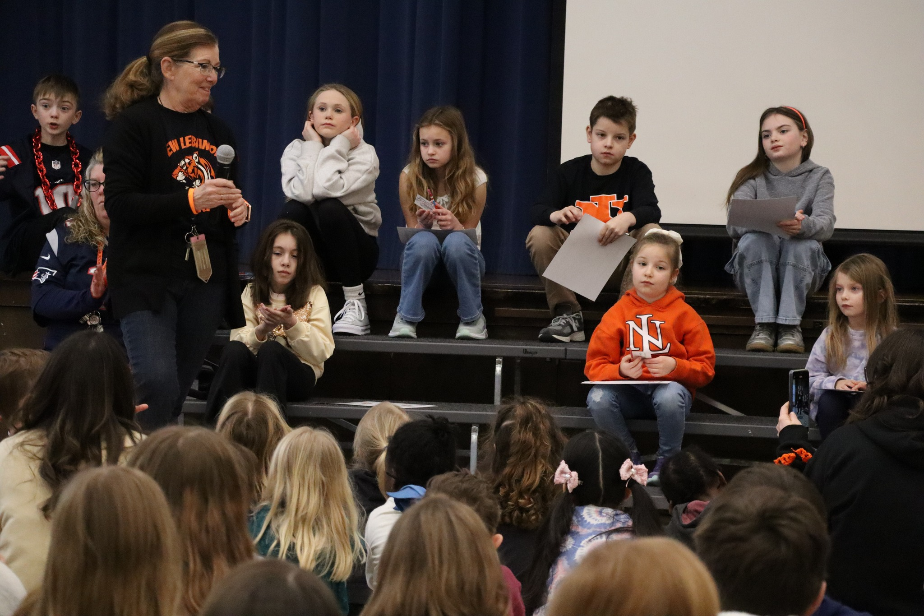
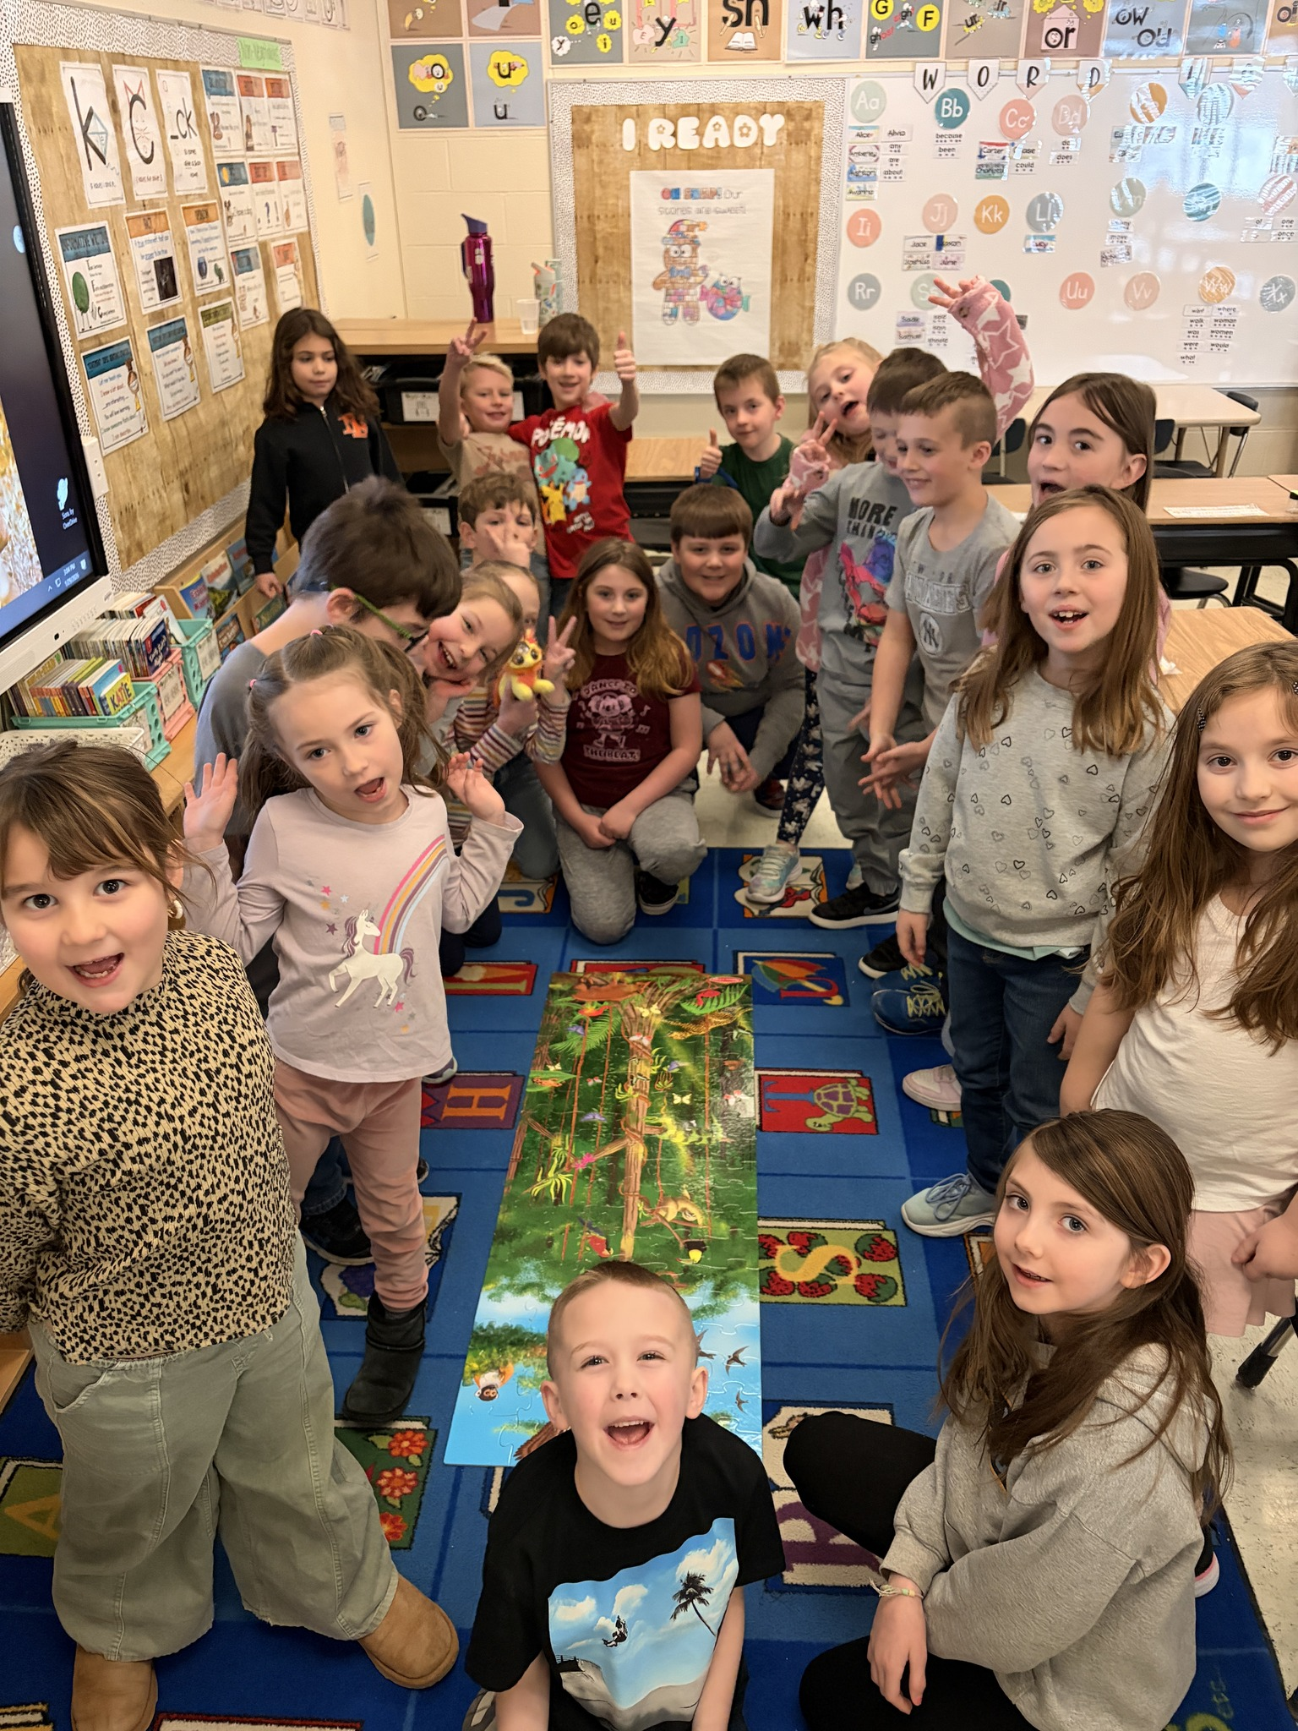
Special Education and Pupil Services
1 Guidance Counselor
3 Psychologists
Recommending to hire full time Special Education Director
1 Secretary
7 Special Education Teachers
3 Self Contained Teachers
7 Aides & 1 Teacher Assistant
OT/PT and Speech Services through Advanced Therapy
ELL Teacher through Questar Boces

Slide 15
Self Contained Classroom
26-27 3 Self Contained Classrooms | 26-27 Budgeted Salaries | 25-26 3 Self Contained Classrooms | 25-26 Budgeted Salaries | Difference
1 Teacher, 2 Aides 8 Students | *$103,208 | 1 Teacher, 2 Aides 8 Students | $97,339 | $5,869
1 Teacher, 3 Aides 6 Students | *$123,117 | 1 Teacher, 4 Aides 6 Students | $144,193 | -$21,076
1 Teacher, 2 Aides 10 Students | *155,409 | 1 Teacher, 2 Aides 10 Students | $97,339 | $58,070
Total: | $381,734 |  | $338,871 | $42,863
Having self contained classrooms saves the district a significant amount of money.
These classrooms service up to 24 students
Total estimated increase $42,863
*Pending CSEA contract negotiations

Slide 16
Tentative Outside SPED Placements for 2026-2027
26-27 Budgeted Amount | 25-26 Budgeted Amount | Difference
$700,000, 8 anticipated outside placements | $700,000, 8 anticipated outside placements | $0
Important to plan for additional placements in case we have an increase in needs.

Slide 17
Special Education Tentative Budget
 | 26-27 Budget | 25-26 Budget | Difference
Salaries* | 1,201,705 | $1,112,888 | $88,817
BOCES (3) | $350,000 | $330,000 | $20,000
Equipment/Supplies/Contractual | $200,000 | $264,000 | -$64,000
Contractual Tuition (5) | $350,000 | $370,000 | -$20,000
Total: | $2,101,705 | $2,076,888 | $24,817
Salaries includes full time Special Education Director, 7 sped teachers, 3 psychologists, and 1 guidance counselor & 8 aides
*Pending CSEA contract negotiations

Slide 18

Transportation
1-Transportation Supervisor
1- Part Time Dispatcher- 2.75 hours per day
1- Mechanic
11- Bus Drivers
3- Bus Monitors

Slide 20

Bus Replacement Plan
This past summer the board agreed to ask our taxpayers to vote on a bus bond proposal for:
1, 66 passenger bus $169,281 & 1, handicap accessible bus $135,567
Total: $304,848
The vote will take place in May 2026.

Slide 21
Transportation Budget
 | 26-27 Budget | 25-26 Budget | Difference
Transportation Supervisor/Mechanic/Dispatcher Salaries | $171,608 | $163,196 | $8,412
Drivers Salaries | $409,224 | $384,055 | $25,169
Bus Monitors Salaries | $31,316 | $30,063 | $1,253
Parts, Motor Oil, Gas, Tires & Contractual Items | $208,000 | $203,000 | $5,000
Total: | $820,148 | $780,314 | $39,834

Slide 22
Preliminary 2026-2027 Budget Outlook
Preliminary Health Insurance Increase
3% increase – Highmark Blue Shield
16% increase – Prescription Coverage
Projected TRS Employer Contribution Rate: 8.24% (Previously 9.59%)
ERS Employer Contribution Rate:
17.6% (Previously 16.5%)
Staffing Changes:
-2 confirmed teacher retirements
-1 confirmed teacher assistant retirement
-Not rehiring for 2 WBH teacher positions
(1 resignation, 1 retirement)
-Recommending to hire a full-time Special Education Director
No anticipated foster care placements
Budget reduced by $50,000

Slide 23
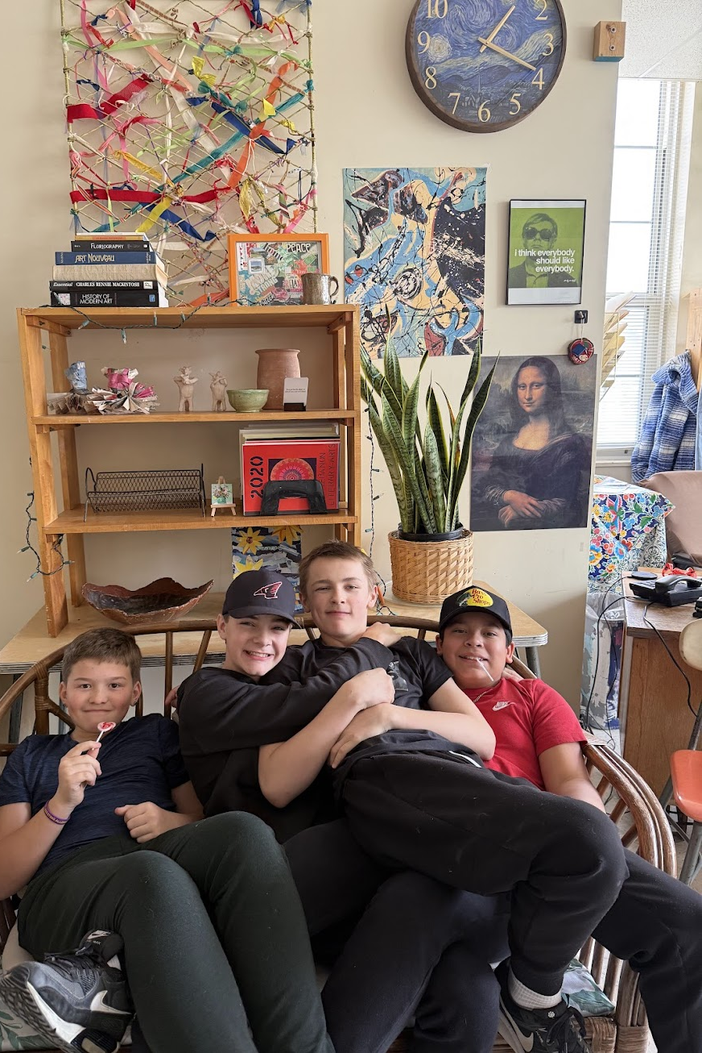
Next Board Meeting
The March Board meeting will include a review of updated budget projections, the full budget, fund balance, reserve balances, and budget-balancing options.

