Slide 1

New Lebanon Central School District
2026-2027 SCHOOL BUDGET
BUDGET HEARING REVOTE
JUNE 8,2026

Slide 2

2026-2027 Revote Timeline
June 1, 2026 Deadline to submit budget notice to printer.
June 2, 2026 Deadline for 1st publication of legal notice.
June 9, 2026 Deadline for 2nd publication of legal notice.
June 8, 2026 Budget hearing
June 10, 2026 Copies of public notice/budget information made available.
June 10, 2026 Deadline for mailing the budget newsletter.
June 16,2026 Budget Revote Day.

Slide 3
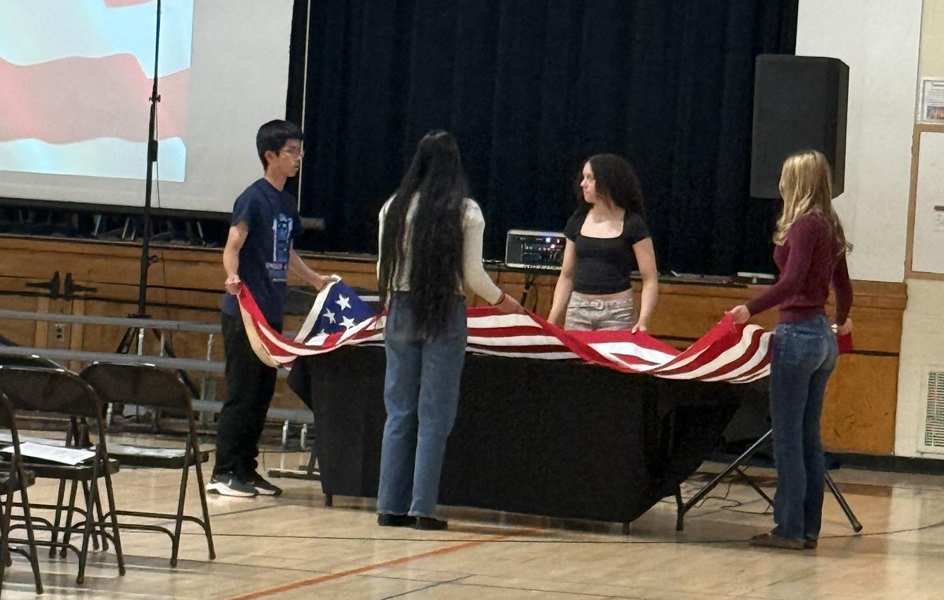
2026-2027 Proposed Budget Breakdown
 | 2025-2026 | 2026-2027 | Difference
Special Education | $1,829,261 | $1,837,479.00 | $8,218.00
Employee Benefits | $4,559,201 | $4,725,797.00 | $166,596.00
Instruction | $4,765,752 | $4,632,296.00 | -$133,456.00
Transportation | $841,574 | $942,462.00 | $100,888.00
Operations and Maintenance | $990,077 | $1,209,861.00 | $219,784.00
General Support | $943,069 | $1,165,364.00 | $222,295.00
Co-Curricular and Athletics | $155,400 | $175,400.00 | $20,000.00
Debt Service | $1,125,486 | $1,126,448.00 | $962.00
Information Technology | $187,979 | $119,870.00 | -$68,109.00
Interfund Transfers | $30,000 | $120,000.00 | $90,000.00
Total Expenditures | $15,427,799 | $16,054,977 | $627,178.00
4.07% Budget increase

Slide 4
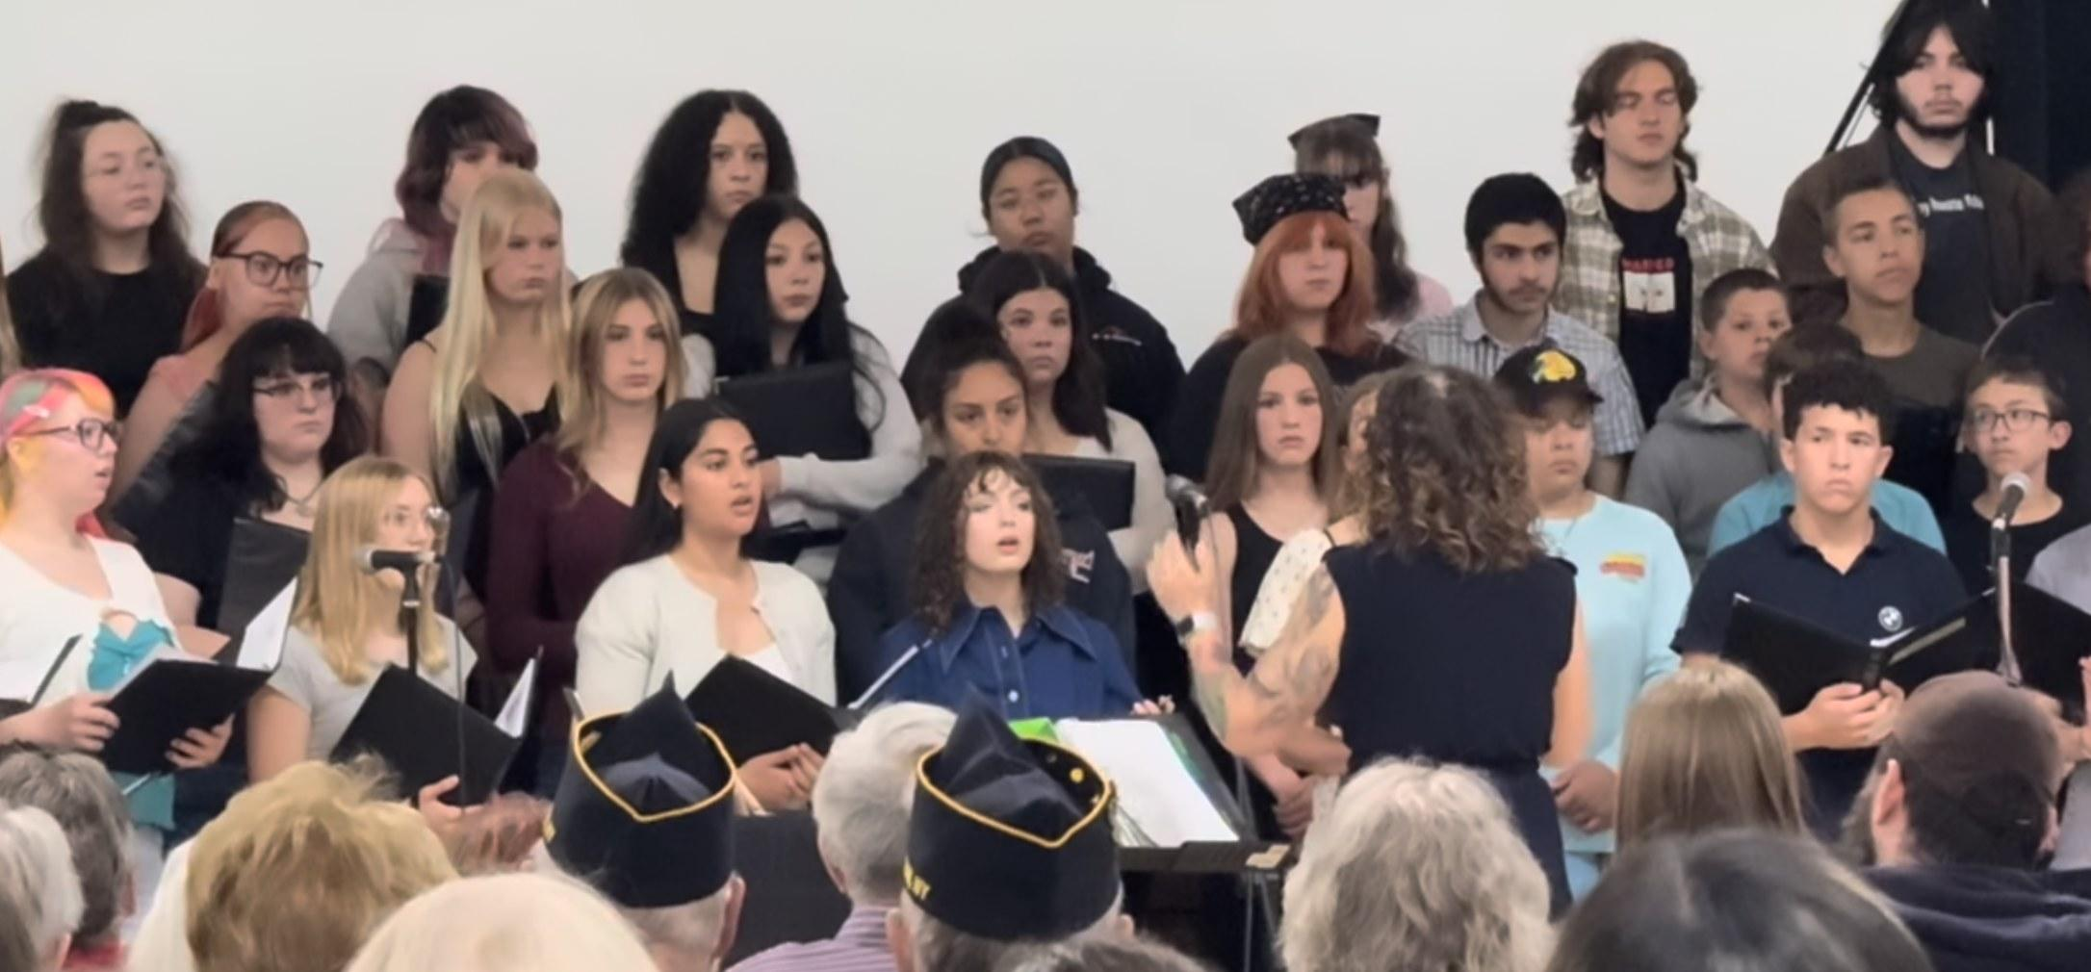
2026-2027 Tax Cap Calculation:
Prior Year Tax Levy | $10,732,666
x Tax Base Growth Factor | 1.0071
PILOT | 0
- PY Tax Cap exclusion | $504,434
x CPI | 1.02
Total adjusted tax levy | $10,510,523
+ Capital exclusion - Aid | $685,747
= 26-27 Allowable Tax levy | $11,196,270
4.32% allowable increase
The board is proposing a 6% tax levy increase which exceeds the tax cap and therefore requires approval by at least 60% of voters to pass.

Slide 5
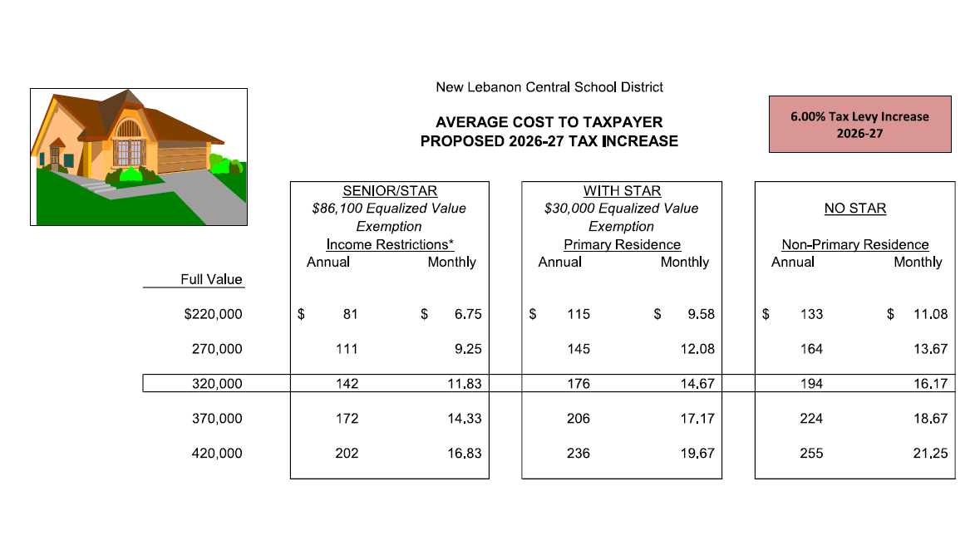
Estimated Impact of Tax Levy Increase

Slide 6


Revenue Summary
 | 2025-2026 | 2026-2027 | Change
Non Tax Revenue | $309,000 | $329,000 | $20,000
State Aid | $3,897,515 | $4,009,660 | $112,145
Tax Levy 6% tax increase | $10,732,666 | $11,376,626 | $643,960
Fund Balance | $400,933 | $339,691 | -$61,302
ERS Reserve | $37,625 | $0 | -$37,625
Debt Service Fund | $50,000 | $0 | -$50,00
Total Budget | $15,427,799 | $16,054,977 | $627,178

Slide 7
What happens if the budget does not pass?
The BOE is required to adopt a contingent budget before July 1st.
When a district goes to a contingent budget:
  The Board of Education would be required to adopt a contingent budget with a 0% tax levy increase. This would require an additional $643,960 in reductions.
  Under a contingent budget, non-contingent expenses could be reduced or eliminated, including:.
  Extracurricular activities and athletics (sports, facility use- including pool, all clubs, school dances, etc.)
  Student programs and field trips
  Equipment and technology purchases
  Operational expenses and classroom supplies
  These reductions would significantly impact student opportunities, programs, and daily district operations.

Slide 8
Contingent Budget reduction examples:
THE BOARD WILL NEED TO CONSIDER REDUCTIONS OF $643,960 REDUCTIONS MAY INCLUDE:
Remedial Reading Teacher- $158,000 | Clerk/Typist- $66,000
Library Media Specialist- $144,000 | All Extra Curricular activities- $20,000
All Sports- $135,000 | All Field trips, Nature’s Classroom- $20,000
Assistant Principal/Athletic Director- $130,400 | Equipment/Supplies- $100,000
Art Teacher-$101,257 | 100k Capital outlay project- to keep up with maintenance on the buildings- $100,000
12- Month Cleaner- $82,312 | *Facilities usage, Community Education programs including all pool related offerings, Memorial Day assembly, school dances, travel club trips, drama club performances, community dinners, and All-County choir and band events — could be impacted.
Music Teacher- $82,000

Slide 9



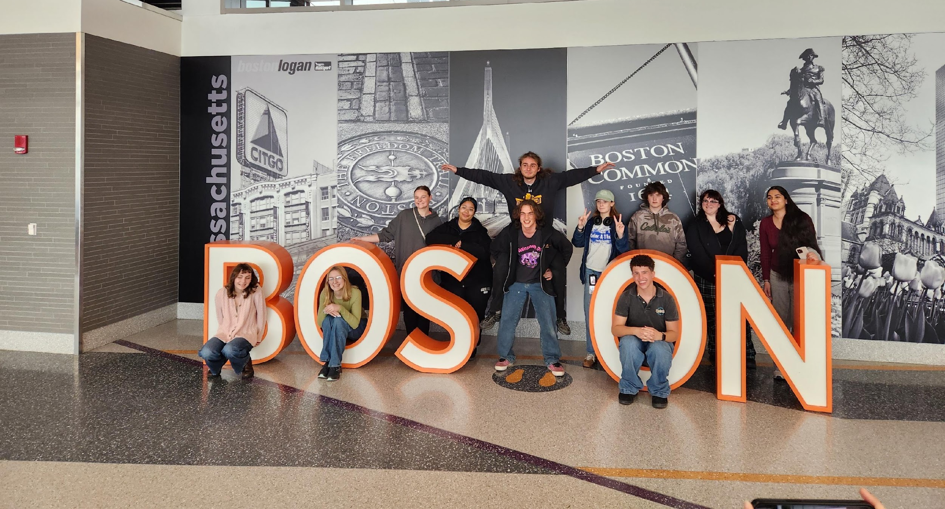
Proposition #1 Budget
Vote on district spending plan
$16,054,977

Slide 10


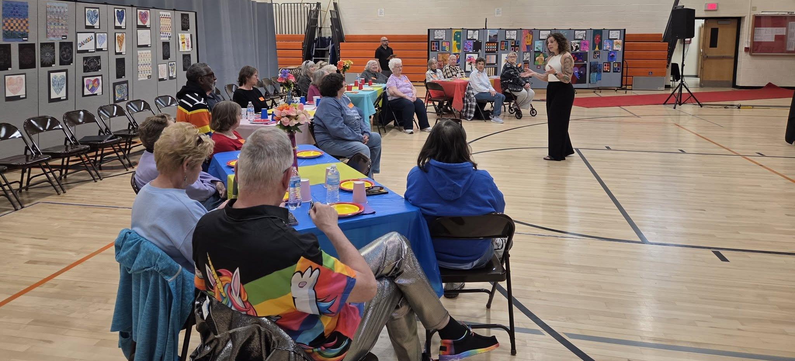
Next Steps:
Budget Revote
June 16,2026
WBH 12-8pm

