Slide 1

New Lebanon Central School District
2026-2027 school Budget
Budget Hearing May 6,2026

Slide 2
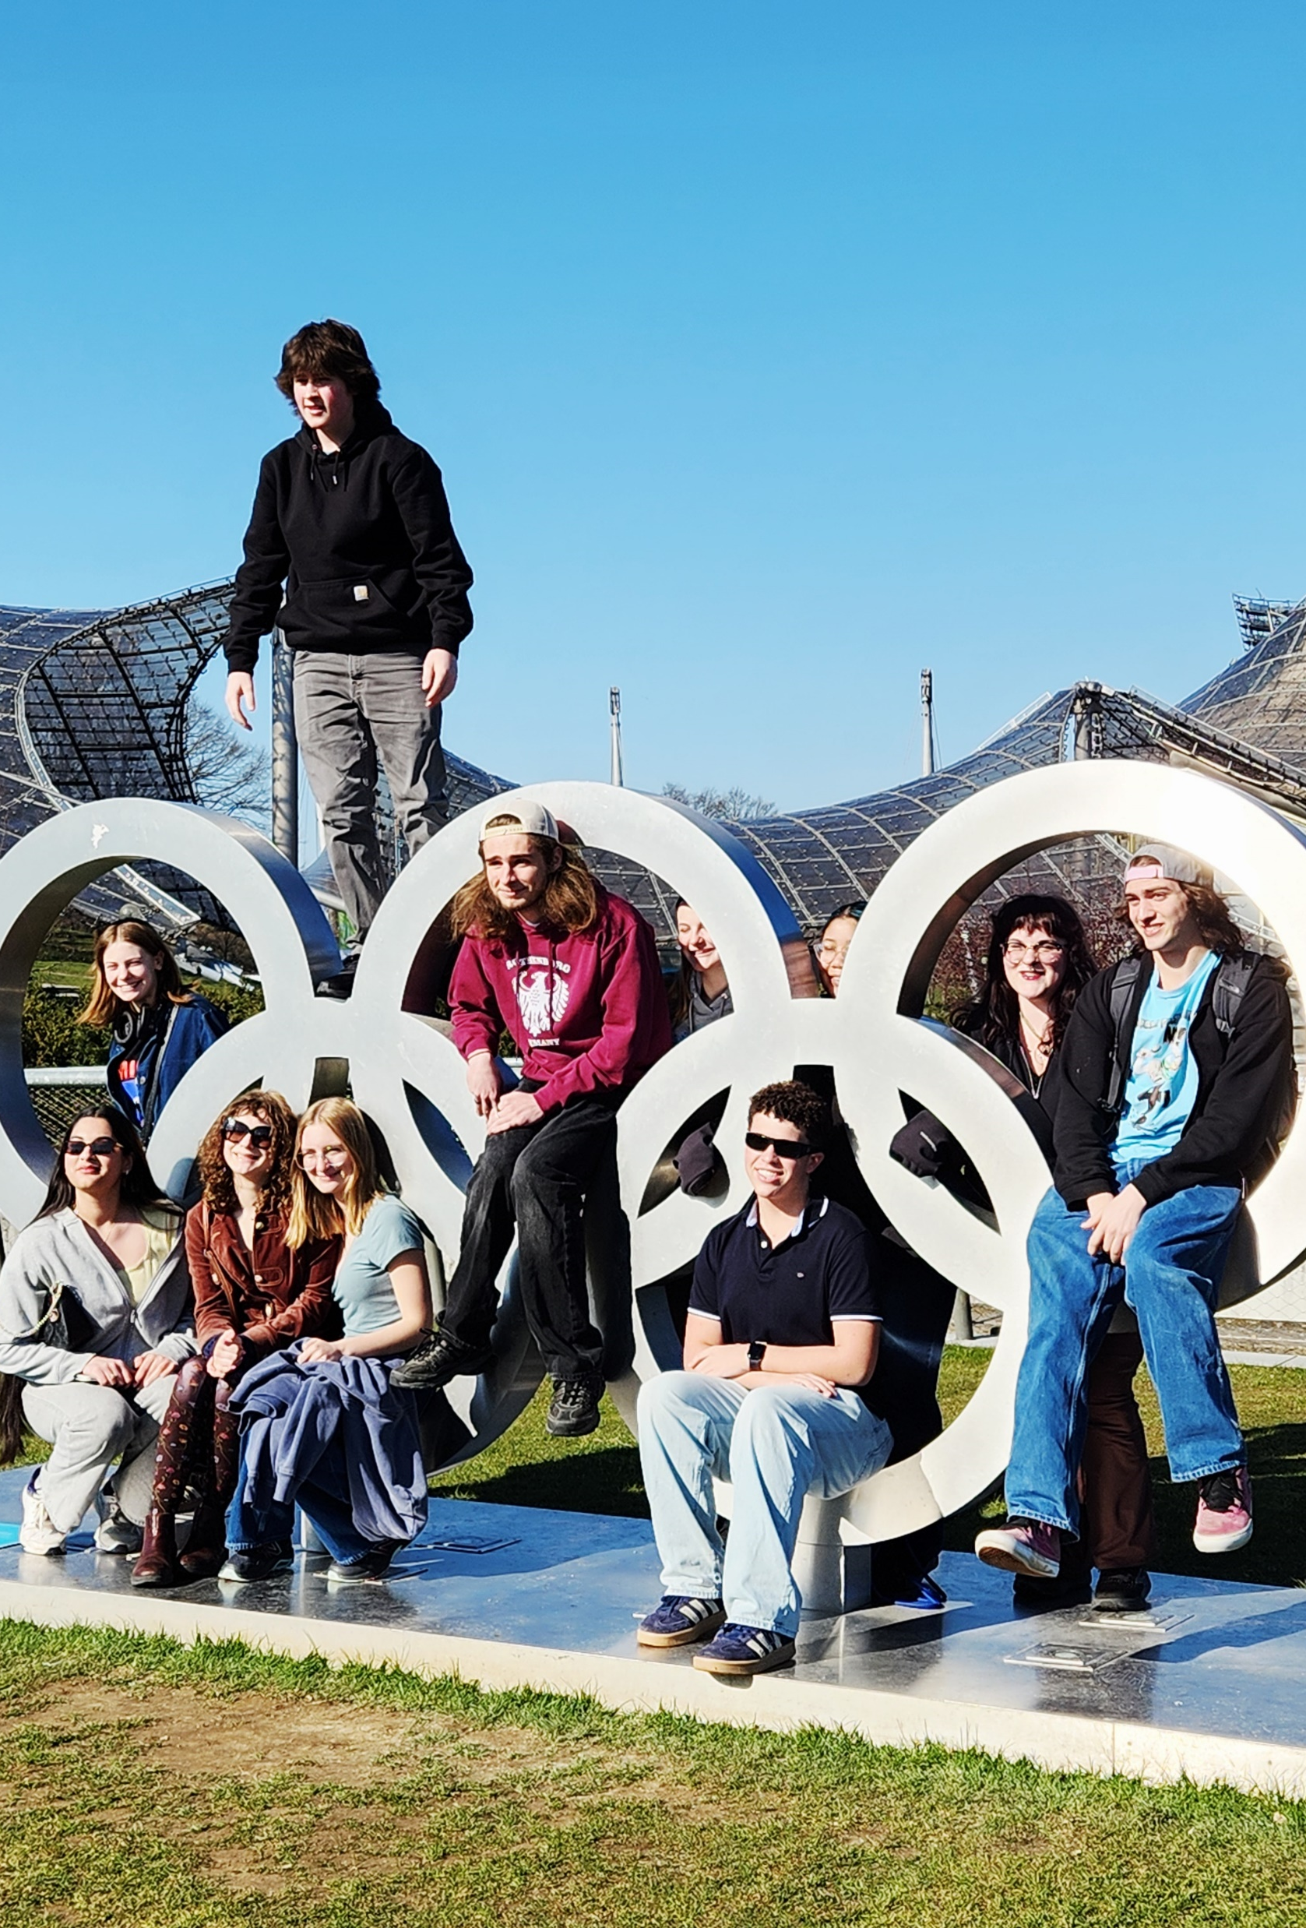
2026-2027 Budget Calendar
January 14, 2026 - Facilities and Food Service.
February 11, 2026- Instructional Programs and Transportation.
March 11, 2026 - Preliminary Full 26-27 Budget Presentation.
April 1, 2026 - Budget Workshop
April 21, 2026 - Final Discussion and Adoption of 26-27 school year budget.
April 21, 2026 - Special BOE Meeting - Questar III Budget Vote and Election
May 6, 2026 - Public Hearing on Proposed Budget.
May 19, 2026 - Public Budget Vote and Board of Education Election.

Slide 3
2026-2027 Proposed Budget Breakdown
 | 2025-2026 | 2026-2027 | Difference
Special Education | $1,829,261 | $1,837,479.00 | $8,218.00
Employee Benefits | $4,559,201 | $4,725,797.00 | $166,596.00
Instruction | $4,765,752 | $4,632,296.00 | -$133,456.00
Transportation | $841,574 | $942,462.00 | $100,888.00
Operations and Maintenance | $990,077 | $1,209,861.00 | $219,784.00
General Support | $943,069 | $1,165,364.00 | $222,295.00
Co-Curricular and Athletics | $155,400 | $175,400.00 | $20,000.00
Debt Service | $1,125,486 | $1,126,448.00 | $962.00
Information Technology | $187,979 | $119,870.00 | -$68,109.00
Interfund Transfers | $30,000 | $120,000.00 | $90,000.00
Total Expenditures | $15,427,799 | $16,054,977 | $627,178.00
4.07% Budget increase

Slide 4
4.32% allowable increase
The board is proposing a 6% tax levy increase which exceeds the tax cap and therefore requires approval by at least 60% of voters to pass.
2026-2027 Tax Cap Calculation:
Prior Year Tax Levy | $10,732,666
x Tax Base Growth Factor | 1.0071
PILOT | 0
- PY Tax Cap exclusion | $504,434
x CPI | 1.02
Total adjusted tax levy | $10,510,523
+ Capital exclusion - Aid | $685,747
= 26-27 Allowable Tax levy | $11,196,270

Slide 5
Revenue Summary
 | 2025-2026 | 2026-2027 | Change
Non Tax Revenue | $309,000 | $329,000 | $20,000
State Aid | $3,897,515 | $4,009,660 | $112,145
Tax Levy 6% tax increase | $10,732,666 | $11,376,626 | $643,960
Fund Balance | $400,933 | $339,691 | -$61,302
ERS Reserve | $37,625 | $0 | -$37,625
Debt Service Fund | $50,000 | $0 | -$50,00
Total Budget | $15,427,799 | $16,054,977 | $627,178

Slide 6
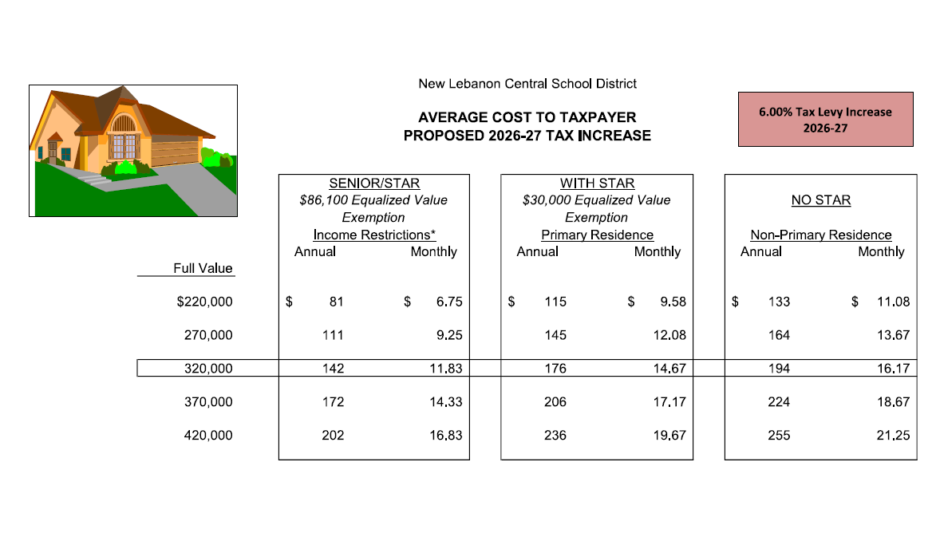
Estimated Impact of Tax Levy Increase

Slide 7
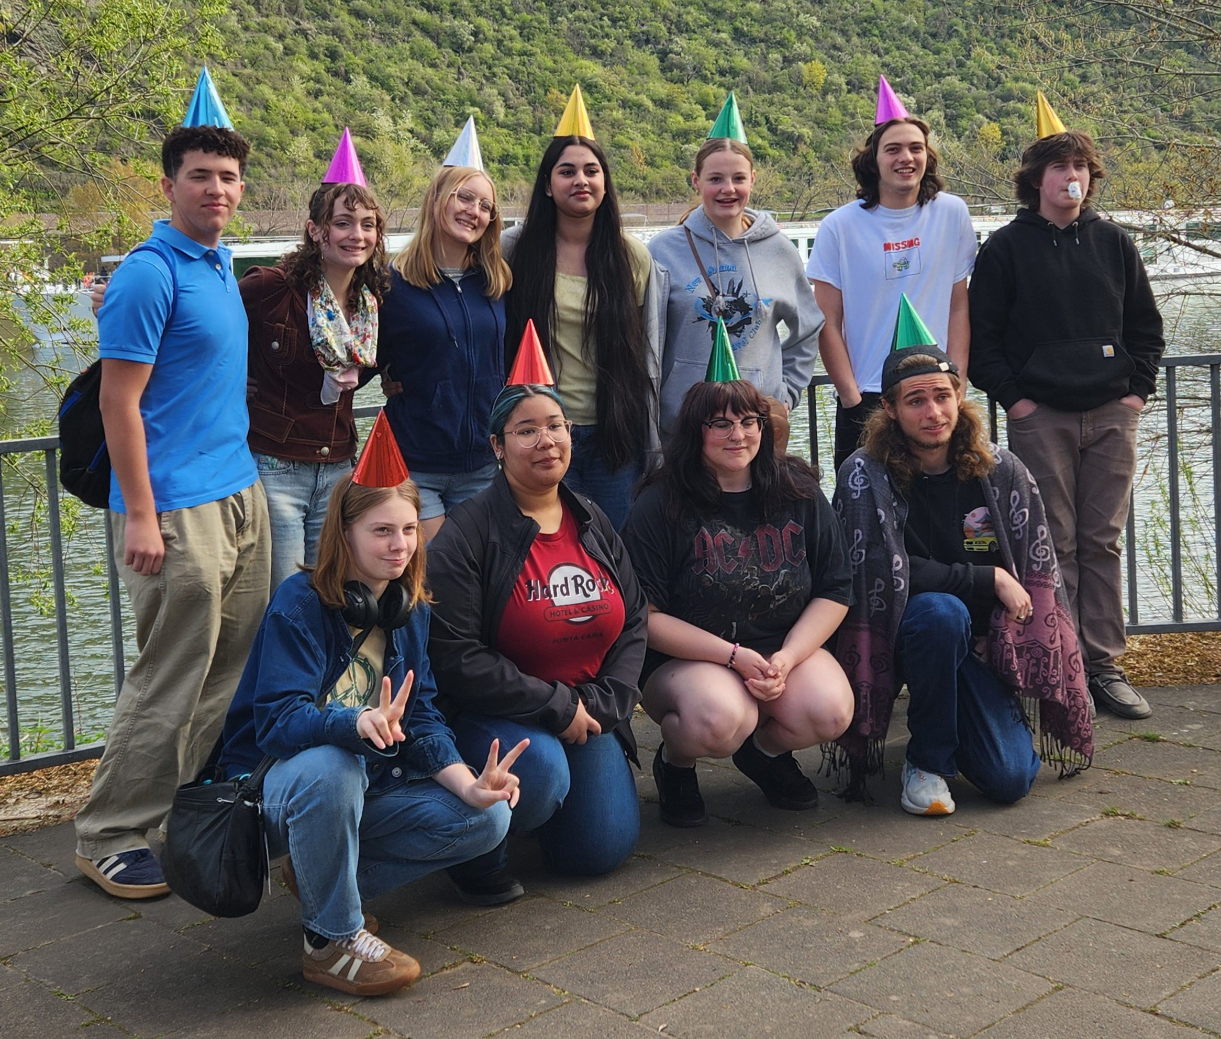

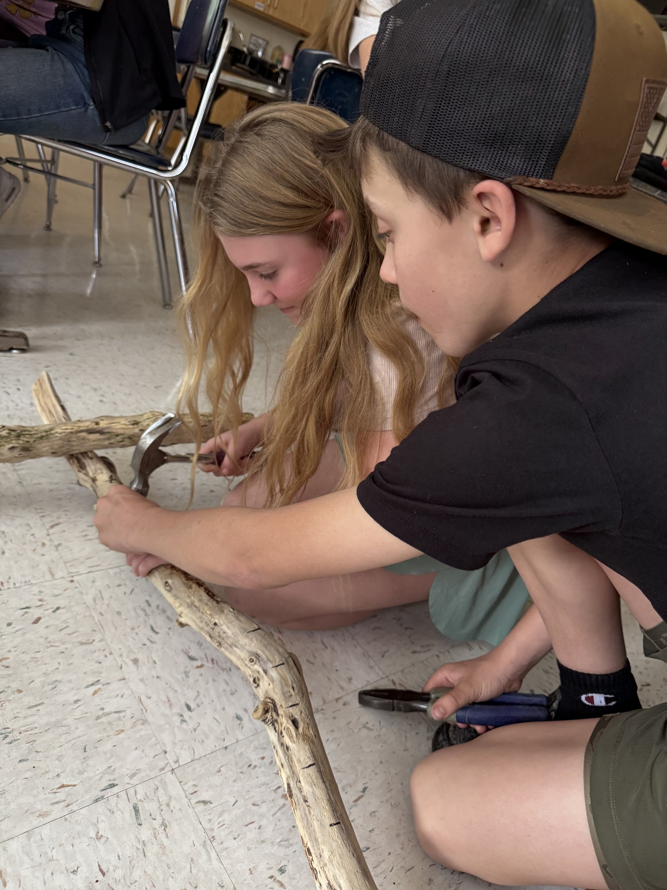
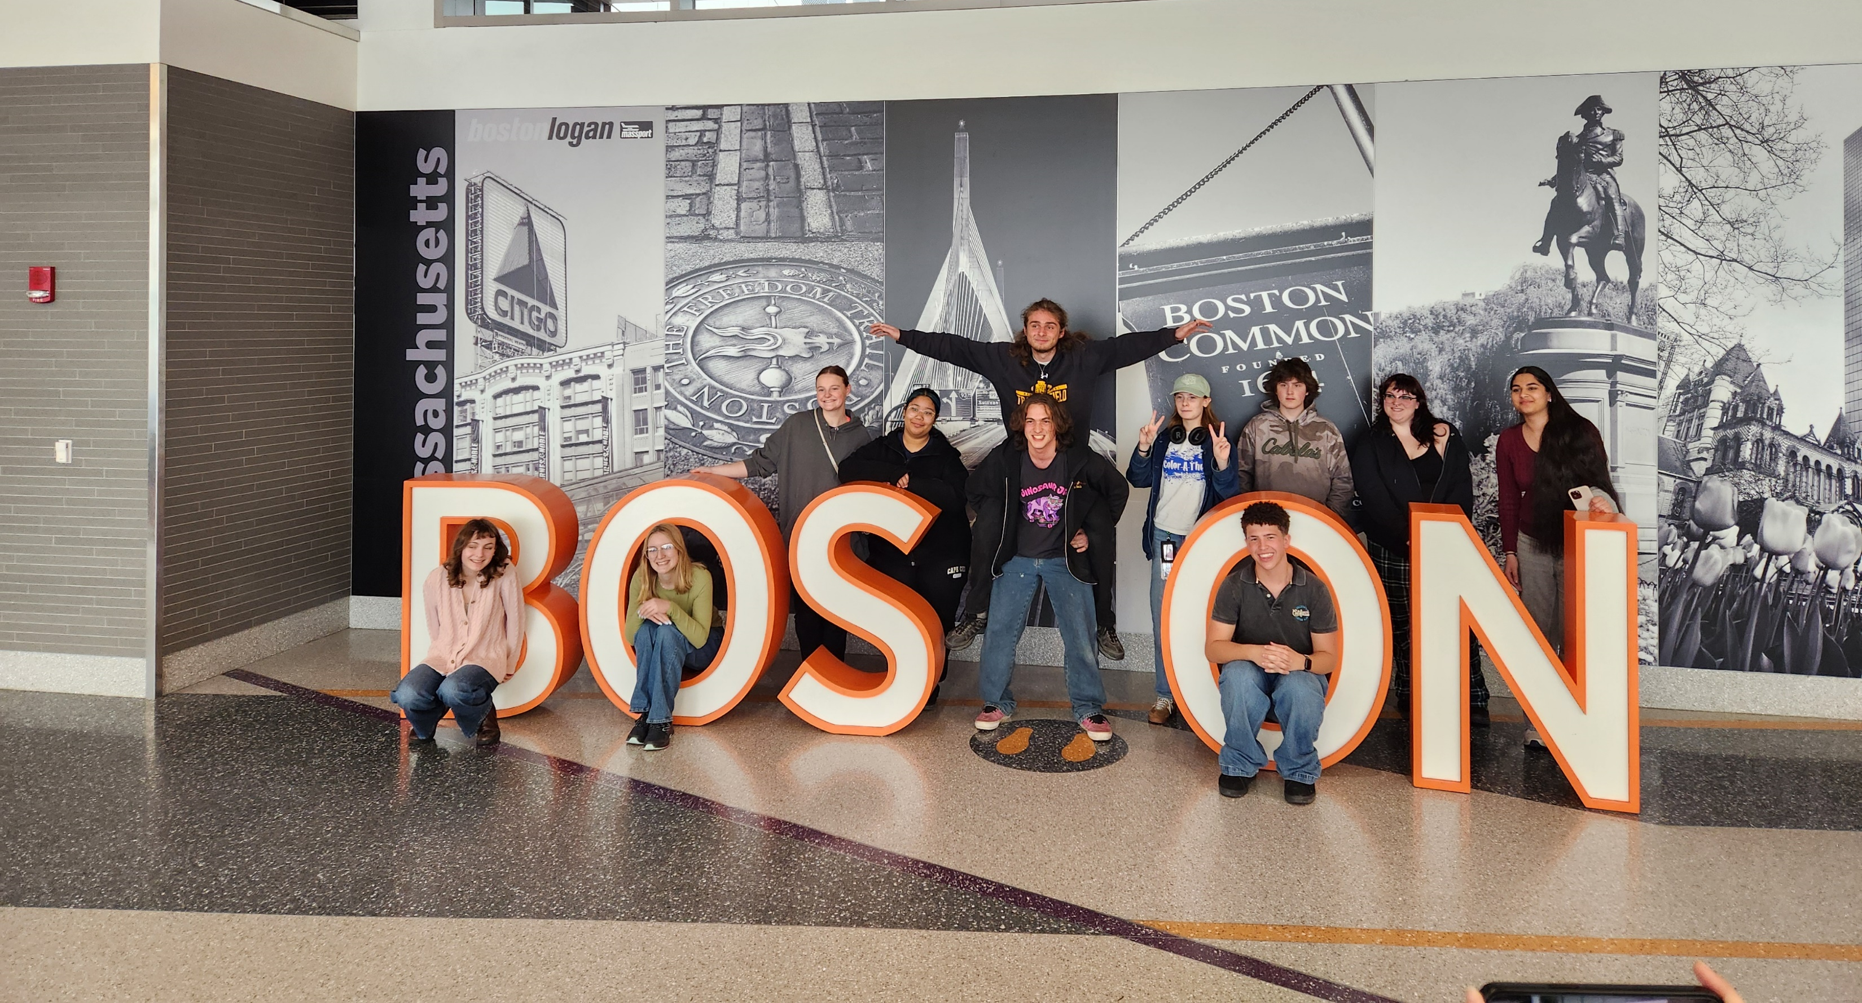
Proposition #1 Budget
Vote on district spending plan
$16,054,977

Slide 8
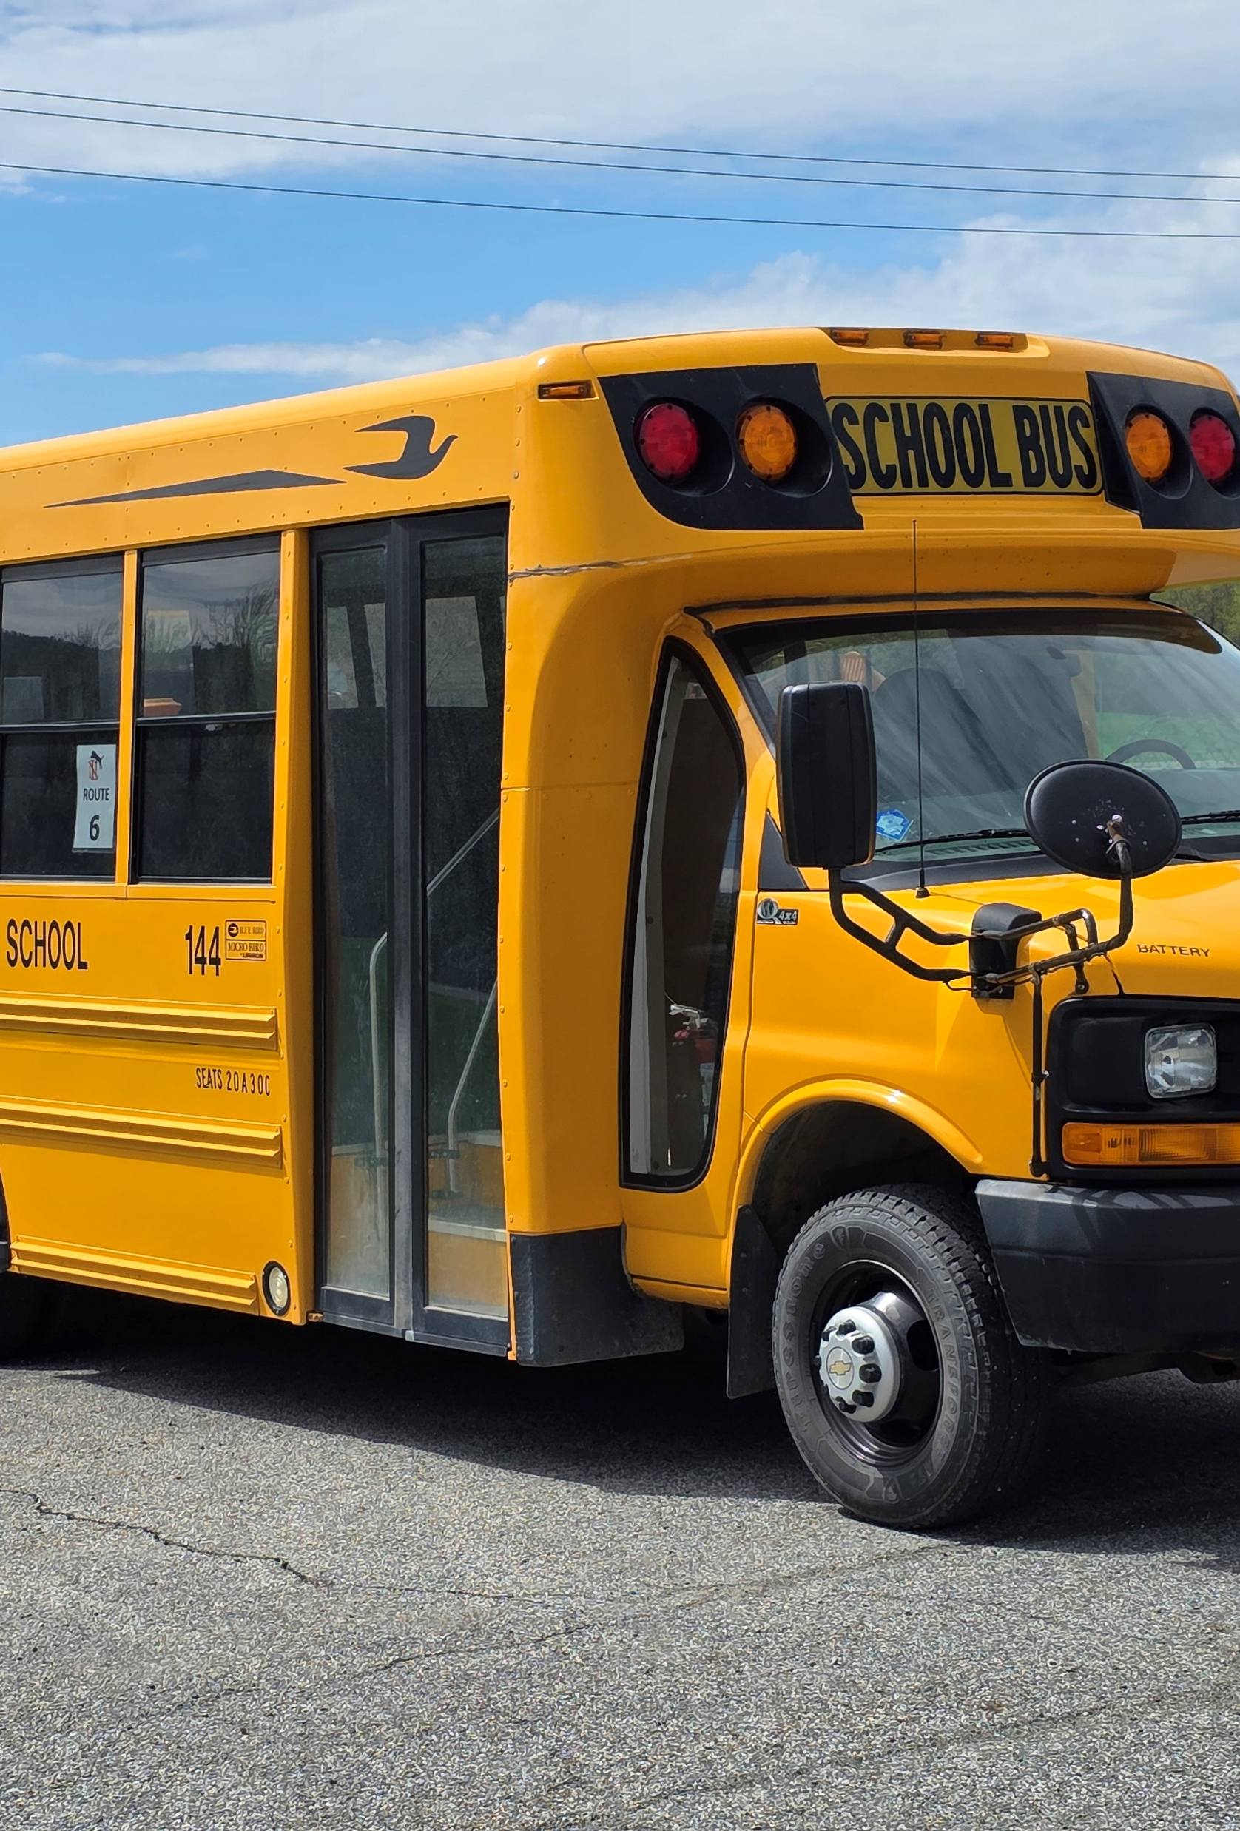
Proposition #2 Bus Purchase
• 66-Passenger Bus — $169,281
• Handicap-Accessible Bus — $135,567
Total Cost: $304,848
✔ No Increase to the School Budget
✔ No Increase to Property Taxes
No new cost. No tax impact.
Part of our planned bus replacement cycle, debt remains level.

Slide 9
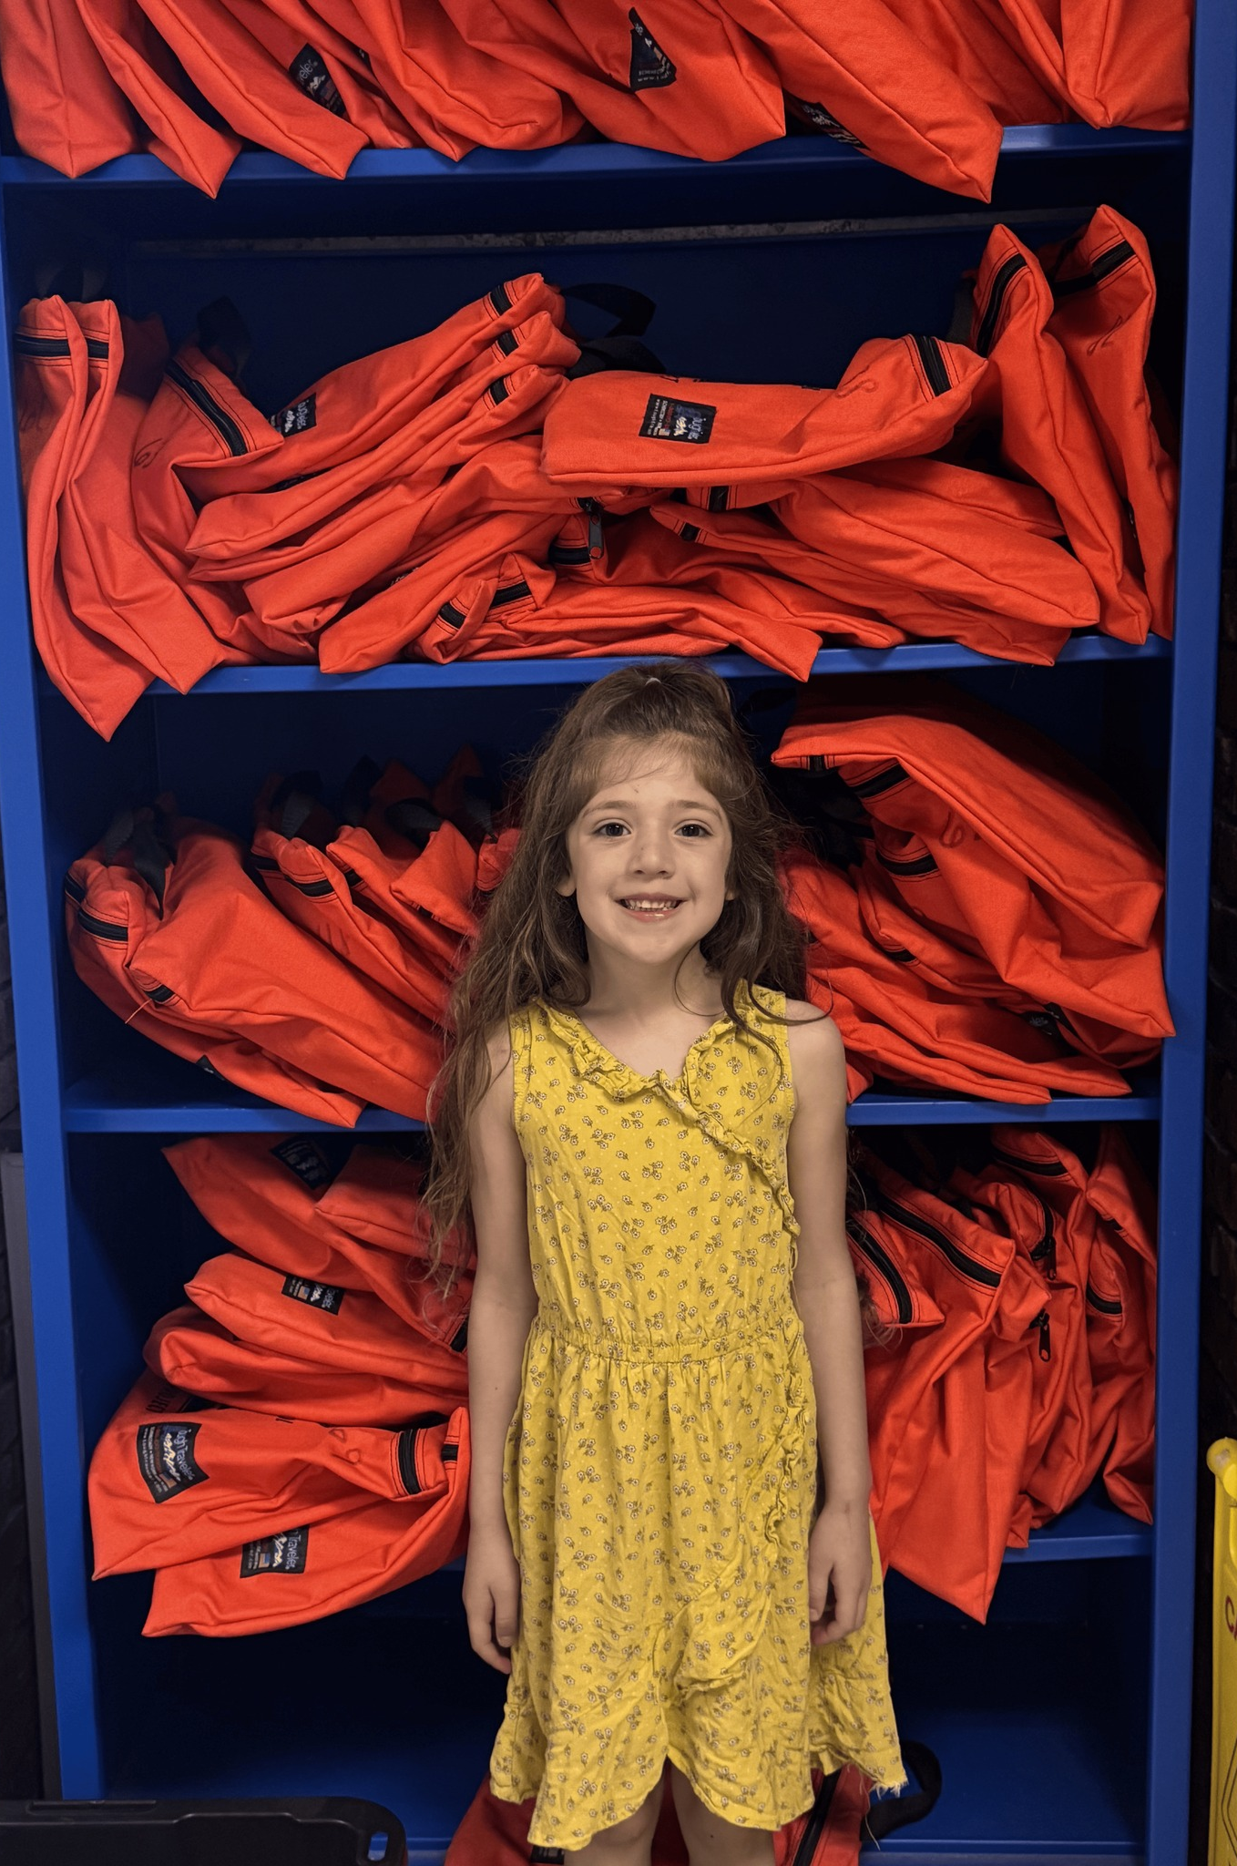
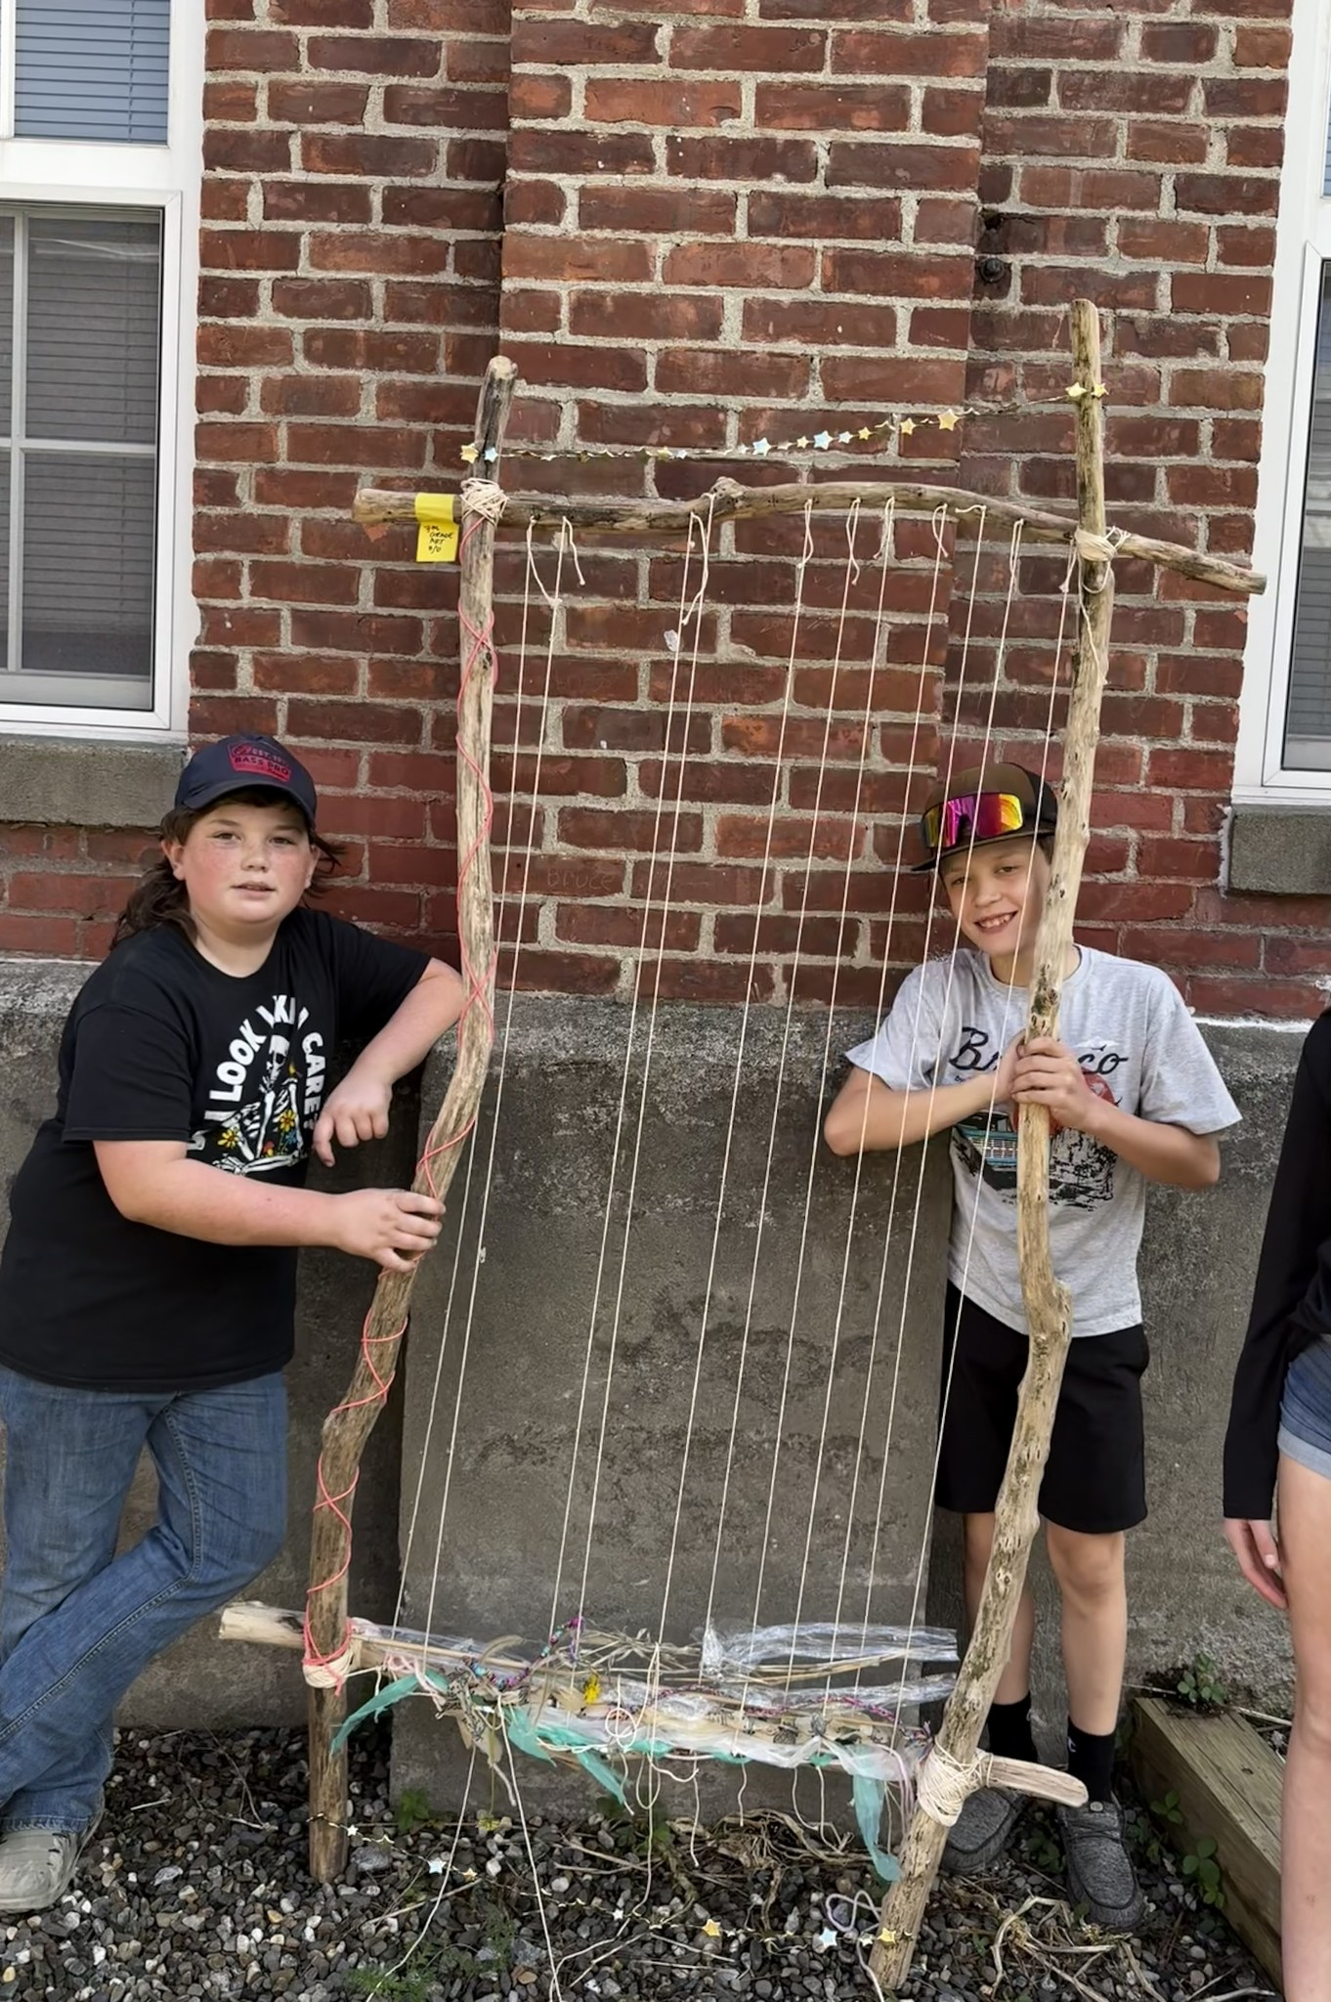
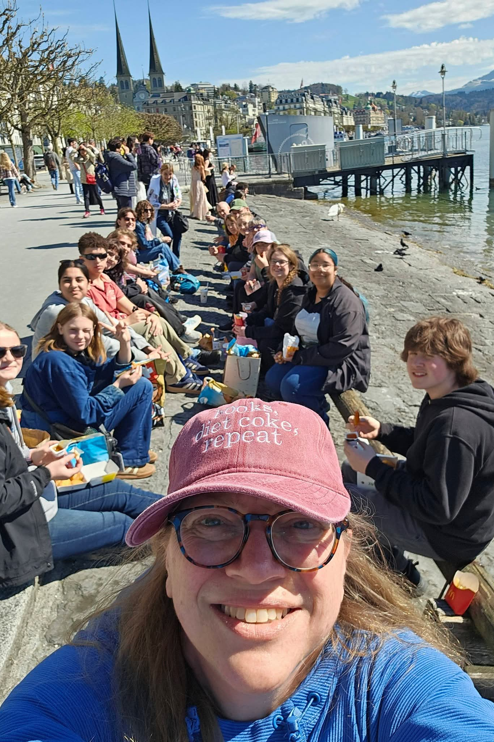
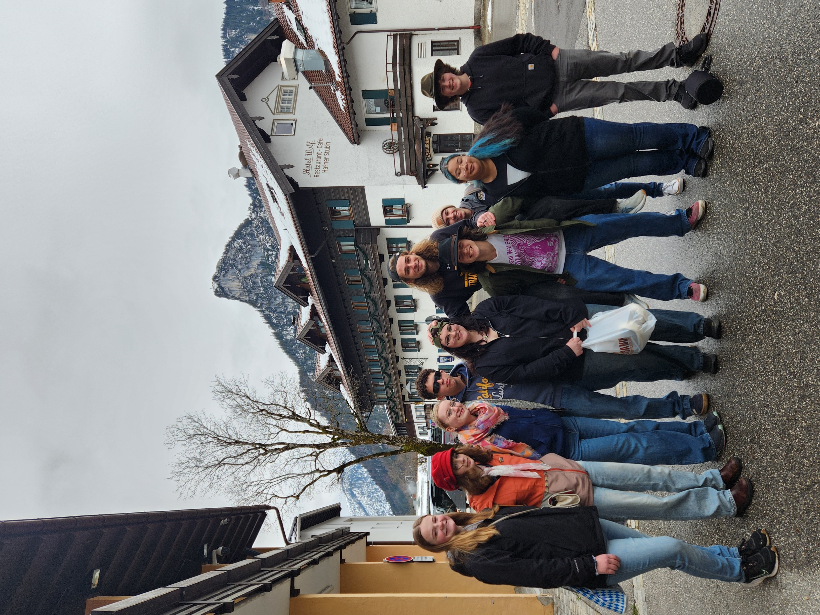
Next Steps:
Budget Vote, May 19,2026

