Slide 1

New Lebanon Central School District
2026-2027 school Budget
Budget Presentation #3
March 11,2026
By, Danielle Brewster and Chris Harper

Slide 2

Budget Goals- 2026-2027
1. New Lebanon CSD will maintain a balanced budget while supporting academic excellence and expanding resources for students and staff.
2. Increase fiscal awareness among all stakeholders through communication and professional development.
3. Stay within the tax cap and meet state mandated requirements.

Slide 3

2026-2027 Budget Calendar
January 14, 2026 - Facilities and Food Service.
February 11, 2026- Instructional Programs and Transportation.
March 11, 2026 - Preliminary Full 26-27 Budget Presentation.
April 1, 2026 - Budget Workshop - If Needed.
April 14, 2026 - Final Discussion and Adoption of 26-27 school year budget.
April 14, 2026 - Special BOE Meeting - Questar III Budget Vote and Election - Time TBD.
May 6, 2026 - Public Hearing on Proposed Budget.
May 19, 2026 - Public Budget Vote and Board of Education Election.

Slide 4
A look back at the 2025-2026 Budget
Budget Summary:
 | 2025-2026
Budget | $15,427,799
State Aid & Non- tax revenue | $4,206,515
Fund Balance | $400,993
ERS Reserve | $37,625
Debt Service | $50,000
Levy Amount | $10,732,666

Slide 5
2026-2027 Tax Cap Calculation:
Prior Year Tax Levy | $10,732,666
x Tax Base Growth Factor | 1.0072
PILOT | 0
- PY Tax Cap exclusion | $504,434
x CPI | 1.02
Total adjusted tax levy | $10,510,523
+ Capital exclusion - Aid | $685,747
= 26-27 Allowable Tax levy | $11,196,270
4.32% allowable increase
$463,604 additional revenue
Capital Exclusion includes 100k capital outlay project

Slide 6

Revenue comparison
 | 2025-2026 Budget | 2026-2027 Projection | Difference
Foundation Aid | $2,643,190 | $2,669,621 | $26,431
Building Aid | $488,093 | $486,945 | -$1,148
Reimbursable Aid | $766,232 | $853,094 | $86,862
Int. & Penalties on Property taxes | $20,000 | $20,000 | $0
Tuition- Out of State | $10,000 | $30,000 | $20,000
Use of Property and Interest and Earnings | $50,000 | $50,000 | $0
Medicaid | $50,000 | $50,000 | $0
Sale of Equipment | $4,000 | $4,000 | $0
Refund Prior year Exp. | $155,000 | $155,000 | $0
Other Unclassified Revenues | $20,000 | $20,000 | $0
Total: | $4,206,515 | $4,338,660 | $132,145

Slide 7
Preliminary Budget Comparison
 | 2025-2026 | 2026-2027 Projection | Change from Last year | % Increase/decrease from last year
General Support | $943,269 | $1,010,740 | $67,671 | 7%
Instructional | $4,765,752 | $4,973,607 | $207,855 | 4%
Operations and Maintenance | $990,077 | $1,141,372 | $151,295 | 15%
Special Education | $1,829,261 | $1,804,569 | -$24,692 | -1%
Co-Curricular and Athletics | $155,400 | $155,400 | $0 | 0%
Information Technology | $187,979 | $261,567 | $73,588 | 39%
Transportation | $841,574 | $889,535 | $47,961 | 6%
Employee Benefits | $4,559,201 | $4,857,762 | $298,561 | 7%
Interfund Transfers | $30,000 | $120,000 | $90,000 | 300%
Debt Service | $1,125,486 | $1,126,448 | $962 | 0%
Total: | $15,427,799 | $16,341,000 | $913,201 | 6%

Slide 8
2026-2027 Preliminary Budget

Slide 9
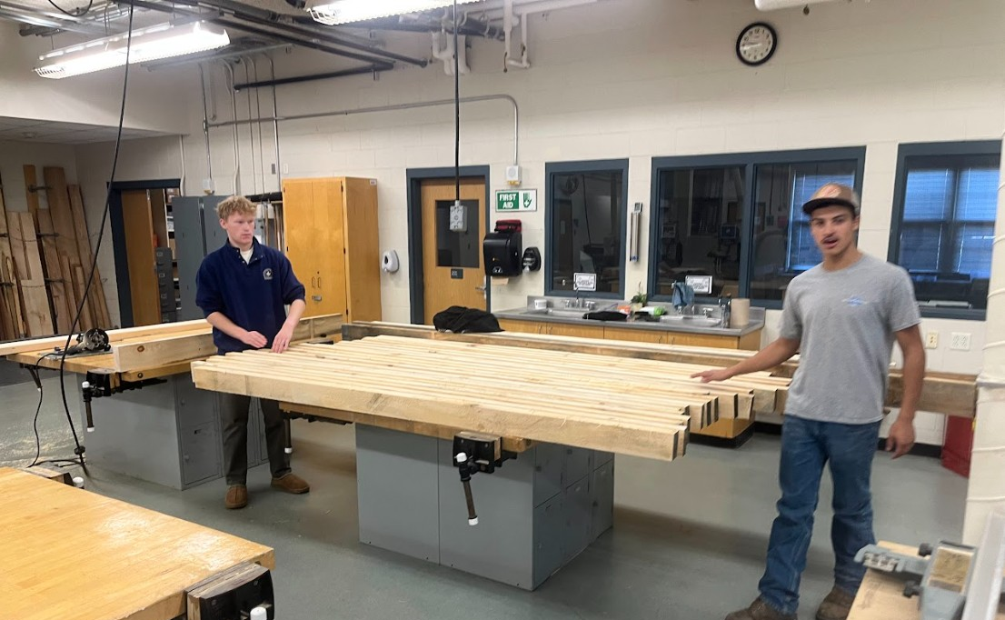
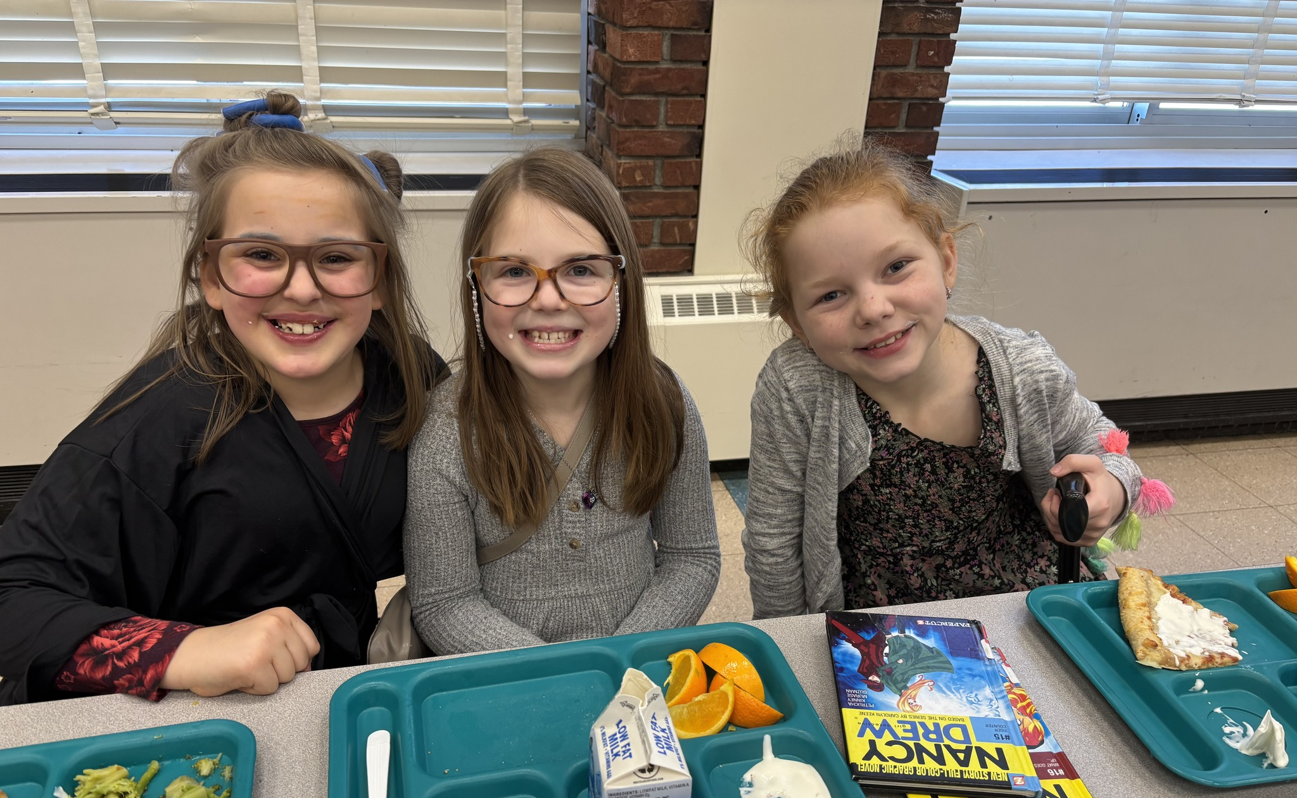
Key Budget Variables Still Pending:
Health Insurance: Budgeted using projected increases of 3% for medical coverage and 16% for prescription coverage; final rates are pending.
CSEA Negotiations: Salary and benefit amounts remain under negotiation and may impact final budget figures.
Property & Liability Insurance: Budgeted with an estimated 8% premium increase based on current projections.
State Aid: Revenue estimates assume a 1% increase in Foundation Aid.

Slide 10
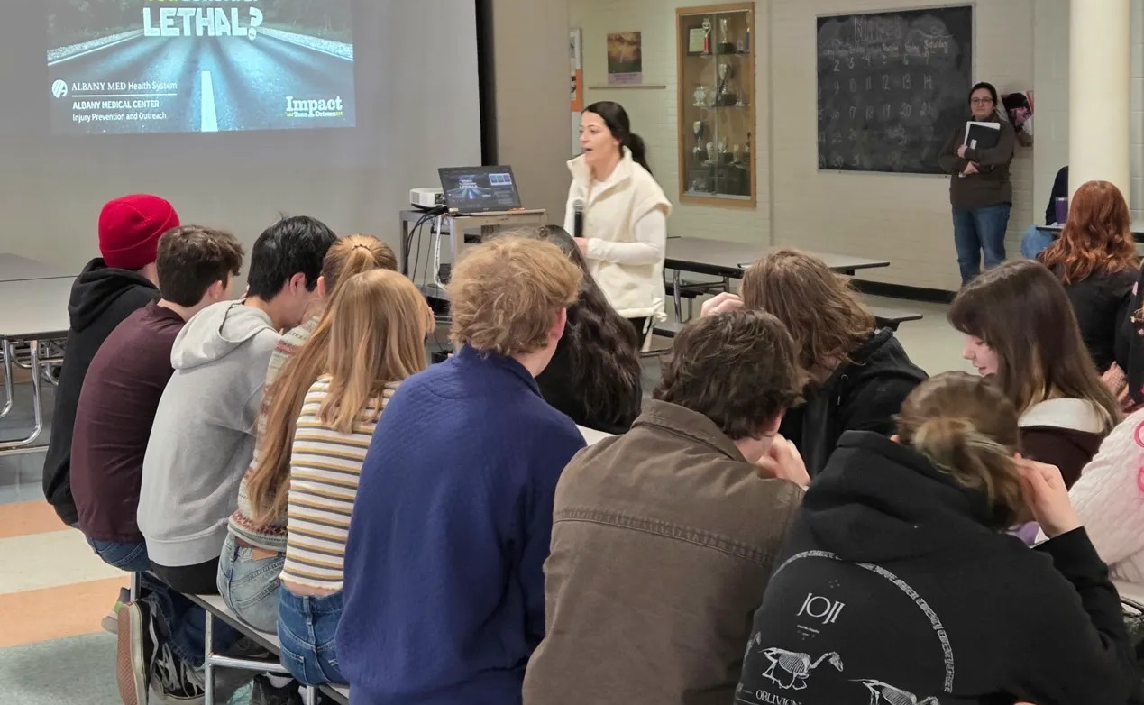
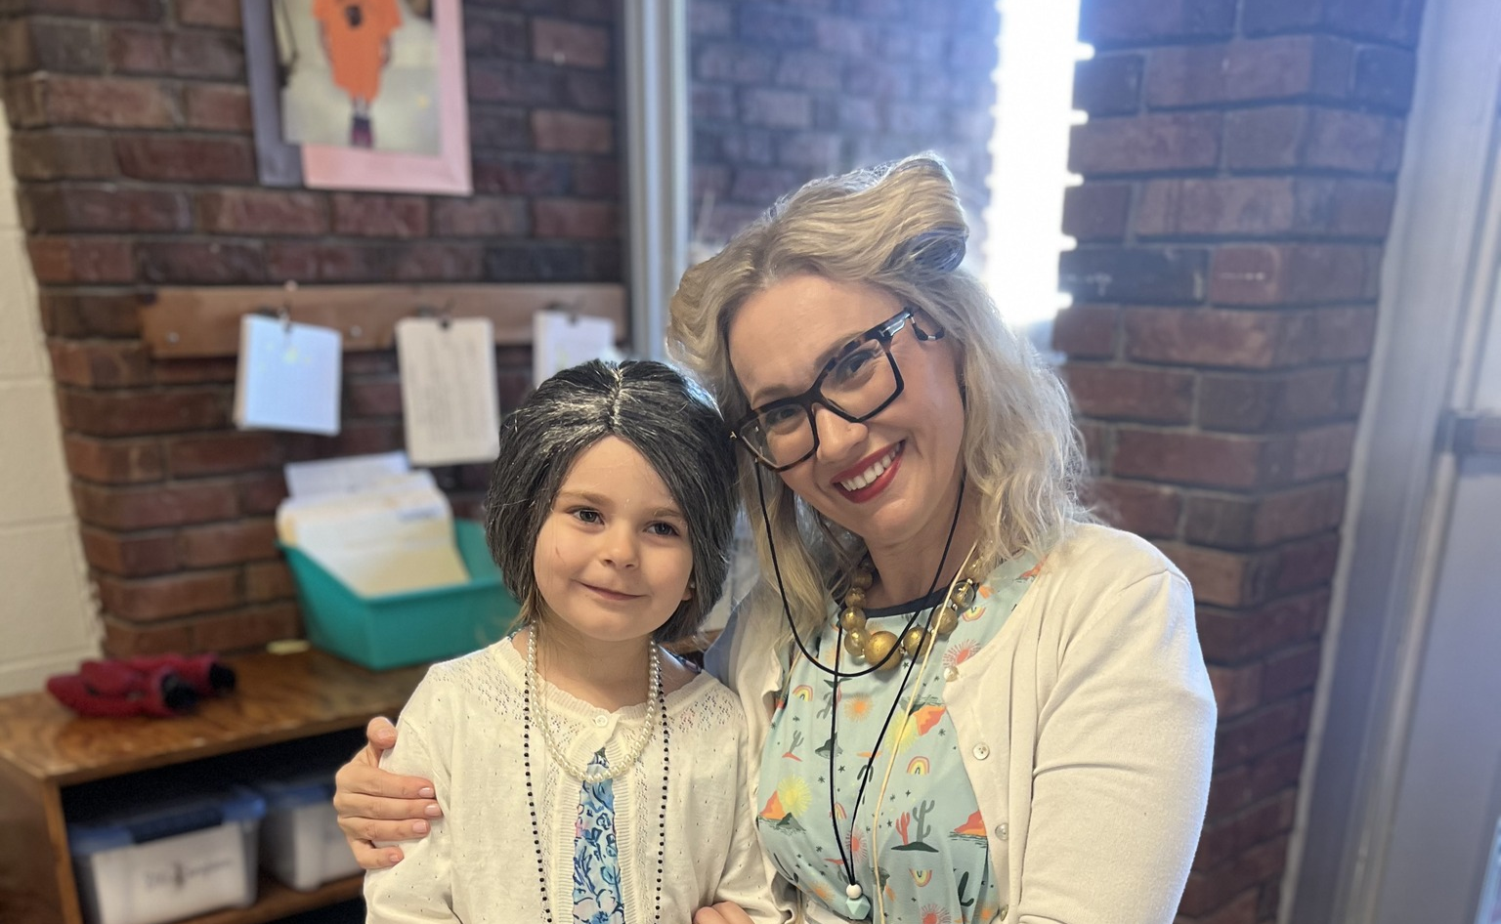
Budget Additions
$70,346 – Full-time Special Education Director (including family health benefits)
$100,000 – Capital Outlay Project
$85,000 – Replacement Truck & Sander for aging vehicle
$104,295 – Teacher Retirement Incentives
$115,000 – Retirees Added to Health Insurance
$60,000 – Computer Replacements due to Windows 10 end-of-support
$16,000 annually (4 years) – Server Replacement Plan for aging infrastructure

Slide 11
Fund Balance Projection 2026-2027
 | Budget | Projection
Revenue | $14,984,997 | $15,098,029
Fund Balance | $400,993 | $0
Reserves/ Debt Service Fund | $87,625 | $0
Expenditures | $15,427,799 | $15,061,103
Excess Revenue over Expenditures | $0 | $0
Unassigned Fund Balance | $596,500 | $650,000
Excess Fund Balance (over 4%) | $0 | Unknown until end of school year
Reduced Special Education out-of-district placement costs.
No current foster care placements impacting tuition costs.
Psychologist positions unfilled for most of the school year, resulting in lower personnel expenditures.
It is recommended to keep 4% of next years projected budget in fund balance which would be about $653,640

Slide 12


Reserves & Debt Service
Reserve | 2025-2026 | Purpose
Capital Reserve | $946,206 | Planned to use for upcoming Capital project
Workers Comp Reserve | $112,717 | To limit a large cost spike due to a significant claim
Unemployment Reserve | $82,902 | To protect district from a significant number of unemployment claims
ERS Reserve | $324,895 | To protect the district from increased employer contribution rates.
Tax Cert Reserve | $33,488 | To protect the district against payments arising from court judgements to reduce school tax assessments on property within districts boundaries.
Employee Benefits Reserve | $128.571 | Protects district from a large single year payout.
Reserve Total: | $1,628,778
Debt Service | $365,180 | Can be used to put towards debt payments
Total Debt Service & Reserves | $1,993,958

Slide 13

Budget Gap of $1,269,674 without a tax increase
 | 2026-2027
Budget | $16,341,000
Revenue | $4,338,660
Tax Levy | ?
Fund Balance | ?
Reserves/Debt Service | ?
Options to Balance Budget:
Tax Levy
Fund balance
Reserves
Debt Service fund
Reductions

Slide 14
Example using 4.32% Max Tax Levy increase:
4.32% tax levy increase
$400k Fund balance
$85k Debt service fund
This would leave a $321,023 budget gap:
Pending variables:
Health insurance rates
CSEA negotiations
State Aid projections
 | 2026-2027
Budget | $16,341,000
Revenue | $4,338,660
Tax Levy | $11,196,317
Fund Balance | $400,000
Reserves/Debt Service | $85,000

Slide 15
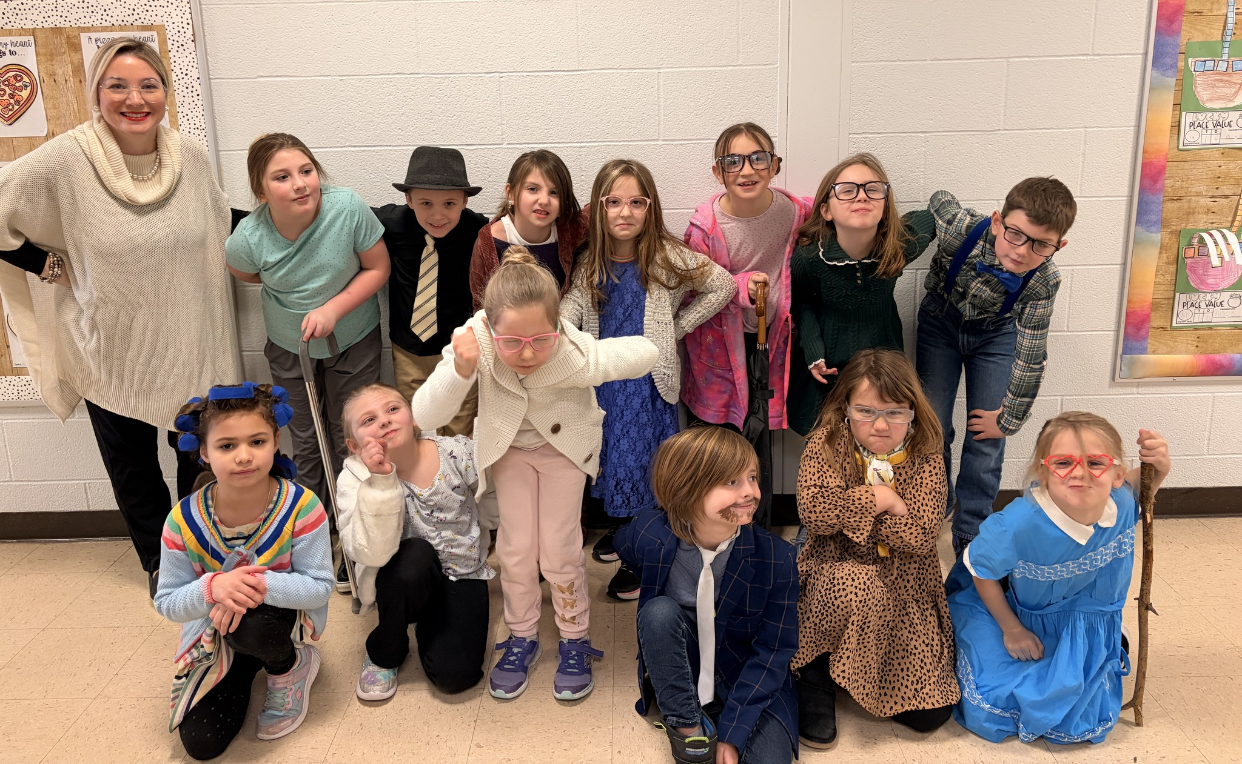
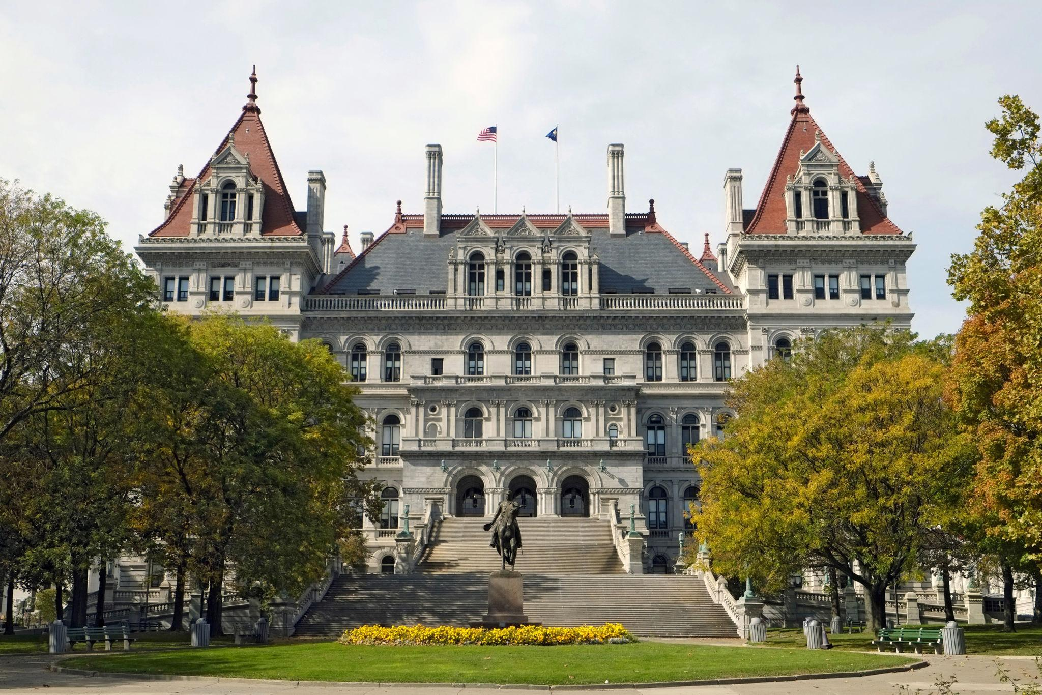
Next Steps:
Would the Board like to schedule a Budget Workshop for April 1st?
The Final Enacted State Budget is expected to be adopted by April 1st.
Final health insurance rates are expected by March 27th.
CSEA negotiations are expected to be closer to finalization.

