Slide 1

New Lebanon Central School District
2026-2027 school Budget
Budget Presentation #1
January 14, 2026
By, Danielle Brewster and Chris Harper

Slide 2

Budget Goals- 2026-2027
1. New Lebanon CSD will maintain a balanced budget while supporting academic excellence and expanding resources for students and staff.
2. Increase fiscal awareness among all stakeholders through communication and professional development.
3. Stay within the tax cap and meet state mandated requirements.

Slide 3
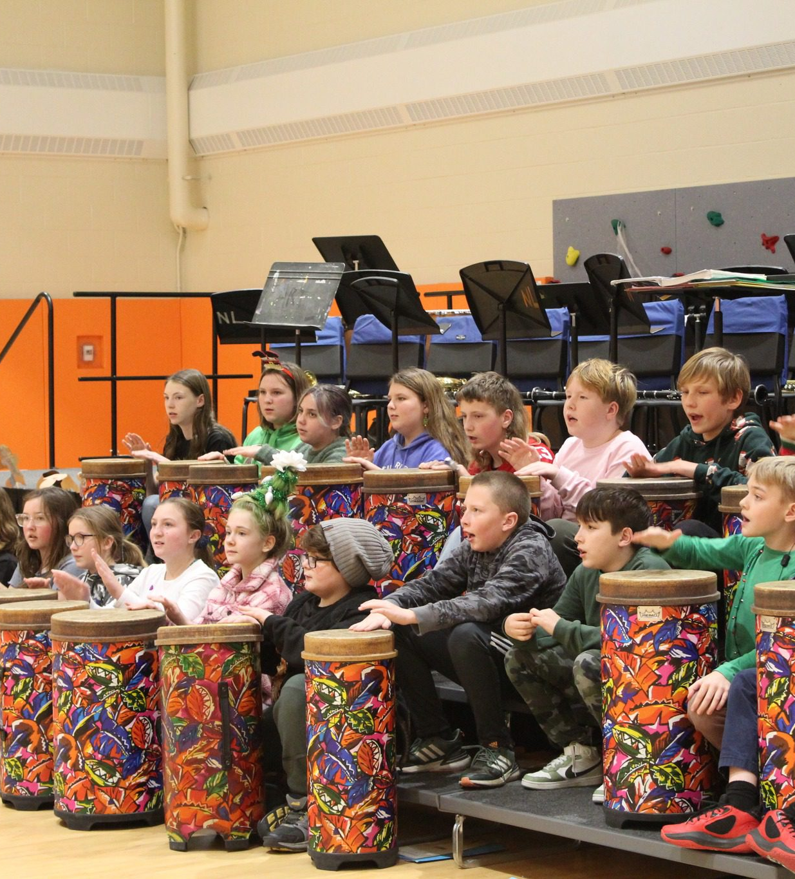
2026-2027 Budget Calendar
January 14, 2026 - Facilities and Food Service.
February 11, 2026- Instructional Programs and Transportation.
March 11, 2026 - Preliminary Full 25-26 Budget Presentation.
April 1, 2026 - Budget Workshop - If Needed.
April 14, 2026 - Final Discussion and Adoption of 25-26 school year budget.
April 14, 2026 - Special BOE Meeting - Questar III Budget Vote and Election - Time TBD.
May 6, 2026 - Public Hearing on Proposed Budget.
May 19, 2026 - Public Budget Vote and Board of Education Election.

Slide 4
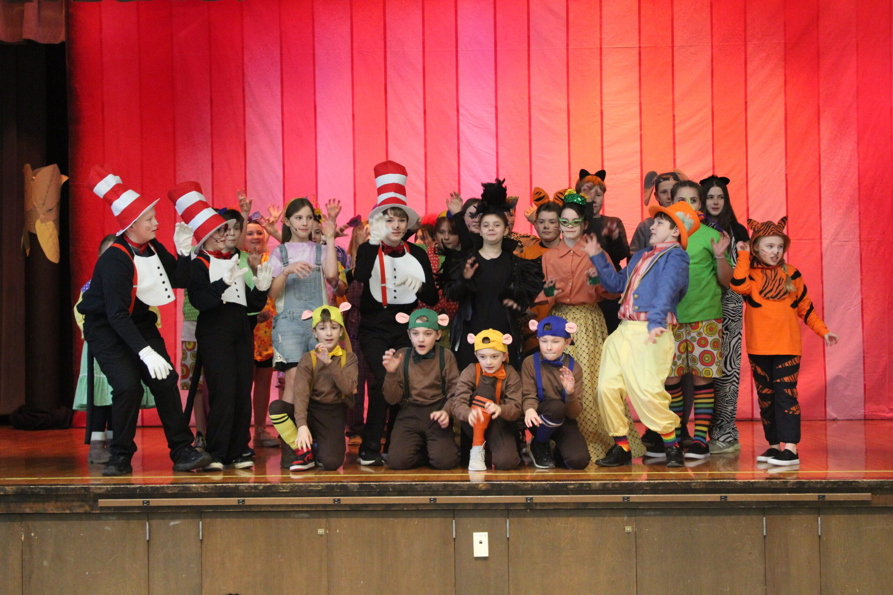
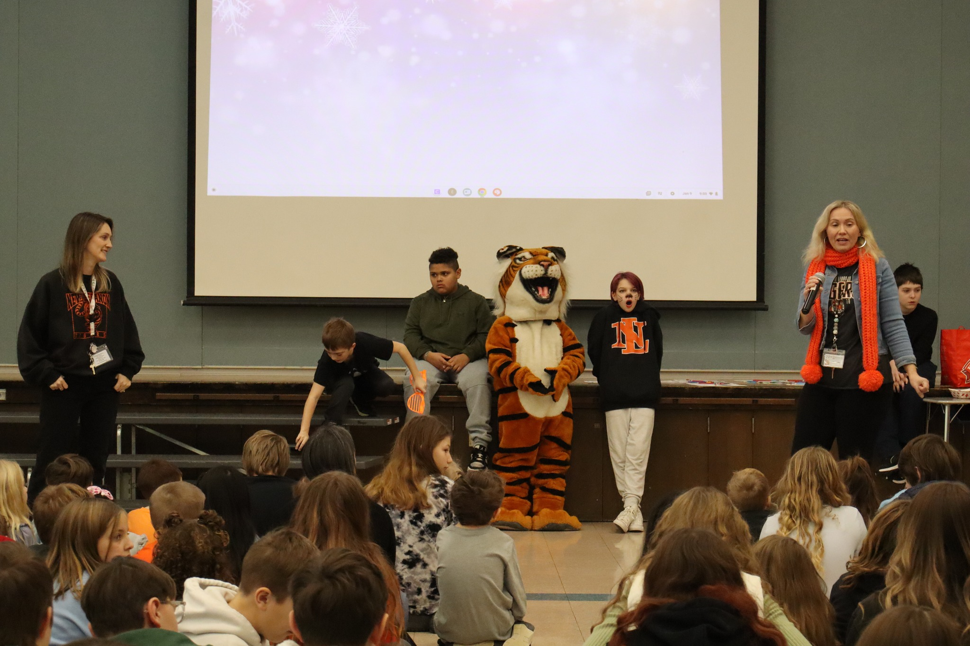

Slide 5
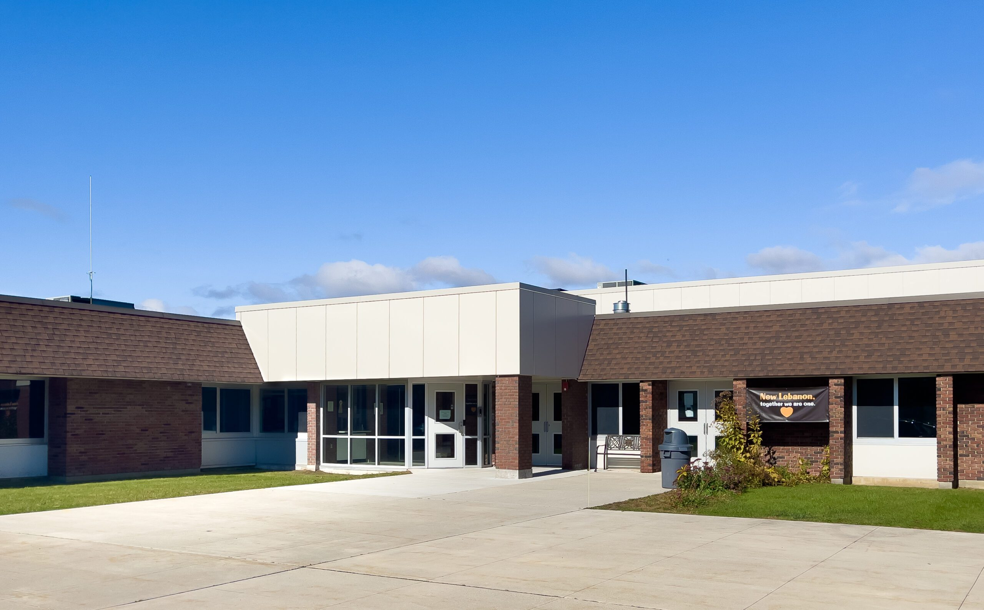
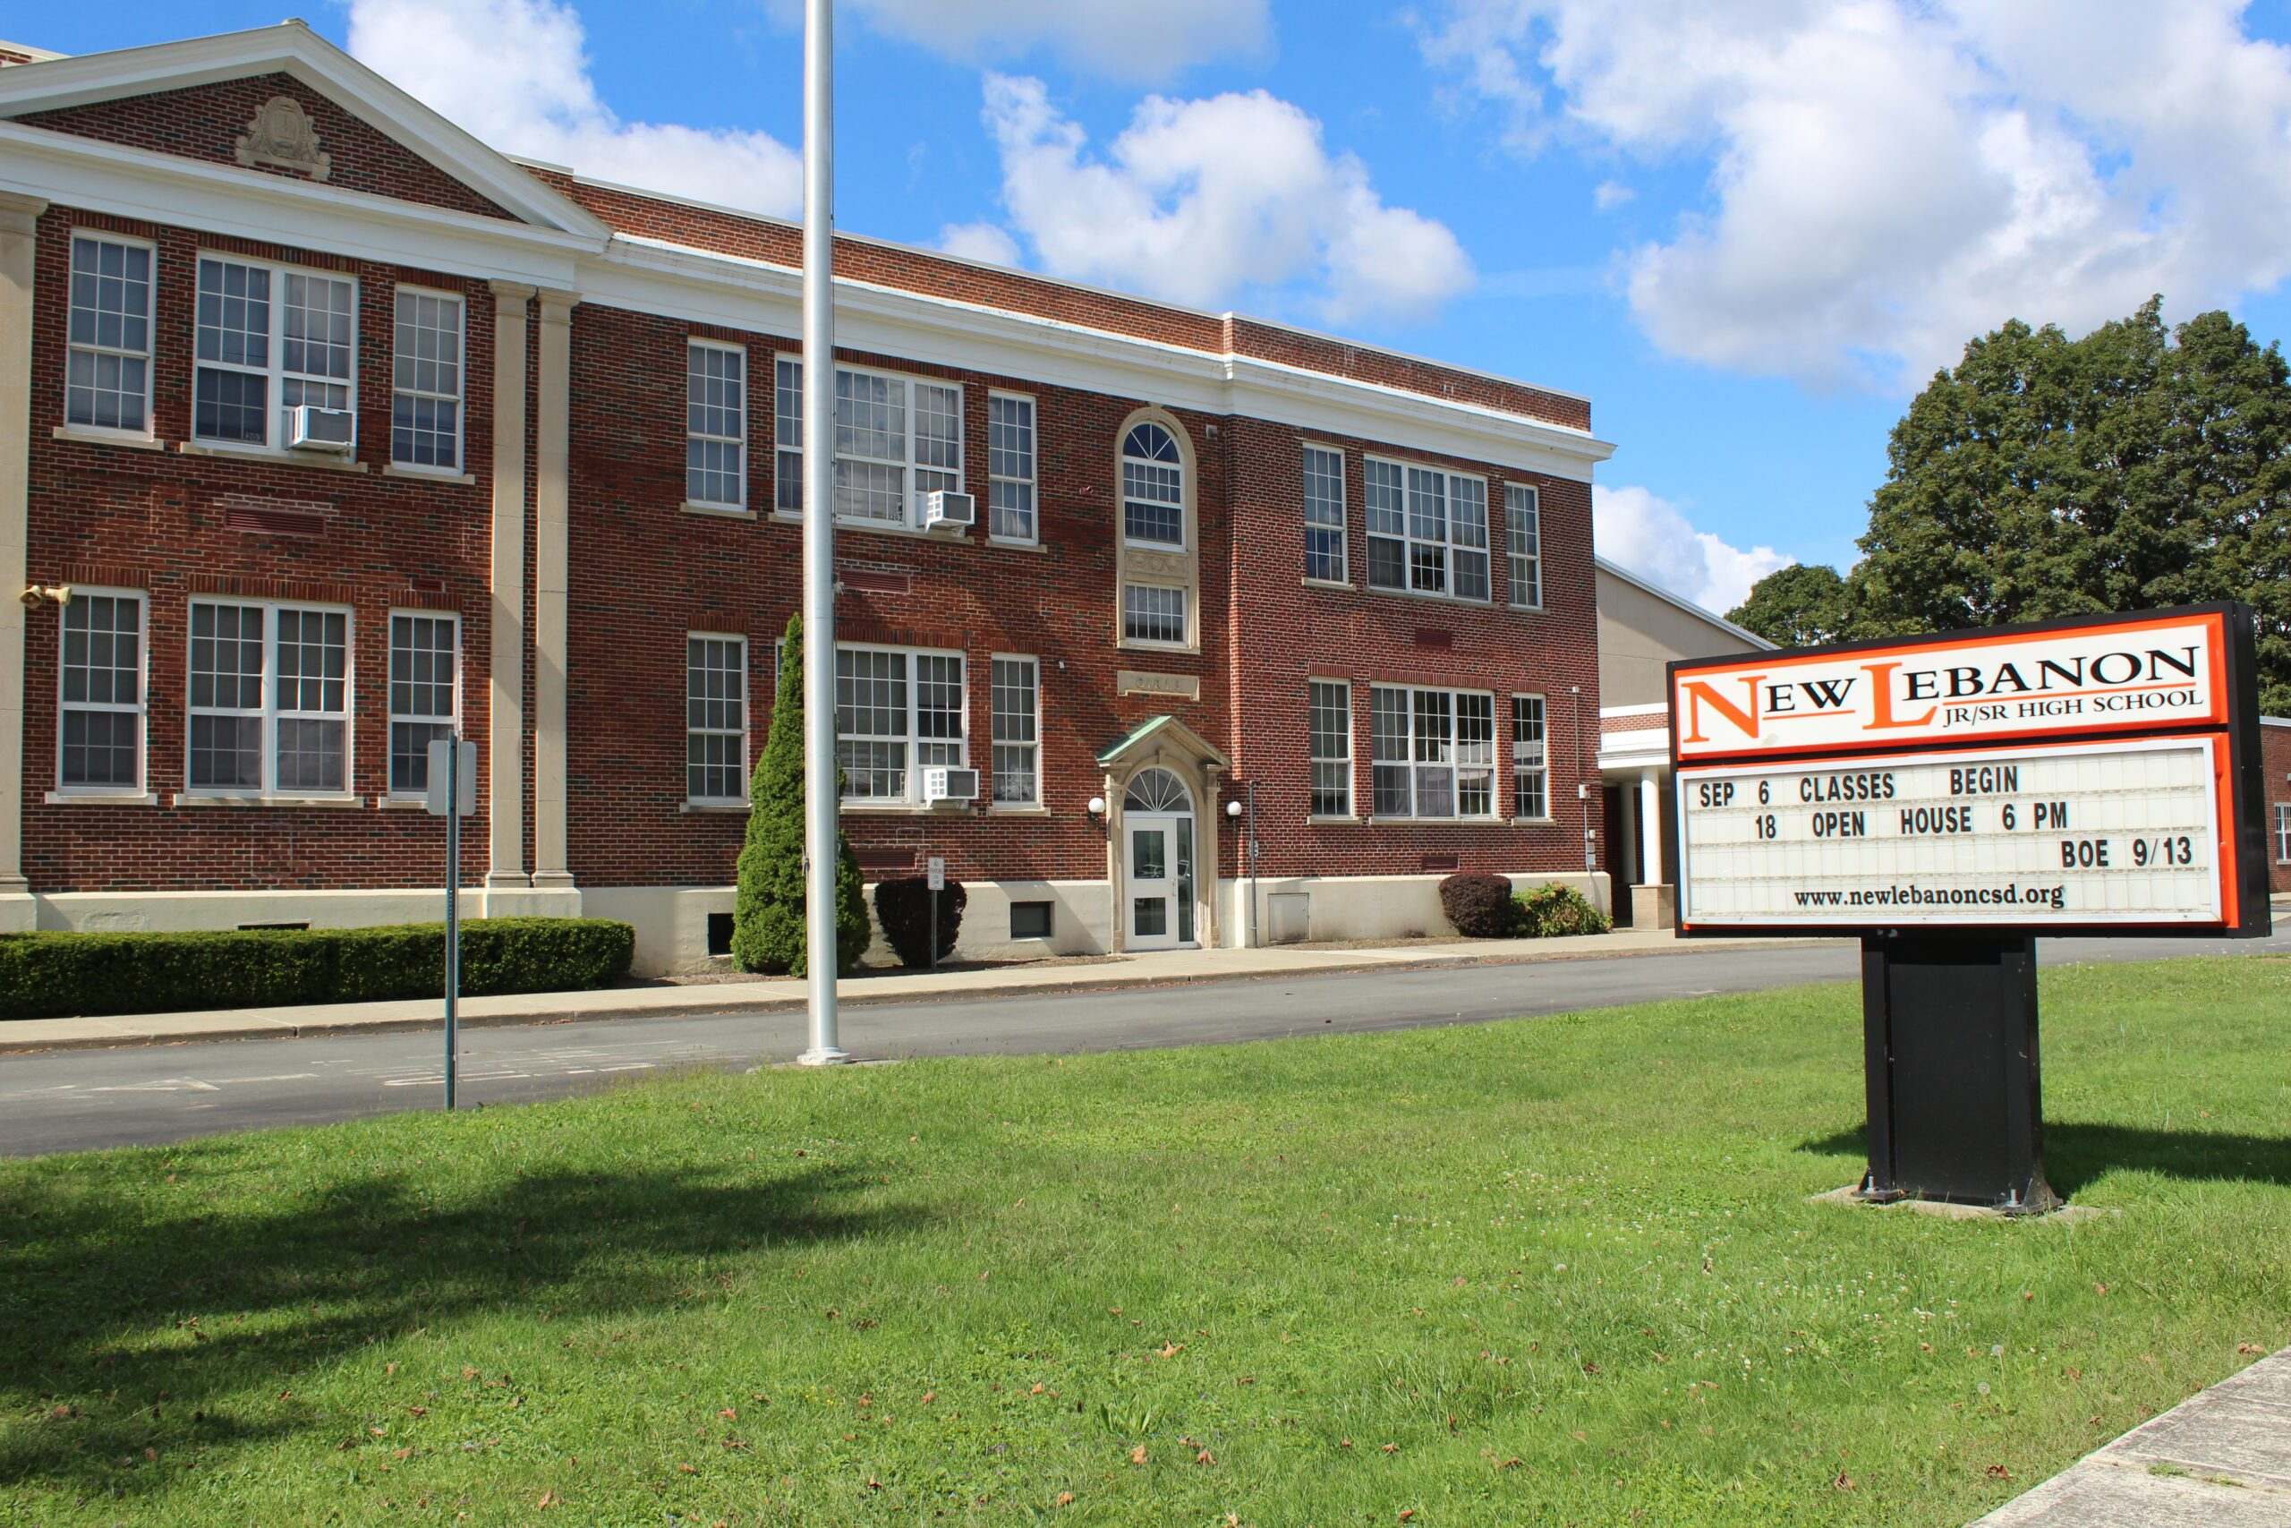
Operations and Maintenance
1 - Head Maintenance Worker -Jr/Sr. High School.
1 - Maintenance worker – WBH.
5 - Laborers - 2 at Jr./Sr. Highschool, 3 at WBH ( 2 part time until October 2026)
1 - (12) month cleaner- WBH.

Slide 6
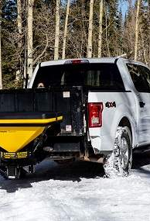
Replacements needed:
2026-2027: Truck with Plow & Sander -estimated cost: $80,000
Replacing 2012 truck, 72,244 miles
2027-2028: Zero Turn Mower for WBH- estimated cost: $20,000
Replacing 2010 mower
2028-2029: Small Compact Tractor for HS/MS- estimated cost $27,000
Replacing 2013 tractor
2029-2030: Loader Tractor for WBH- estimated cost: $70,000
- Replacing 2014 tractor

Slide 7
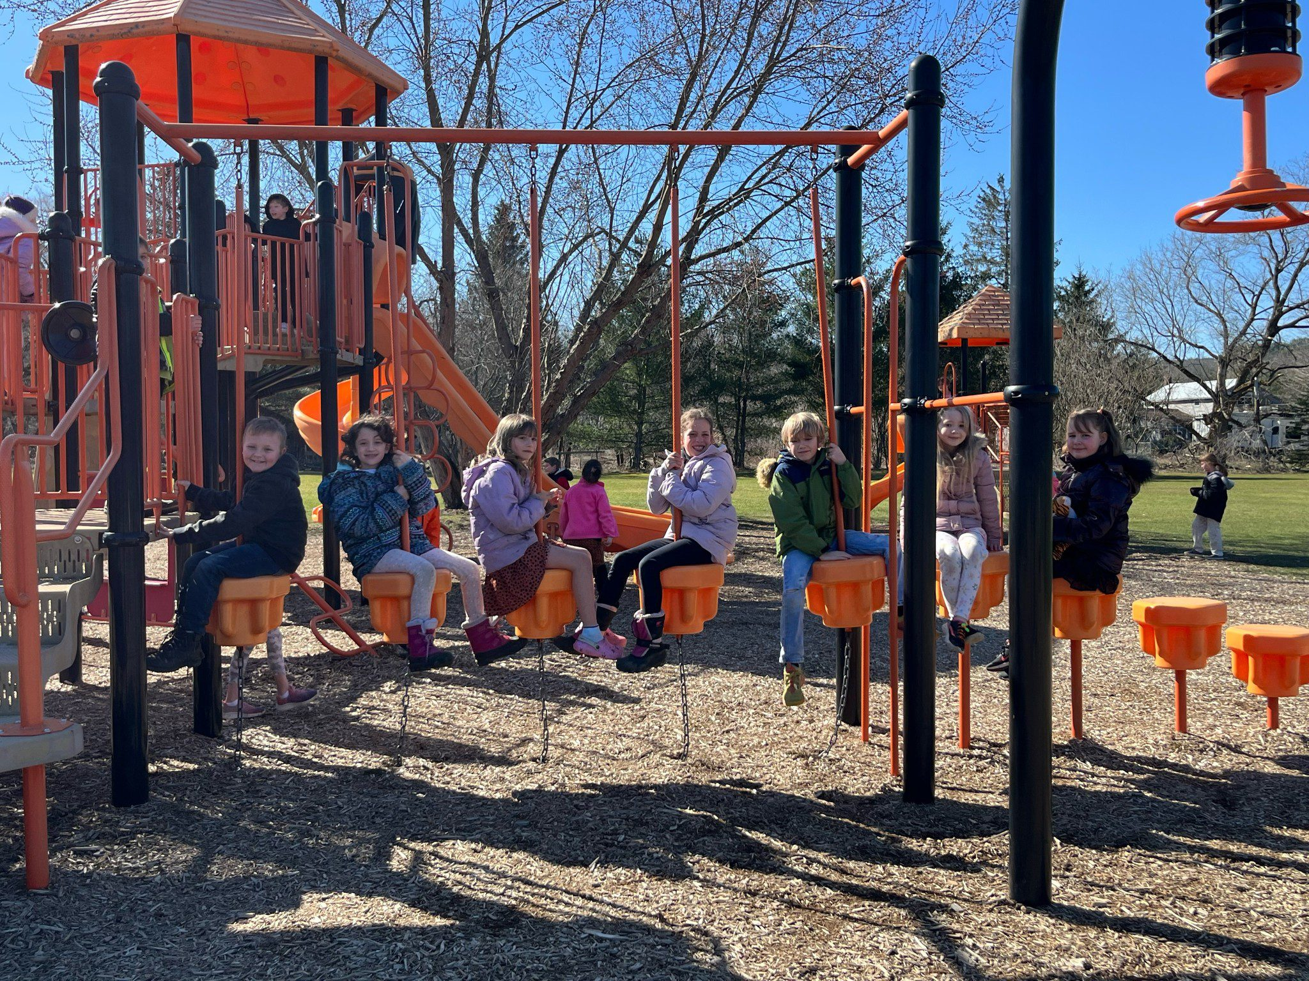
$100k Capital outlay project
Why a $100k project?
What it is: An annual capital outlay project of up to $100,000 for eligible building and grounds improvements. State Aid Impact: The District receives Building Aid at a 45% ratio, resulting in approximately $45,000 in additional State Aid in the following year. Facilities Benefit: Supports ongoing maintenance and infrastructure needs, helping preserve building conditions and reduce the risk of higher future repair costs.
History of the last 5 years:
2023-2024 Project- Refinished gym floor & purchased stage curtain for Jr/Sr Hs.
2024-2025 Project- Not funded
2025-2026 Project- Not funded
2026-2027 Project- ?

Slide 8
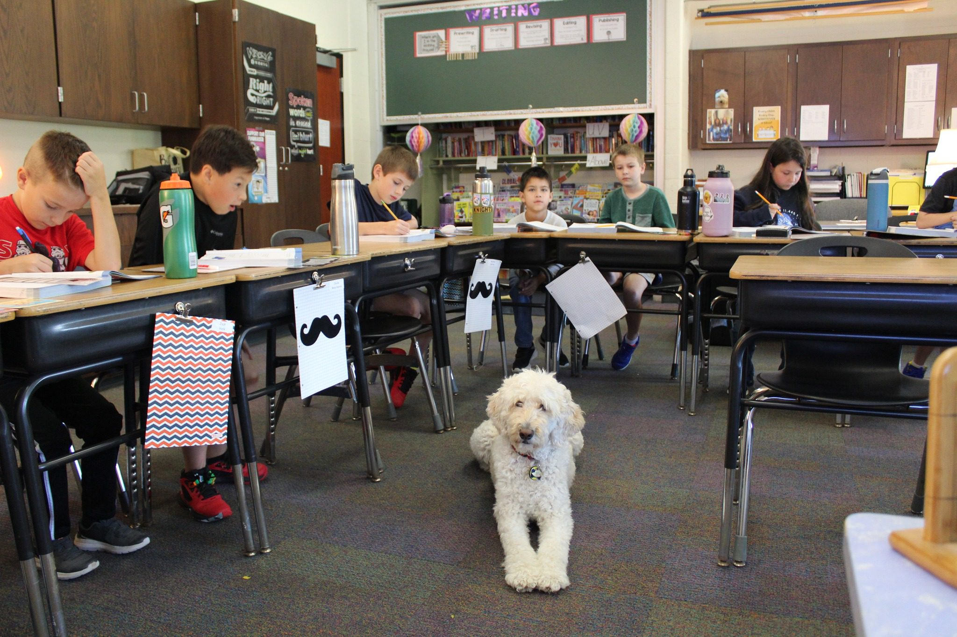
Preliminary O&M Budget Estimate
 | 2025-2026 | 2026-2027 Estimate | Difference
Equipment & Supplies | $96,500 | $176,500 | $80,000
Contractual | $189,500 | $200,000 | $11,000
Electric | $120,000 | $125,000 | $5,000
Fuel/Propane | $130,000 | $140,000 | $10,000
BOCES | $50,000 | $51,500 | $1,500
Salaries & Benefits | $550,077 | $585,077 | $35,000
Total: | $1,136,077 | $1,293,000 | $142,500

Slide 9
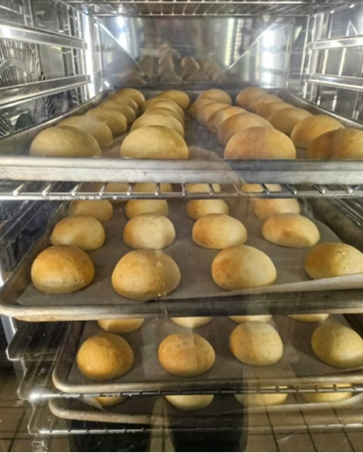
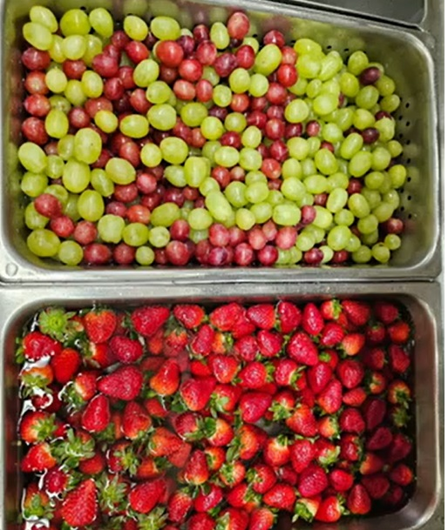


Food Service Program
Food Service Manager
5- (10) month cook/server cashiers
1 employee - 7.5 hrs. per day
1 employee 4.75 hours per day
2 employees - 4 hours per day
1 employee 4 hours per day

Slide 10
Breakfast & Lunch Participation Rates
2023–2024 school year, the district adopted the Community Eligibility Provision (CEP), a federal program that allows schools to provide free breakfast and lunch to all students at no cost to families.
Due to increased participation rates, the Food Service Program became self-sustaining in 2023–2024, generating a surplus and no longer requiring a transfer from the General Fund.

Slide 11
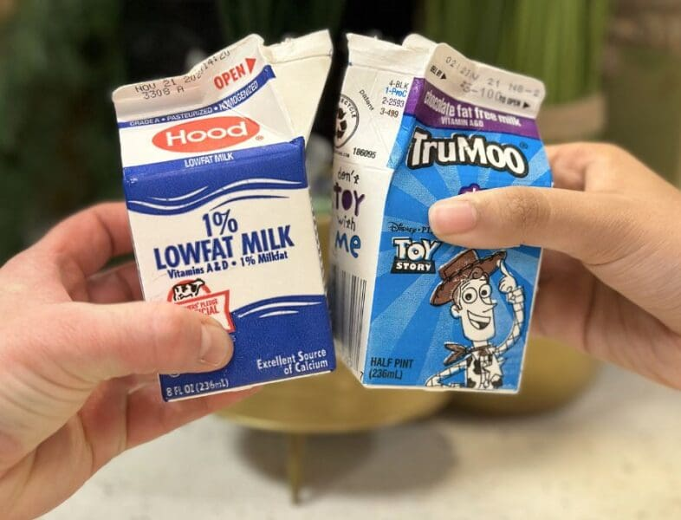
Preliminary Cafeteria Budget Estimate:
 | 2025-2026 | 2026-2027 Estimate | Difference
Food | $100,000 | $110,000 | $10,000
Supplies | $10,000 | $10,000 | $0
Salaries & Benefits | $220,000 | $240,000 | $20,000
Total: | $330,000 | $360,000 | $30,000

Slide 12

Questions

