Slide 1

New Lebanon Central School District
2025-2026 school Budget
Budget Hearing
May 7,2025

Slide 2
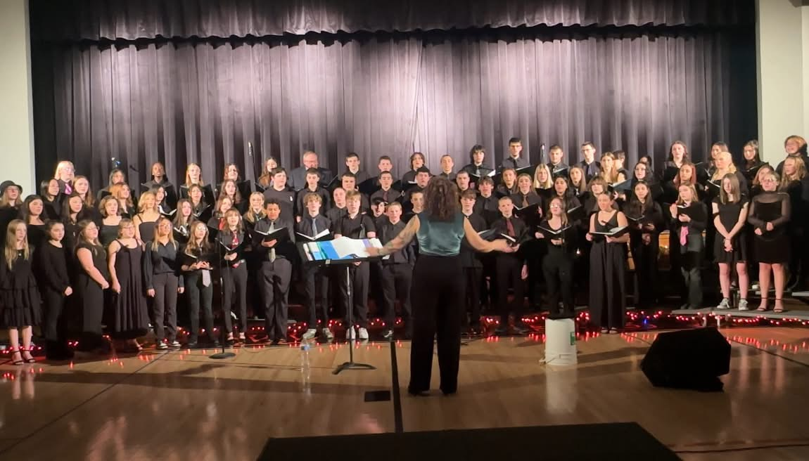
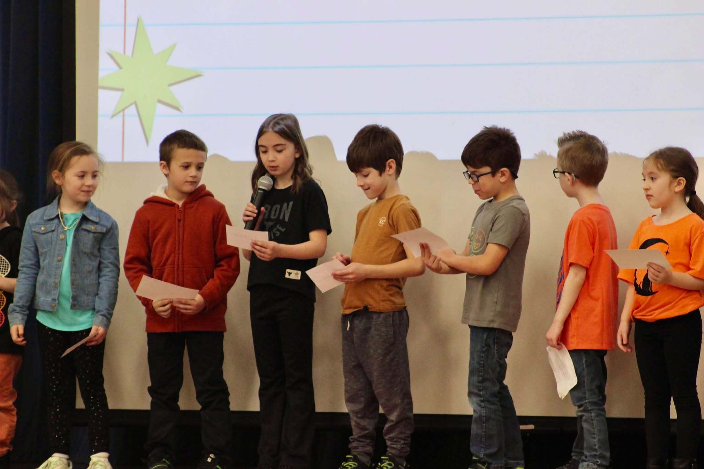
Budget Goals- 2025-2026
1. New Lebanon CSD will maintain a balanced budget while supporting academic excellence and expanding resources for students and staff.
2. Increase fiscal awareness among all stakeholders through communication and professional development.
3. Stay within the tax cap and meet state mandated requirements.

Slide 3
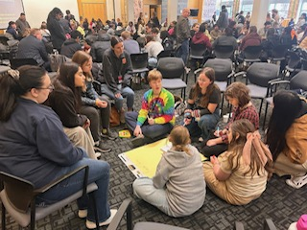
2025-2026 Budget Calendar
January 8, 2025 - Facilities and Food Service.
February 5, 2025- Instructional Programs and Transportation.
March 5, 2025 - Preliminary Full 25-26 Budget Presentation.
April 2, 2025 - Budget Workshop
April 22, 2025 - Final Discussion and Adoption of 25-26 school year budget & Questar III Budget Vote and Election.
May 7, 2025 - Public Hearing on Proposed Budget.
May 20, 2025 - Public Budget Vote and Board of Education Election.

Slide 4
2025-2026 Proposed Budget Breakdown
 | 2024-2025 | 2025-2026 | Change
Special Education | $1,384,321 | $1,886,218 | $501,897
Employee Benefits | $4,329,882 | $4,712,337 | $382,455
Instruction | $4,901,426 | $5,095,454 | $194,028
Transportation | $761,629 | $841,574 | $79,945
Operations and Maintenance | $926,943 | $990,077 | $63,134
General Support | $884,877 | $943,069 | $58,192
Co-Curricular and Athletics | $155,400 | $155,400 | $0
Debt Service | $1,127,015 | $1,125,486 | -$1,529
Information Technology | $195,581 | $187,979 | -$7,602
Interfund Transfers | $40,000 | $30,000 | -$10,000
Total Expenditures | $14,707,074 | $15,967,594 | $1,260,520

Slide 5
Mandated Special Education additions:
Increase in out-of-district placements.
Addition of one self-contained classroom. (includes one special education teacher and two aides)
Hiring of one additional special education teacher.
Expansion of mandated related services, including physical therapy (PT), occupational therapy (OT), speech therapy, ENL and interpreter services.
+$501,897

Slide 6
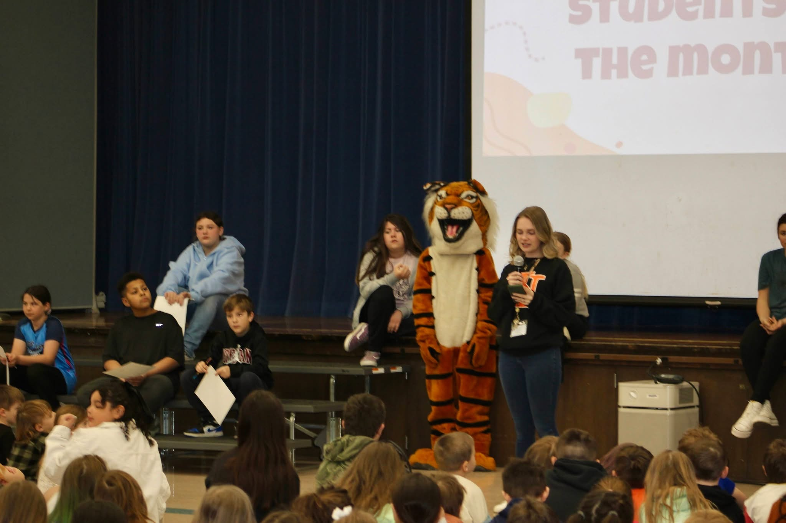
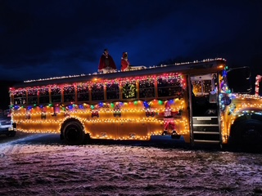
Other significant cost increases:
Employee/Retiree Benefits +$382,455
18% increase in casualty property insurance +$36,000
Budgeting for a shared Resource officer +$55,000
Contractual salary Increases ( including Special education) +$311,712

Slide 7
2025-2026 Tax Cap Calculation:
Prior Year Tax Levy | $9,846,483
x Tax Base Growth Factor | 1.0072
PILOT | 0
- PY Tax Cap exclusion | $267,133
x CPI | 1.02
Total adjusted tax levy | $9,843,250
+ Capital exclusion - Aid | $504,434
= 25-26 Allowable Tax levy | $10,347,684
5.09% allowable increase
+$504,434
Capital Exclusion includes use of Reserves and Debt service

Slide 8
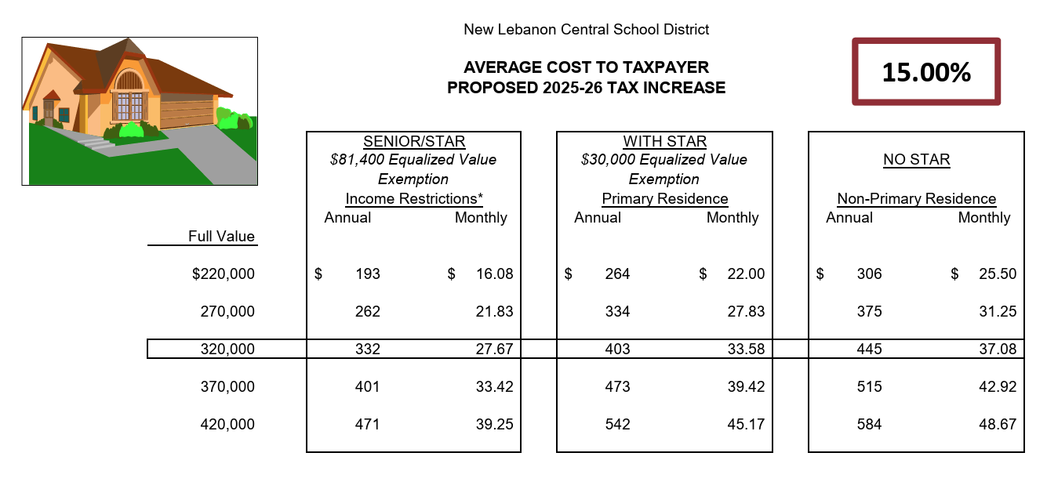
Estimated Impact of Tax Levy Increase

Slide 9

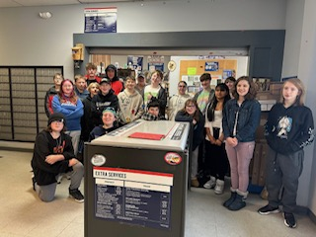
Revenue Summary
 | 2024-2025 | 2025-2026 | Change
Non Tax Revnue | $258,000 | $309,000 | $51,000
State Aid | $3,880,675 | $3,897,515 | $16,840
Tax Levy | $9,846,484 | $11,323,454 | $1,476,970
Fund Balance | $404,915 | $350,000 | -$54,915
ERS Reserve | $157,000 | $37,625 | -$119,375
Debt Service Fund | $160,000 | $50,000 | -$110,000
Total Budget | $14,707,074 | $15,967,594 | $1,260,520

Slide 10
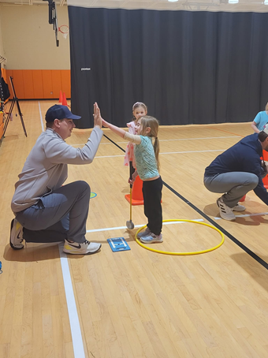
Budget Summary
 | 2024-2025 | 2025-2026 | Difference
Budget | $14,707,074 | $15,967,594 | $1,260,520
State Aid & Non Tax Revenue | $4,138,675 | $4,206,515 | $67,840
Fund Balance to Balance the Budget | $404,915 | $350,000 | -$54,915
ERS Reserve | $157,000 | $37,625 | -$119,375
Debt Service Fund | $160,000 | $50,000 | -$110,000
Levy Amount | $9,846,484 | $11,323,454 | $1,476,970

Slide 11


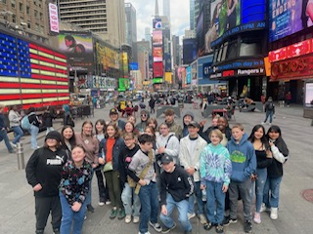
Proposition #1 Budget
Vote on district spending plan.
$15,967,594

Slide 12
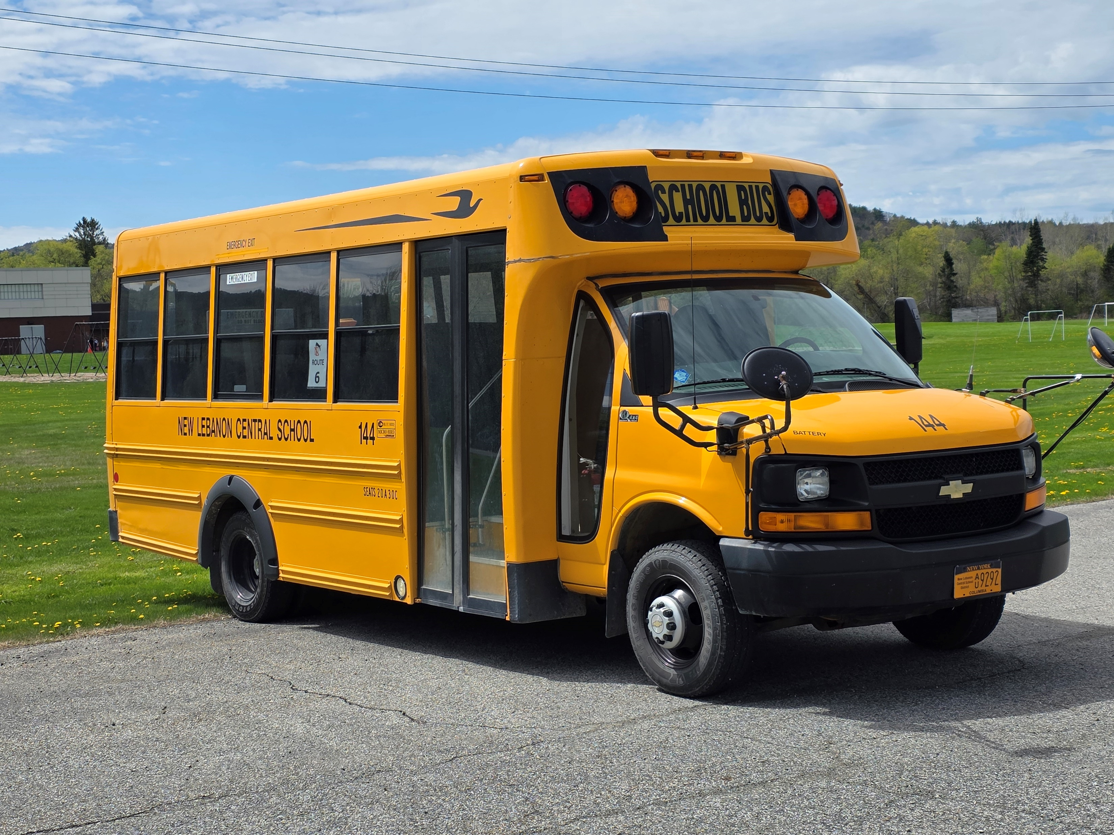
Proposition #2: Bus Purchase
District to purchase 2 30 passenger Buses and 2 Mini vans at a cost not to exceed $297,000.

Slide 13

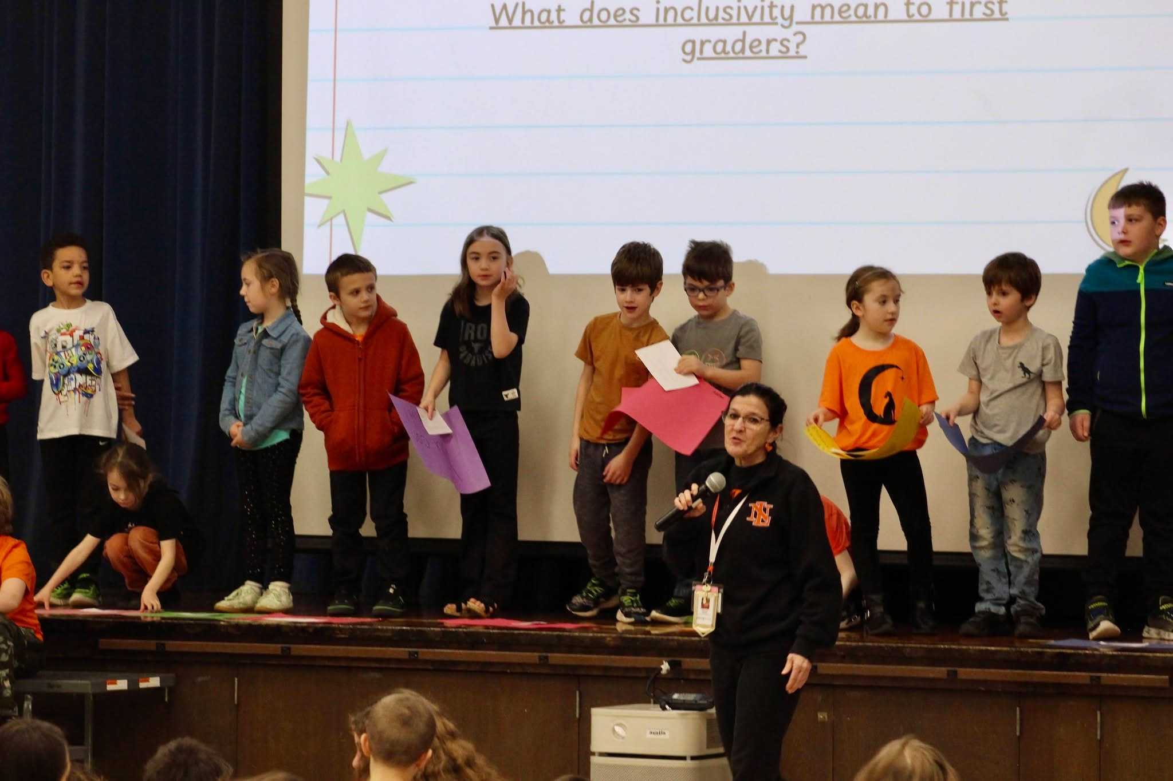
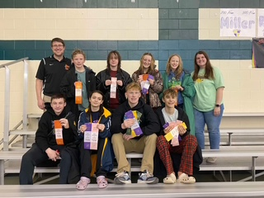
Next Steps:
Budget Vote, May 20, 2025

Slide 14

Questions

