Slide 1

New Lebanon Central School District
2025-2026 school Budget
Budget Hearing REVOTE
June 4,2025

Slide 2
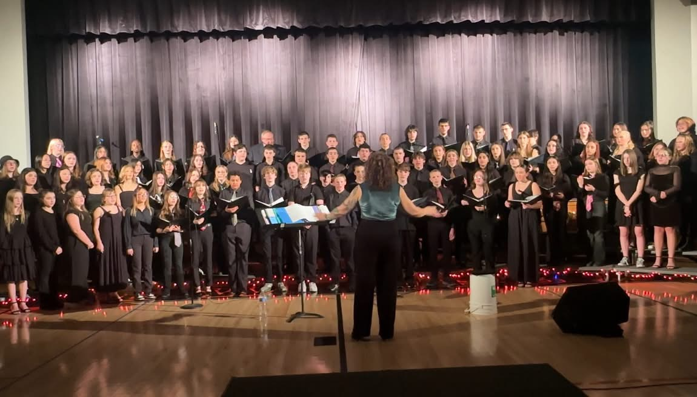

Budget Goals- 2025-2026
1. New Lebanon CSD will maintain a balanced budget while supporting academic excellence and expanding resources for students and staff.
2. Increase fiscal awareness among all stakeholders through communication and professional development.
3. Stay within the tax cap and meet state mandated requirements.

Slide 3

2025-2026 Revote Timeline
June 2, 2025 Deadline to get legal notices to Newspaper for June 3 publication.
June 3, 2025 Deadline for publication of first of two required notices and deadline to submit budget notice to printer.
June 4, 2025 Budget hearing
June 10,2025 Publication of second and final legal notice prior to budget re-vote.
June 10, 2025 Copies of public notice/budget information packet made available.
June 11, 2025 Deadline for mailing the budget newsletter.
June 17,2025 – Budget Revote Day

Slide 4
Reductions made for the 25-26 revote
2 Elementary regular education teachers
1 PE teacher
1 Business Teacher
1 Special Education Teacher
1 Reading Teacher
-$539,795

Slide 5
2025-2026 Proposed Budget Breakdown
 | 2024-2025 | 2025-2026 | Change
Special Education | $1,384,321 | $1,829,261 | $444,940
Employee Benefits | $4,329,882 | $4,559,201 | $229,319
Instruction | $4,901,426 | $4,765,752 | -$135,674
Transportation | $761,629 | $841,574 | $79,945
Operations and Maintenance | $926,943 | $990,077 | $63,134
General Support | $884,877 | $943,069 | $58,192
Co-Curricular and Athletics | $155,400 | $155,400 | $0
Debt Service | $1,127,015 | $1,125,486 | -$1,529
Information Technology | $195,581 | $187,979 | -$7,602
Interfund Transfers | $40,000 | $30,000 | -$10,000
Total Expenditures | $14,707,074 | $15,427,799 | $720,725

Slide 6


Significant cost increases:
Employee/Retiree Benefits +$229,316
Budgeting for a shared Resource officer +$50,000
Mandated special education services +$444,940

Slide 7
2025-2026 Tax Cap Calculation:
Prior Year Tax Levy | $9,846,483
x Tax Base Growth Factor | 1.0072
PILOT | 0
- PY Tax Cap exclusion | $267,133
x CPI | 1.02
Total adjusted tax levy | $9,843,250
+ Capital exclusion - Aid | $504,434
= 25-26 Allowable Tax levy | $10,347,684
5.09% allowable increase
+$504,434
Capital Exclusion includes use of Reserves and Debt service

Slide 8
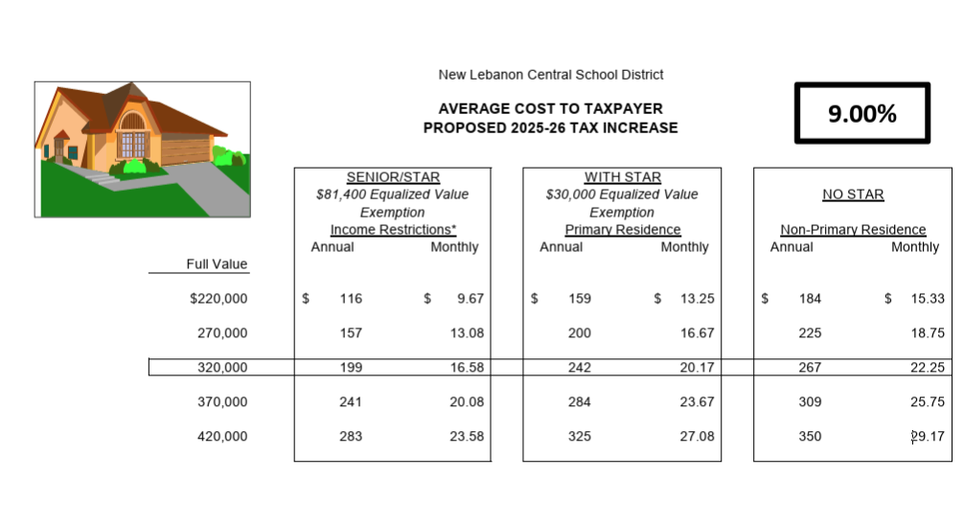
Estimated Impact of Tax Levy Increase

Slide 9

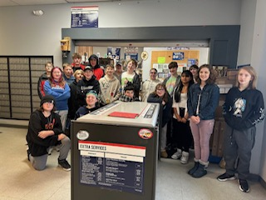
Revenue Summary
 | 2024-2025 | 2025-2026 | Change
Non Tax Revenue | $258,000 | $309,000 | $51,000
State Aid | $3,880,675 | $3,897,515 | $16,840
Tax Levy | $9,846,484 | $10,732,666 | $886,182
Fund Balance | $404,915 | $400,933 | -$3,982
ERS Reserve | $157,000 | $37,625 | -$119,375
Debt Service Fund | $160,000 | $50,000 | -$110,000
Total Budget | $14,707,074 | $15,427,799 | $720,725

Slide 10
What happens if the budget does not pass?
The BOE is required to adopt a contingent budget before July 1st.
When a district goes to a contingent budget:
The BOE is required to adopt a budget with a 0% Tax levy increase.
The district would need to make an additional $886,244 of reductions.
All Non-Contingent expenses deemed by the board would be removed from the budget. (equipment purchases, supplies, extracurricular, sports, field trips etc.)

Slide 11
Contingent Budget Example:
District would use:
Fund Balance $400,993
Reserves $37,625
Debt Service $50,000
Example of reductions could include:
1 School Psychologist
2 Art Teachers
1 Music Teacher
1 Librarian
Assistant Principal/Athletic Director
Sports
Extra Curricular/ Field Trips
Equipment/Supplies
1 Cleaner
Reductions of $886,244

Slide 12



Proposition #1 Budget
Vote on district spending plan
$15,427,799

Slide 13

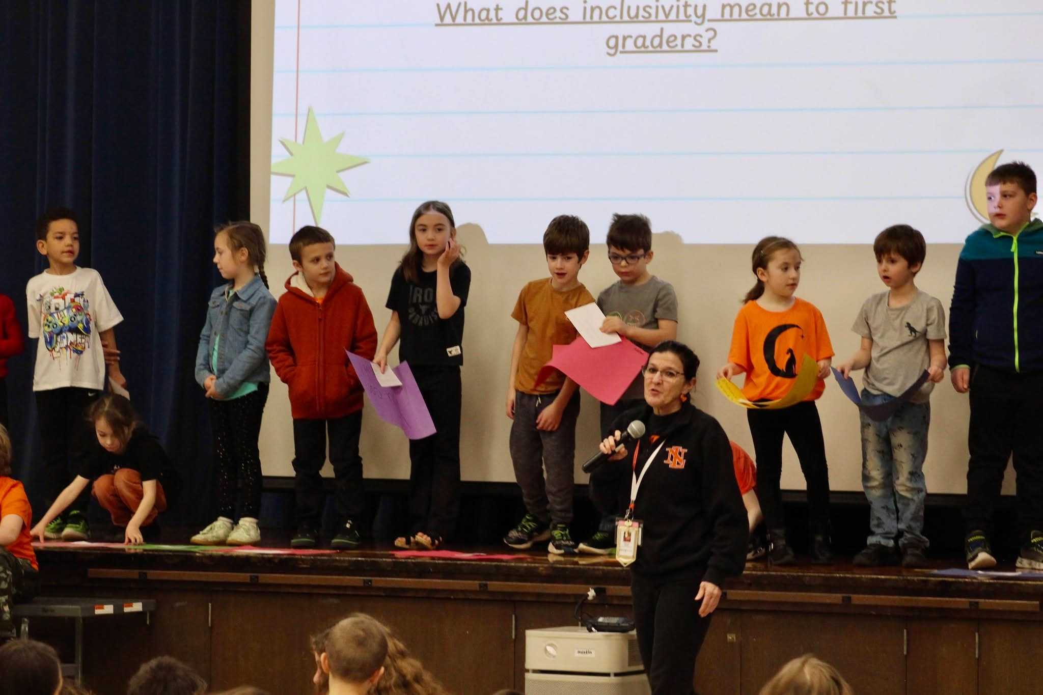

Next Steps:
Budget Vote, June 17,2025

